Slide 1



Physics Today…
And What’s Still The Matter?
Presented by:
Dr. Glen Collins
Tuesday, June 20, 2023
All Slides, Animations, Notes and Content are Copyright of Common Sense Science June 2023. Content May Be Copied If Used For Educational Purposes Only, Provided This Copyright Notice Is Included in All Copies.
Notes:
Presentation based on original briefing slides created by Dr. William (Bill) Lucas, modified and extended by Dr. Glen Collins, June 2023.
“What’s the Matter?” is a play on words since, in CSS’ physics work, matter is a derived property (measured by the amount of force required to move an object) and is not intrinsically ‘stuff’ of which the material world is made. It also implies that there IS something the matter (amiss) in the world of mainstream permitted-to-be-published physics these days. This is your invitation to review the material presented in these slides and consider the ideas and claims on their own merits.

Slide 2


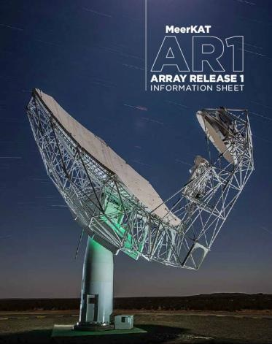
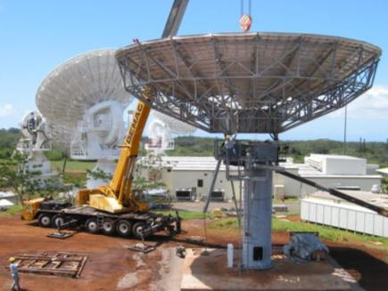

  Dr. Glen C. Collins, Director, CSS
  B.E.E., M.S.E.E., Georgia Institute of Technology
  Ph.D. Artificial Intelligence, Vanderbilt University
  Certificate in Acoustical Engineering
  Registered Professional Engineer (PE) (ret.)
  Chartered Engineer (C.Eng) (ret.)
  Assistant Editor of Foundations of Science
        MeerKAT Radio Telescope Program Manger (ret.)
          Square Kilometer Array, South Africa
        Satellite Communications Earth Stations Program Manager
          for General Dynamics (ret.)
Afghanistan
2002
Notes:
Background of Dr. Glen Collins, presenter and a Director of Common Sense Science.

Slide 3
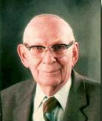
Founded Upon the Work of
Dr. Thomas G. Barnes
(d. 2001) Professor Emeritus of Physics, The University of Texas at El Paso, El Paso, Texas (1938 - 1981)
Dr. Barnes has authored books titled
  Space Medium,
  Science and Biblical Faith,
  Physics of the Future,
  Foundations of Electricity and Magnetism, and
  Origin and Destiny of the Earth's Magnetic Field.
Notes:
Dr. Barnes is best known through his many publications, particularly books
Science and Biblical Faith: A Science Documentary, Creation Research Society Books, 191pp. (1993) (ISBN 978-0963755001)
Space Medium: The Key to Unified Physics, Geo/Space Research Foundation, 170pp. (1986) (ISBN 978-0936961019)
Physics of the Future: A Classical Unification of Physics, Master Books, 208pp., (1983) (ISBN 978-0932766090)
Origin and Destiny of the Earth's Magnetic Field, Institute for Creation Research, (1973) (ISBN 978-0890510131)
Foundations of Electricity and Magnetism, Heath, 331pp., (1965) (ASIN B0006BMTRU).
These books were very influential on the presenter’s life and thinking, and Dr. Barnes introduced me (Glen) to David Bergman in ~1997 which led to my involvement in CSS.

Slide 4
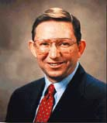
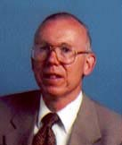
CSS Scientists
Mr. David L. Bergman, (d. 2020)
B.S. Physics from Univ. of California, Berkeley M.S. Electrical Engineering, Univ. of California, Santa Barbara.
Engineer and Researcher for US Military Programs. Founder and President of CSS until 2020.
Dr. Charles W. (Bill) Lucas
Ph.D. Theoretical Physics from The College of William and Mary, Williamsburg, Virginia
Performed research on elementary particles and served as a professor of physics at Catholic and American Universities in Washington, DC
Notes:
David Bergman was both a personal friend and scientific/engineering mentor for me (Glen). His passing in 2020 has been a great loss to CSS, and to the collection of rational thinking people left in this world.
Dr. Bill Lucas is retired, living in Maryland. Caring for other family members and personal injuries from a vehicle accident have limited Dr. Lucas’ time and ability to continue writing for CSS. It is our hope that he can fully recover and continue contributing to the CSS body of work and publications soon.

Slide 5
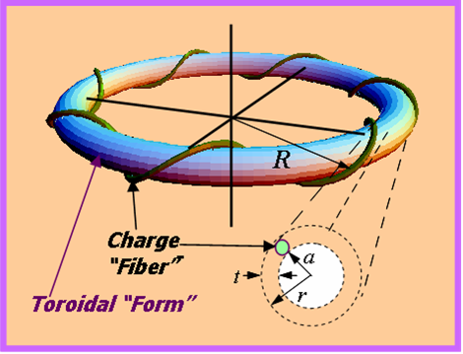

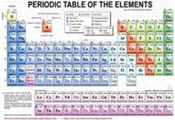
Why Do This Work?
Common Sense Science’s goal has been to correct perceived deficiencies in modern physics by reapplying sound scientific methods to develop better fundamental theories of the physical world.
CSS is a body of theory regarding matter and forces that describes the physical world building upon classical laws, geometric models, absolute time and Galilean space.
The foundational principles of CSS theory are based upon the law of cause and effect, and the assertion that the universe and all natural phenomena are fundamentally electrical in character.
Applying these principles has led to:
  Derivation of a universal force law that applies on all scales ranging from the sub-atomic to the cosmic domain, and
  Development of physical models for elementary particles, nuclei, atoms and molecules
Notes:
These notes are largely from the www.commonsensescience.net webpages.

Slide 6
Physics Today…
And What’s Still The Matter?
From CSS’ Point of View, Physics, and the Real World It Purports to Represent, Can Be Described Using Fully Physical Models (vs. Abstractions)
This Presentation will Describe the Forces, Structures and Characteristics at the Electron and Proton Level using the Models developed by Common Sense Scientists Lucas and Bergman.
As It Is at the Atomic/Molecular Level (solids, liquids, gases), the Subatomic Realm is also Physical and Structured much more so than has been discussed for the last 100 years.
Notes:
This briefing, using the “What’s the Matter?” styling, will present physical models of matter, particles, and the sub-atomic realm based upon CSS’s extension of classical mechanics and electrodynamics.

Slide 7
Presentation Outline
What Matters?
Derivation of the Universal Force Law
Derivation of Gravitational Force
Electromagnetic Model of Matter
Derived Features: Mass, Neutron…
New Atomic Model
Subatomic Particle Model
Conclusions
Notes:
Due to limited time for the presentation portion, the section on Subatomic Particle Model has been moved to the appendix and will not be presented formally.

Slide 8
Presentation Outline
What Matters?
Derivation of the Universal Force Law
Derivation of Gravitational Force
Electromagnetic Model of Matter
Derived Features: Mass, Neutron…
New Atomic Model
Subatomic Particle Model
Conclusions
Notes:
Agenda for this presentation.

Slide 9
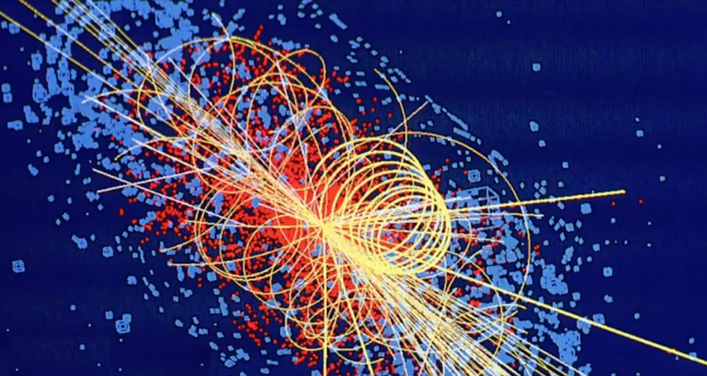
What Matters?
Size Matters
Shape Matters
“Normal” Time Matters
“Normal” Space Matters
What the Forces Are Matters
Understanding What an Electron IS, Matters
CERN Photo Credit
Notes:
Things that matter in the science of physics, from CSS’ perspective. Each will be discussed in turn.

Slide 10
Size Matters: When Distance Center-to-Center Between “Point Particles” Is “Large”
Introduce the Concepts of the ‘Near Field’ and the ‘Far Field’
q₁ x q₂
Coulomb’s Law: Traditional approach yields a Force value that is reasonably correct
F = k
d²_{centers}
Coulomb’s Law
d_{centers}
q₁
From Antenna Theory: This is Considered the “Far Field” Relative to the Size of the Charged Objects.
q₂
d_{q1} ≈ 0
d_{q2} ≈ 0
d_{min.}
In an Object’s Far Field, Its Radiation Varies with 1/R², i.e., It Appears Like a Spherical Source.
d_{min.}
≈
d_{centers}
Notes:
These concepts are taken directly from antenna theory where one must consider the difference between the ‘near field’ and ‘far field’ of a radiating object (antenna). Functionally, every charged (and neutrally charged) particle functions as an antenna both radiating and absorbing energy.
This slide illustrates how Coulomb’s Law of the Force of electrical attraction (or repulsion) gives reasonably correct answers when the distance between two charged particles is large when compared to the size of the charged objects themselves. When in the far field of an object giving off energy, you can “treat” the object as a spherical source (or, mathematically, a point source), meaning you can ignore the details of the object’s size and shape, if any.

Slide 11
Size Matters: When Distance Center-to-Center Between “Point Particles” Is “Small”
q₁ x q₂
Traditional approach yields a Force value that is Too Small
F = k
d²_{centers}
d_{centers}
(is not a ‘point’ but is often assumed to be so)
(is not a ‘point’ but is often assumed to be so)
q₁
q₂
d_{q1} >0
d_{q2} >0
d_{min.}
The Conclusion, Over 100 Years Ago, Was That Coulomb’s Law (Among Other Classical Understandings) Was WRONG!
From Antenna Theory: This is Considered the “Near Field” Relative to the Size of the Charged Objects.
d_{min.}
<
d_{centers}
Notes:
This slide illustrates how Coulomb’s Law of the Force of electrical attraction (or repulsion) gives seemingly incorrect answers when the distance between two charged particles is small when compared to the size of the charged objects themselves. In antenna theory this is called being in the “near field” relative to the two objects. In antenna theory, when in the near field, one MUST take into consideration the shape (geometry) of the antenna to determine what the distribution of field energy actually is.

Slide 12
So…
What If The Particles of Charge Actually, Really, Really Have Some Finite Size and Shape!?
What Then?
_{(a ‘point’)} q₁
or
q₁
Does Size or Shape Matter?
Notes:
So, we’ll see that, just as in antenna theory, the size and shape of an object giving off (or absorbing/receiving/being-affected by) energy MATTERS particularly when you’re up close to the object. The reason antenna theory is applicable is because every charged particle IS an antenna both radiating and receiving energy continuously.

Slide 13
Size Matters: When Distance Center-to-Center Is Greater Than ~10x Size of Object
q₁ x q₂
Traditional approach yields a Force value that is reasonably correct
F = k
d²_{centers}
d_{centers}
q₁
q₂
Far Field Circumstance
d_{q1}>0
d_{q2}>0
d_{min.}
d_{min.}
~
d_{centers}
~
Notes:
Here we have two ring shaped charged objects, which are small compared to the distance between them. This can be treated as a far field situation, so treating the objects as point particles will yield a reasonably correct force solution.

Slide 14
Size Matters: When Distance Center-to-Center Is Less Than ~10x Size of Object
q₁ x q₂
Traditional approach yields a Force value that is too small (due to the ‘point’ assumption)
F = k
d²_{centers}
d_{centers}
q₁
Near Field Circumstance
q₂
d_{q1}>0
d_{q2}>0
d_{min.}
Correct Force Solution Requires Integration of Shape (Geometry) Using Coulombs Law, and Then Gives The Correct Force
d_{min.}
<< d_{centers}
Notes:
Here the ring shaped objects are close together, relative to their individual sizes. A classic near field situation where one must consider the size and shape (charge distribution) of each object. To treat them as point particles will give the wrong answer because one would be using Coulomb’s Law incorrectly. This situation requires integration over the charge distributions’ shapes to obtain the correct force. Nothing wrong with Coulomb’s Law; it will give the correct answer when used correctly.

Slide 15
Shape Matters: When Distance Center-to-Center Is Less Than ~10x Size of Object and The Objects’ Orientations Vary
q₁ x q₂
Traditional approach may yield a Force value that is reasonably correct (due to the shape and orientation of the real particles)
F = k
d²_{centers}
d_{centers}
A Precise Force Solution Still Requires Integration of Shape (Geometry) Using Coulombs Law
q₁
q₂
Far Field Circumstance?
d_{min.}
d_{q1}<< d_{centers}
d_{q2}<< d_{centers}
d_{min.}
~
d_{centers}
~
Notes:
Changing the orientation of the objects contributes to whether the distance between them constitutes a near field or far field situation. This circumstance can be treated as far field if precision is not required.

Slide 16
Common Sense Science
Basic Postulates
Size Matters Finite Sized Particles
Shape Matters Helicon Ring Geometry
Time Matters t = t’
Space Matters Galilean Transformation
r’ = r – vt – ½ at² – …
What the Forces Are Matters F = ??
What an Electron Really IS Matters…
Prime Indicates the Frame in Motion
Notes:
Things that matter, if one is to understand physics properly.

Slide 17
Presentation Outline
What Matters?
Derivation of the Universal Force Law
Derivation of Gravitational Force
Electromagnetic Model of Matter
Derived Features: Mass, Neutron…
New Atomic Model
Subatomic Particle Model
Conclusions
Notes:
The next section will present how Dr. Lucas derived the Universal Force equations, basically be repeating Maxwell’s work of combining all known physical laws simultaneously but without using assumptions (simplifications) that are now known to be in error.

Slide 18
Lucas’ New Derivation of Universal Force Law (1 of 4)
An Electrodynamics Force Law Based Upon Elastic/Deformable Finite-Size Charged Particles
Derived From The Fundamental Empirical Laws of Classical Electrodynamics Assuming Galilean Invariance
Assumes Local Contact Forces (due to the Nature of Particles), i.e., Does Not Use Action-at-a-Distance Forces
Satisfies Mach’s Principle
A very general statement of Mach's principle is "Local physical laws are determined by the large-scale structure of the universe."
i.e., Not “Point” Particles,
Not ‘Mathematical Abstractions’
Galilean Invariance = ‘Normal’ 3-D Space
(not warped or curved space or space-time)
For Example: QM “Entanglement” Is Action-at-a-Distance with No Specified Connection Mechanism
Notes:
Slide is largely self-explanatory. Mach’s Principle, much ignored these days (said to not be essential), basically says one must consider the complete environmental effects upon a particle’s motion and behavior, which, of course, makes sense but may be difficult to do. One’s understanding of the universe itself affects this. For example, relativity theory treats the universe as uniform (i.e., matter and energy are uniformly distributed) even though this is, with the naked eye, observably incorrect.

Slide 19
Lucas’ New Derivation of Universal Force Law (2 of 4)
Uses The Galilean Transformation Based Upon Three-Dimensional Linear Space
  r’ = r – vt – ½ at² – …
  Instead of the Lorentz Transformation of Relativity Theory (which is limited to velocity terms)
Conserves Energy and Momentum 100% of the Time
  Differs from Quantum Electrodynamics Which Posits The Uncertainty Principle Allows Conservation Laws to Be Violated for Brief Periods of Time
Notes:
It’s difficult to emphasize how important using Galilean relativity is. The whole conception of space-time, while intellectually stimulating and mathematically elegant, is simply in error. In the real physical world, time is the same everywhere in all reference frames, and space may be treated as relative (among objects) and purely 3-D. So-called relativistic effects, as will be seen, come directly from the properly derived electrodynamics force laws (called by Lucas as the Universal Force Law/Equation). NOTICE that this gives Lucas’ mathematics a distinct advantage over Relativistic/Lorentz mathematics in that resulting equations can take into consideration any order of derivatives of motion (i.e., can include 2nd derivative of location which is called ‘acceleration,’ or also the third derivative sometimes called ‘jerk,’ and so forth). Extant SRT/GRT mathematics are properly limited to velocity terms ONLY, and therefore struggle with acceleration in all it’s forms, including rotation such as in cyclotrons.
Also, the impact of ignoring Conservation of Energy (in all it’s forms: kinetic (momentum), magnetic, electric) cannot be underestimated, and has given rise to a multiplicity of errors particularly in QT where the necessity of ‘particles’ coming into and out of existence results from failing to conserve one form of energy or another.

Slide 20
Lucas’ New Derivation of Universal Force Law (3 of 4)
Accounts for Acceleration, Angular Acceleration and Radiation Reaction which have Eluded Quantum Electrodynamics and General Relativistic Approaches
Explains the Physical Origin of So-Called "Relativistic Effects“
  Does Not Require Any Reference to Special Relativity Theory (SRT) or Use of Retarded Fields
  In CSS’ Theory, ‘Relativistic Effects’ are Due to the Physical Rearrangement of the Charge (and Fields) Density Within Finite-sized Moving Particles Resulting from the Feedback of Induction Forces
Notes:
First bullet is a direct result of using Galilean relativity, normal time, and 3-D space.
Second bullet is direct result from Lucas’ correctly-derived Universal Force equation, specifically by incorporating Lenz’s Law which is a Conservation of Energy law.

Slide 21
Lucas’ New Derivation of Universal Force Law (4 of 4)
Reveals a New Relativistic Acceleration Term That Has Been Unknown to Covariant Maxwell Electrodynamics and Special Relativity Theory
This Term Explains Many Fundamental Electrodynamics Experiments That Have Not Been Previously Explainable in Terms of Traditional Relativistic Co-variant Maxwell Electrodynamics, Including:
    1. The force on Ampere’s bridge
    2. The tension required to rupture current carrying wires
    3. The force to drive the Graneau-Hering submarine
    4. The force to drive the mercury in Hering’s pump
    5. The force to drive the oscillations in a current carrying wedge
    6. Localized unipolar induction
    7. The zero self-torque on the Z-shaped Pappas-Vaughan antenna
Notes:
As will be seen, the correctly-derived force equation, has a second term which mathematically and physically shows where relativistic effects come from. Having the correct force law applied to the experimental results listed here, gives the correct answers to why the phenomena occur as they do.

Slide 22
Maxwell’s Equation for Inductance
(Example of What Not to Do)
1
δB
Δ
X
E =
c
δt
This Equation is a Reformulation of Faraday’s Law of Inductance for Forces When Motion Is a Factor
Maxwell’s Equation for Inductance
Two Errors In Logic:
  Inductance Effects Lost By Neglect of Relative Velocity (And Changes In Velocity)
  Finite Size Effects Lost In Point Particle Assumption
Result: This Form of Maxwell’s Equation Will Be Inaccurate For Predicting High Speed Phenomena.
  These errors caused Maxwell’s equation to fail where high velocity effects are the most important and motivated the invention of the Special Theory of Relativity to calculate and predict “relativistic” effects.
Notes:
Faraday’s Law of Magnetic Induction is the fundamental force law dealing most directly with the relative velocities between objects. Therefore, it is self-evident that an accurate form of the law is necessary where precision is sought for objects with high velocity.
In 1996, Bill Lucas pointed out two fundamental errors made when Faraday’s Law was cast into differential form.
1. The electromotive force induced in a circuit depends upon any change of flux within the loop from two causes: (a) time variation of the flux, and (b) distance variation of the magnetic flux strength. The latter effect has been eliminated from Maxwell’s differential equation for induction.
2. In order to find the total flux by integrating over the surface obtained by Stoke’s transformation, a point particle approximation was made. Wherever the object is not a point or spherically symmetrical, inductance effects are lost.
This causes Maxwell’s equation to fail where high velocity effects are the most important and necessitated the invention of the Special Theory of Relativity to predict “relativistic” effects.

Slide 23
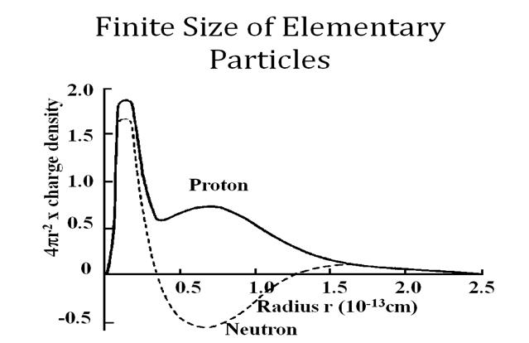
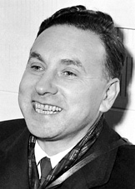
Electron Scattering Experiments Show Particles Have Significant Size
Robert Hofstadter
1961 Nobel Prize
Notes:
As evidence in support of abandoning the point particle assumption, the first piece of information that should be taken into account comes from electron scattering experiments. Robert Hofstadter performed these experiments in 1956 and discovered that the proton and neutron are approximately the same size and both consist of three principal substructures. They are definitely not point particles and can only be treated as such in the far field of each particle.

Slide 24
Let’s Start Over Then…
Re-derive ‘Maxwell’s Equations’ with the Following Revisions:
  Use ALL Known Physical Laws including Lenz’s Law and Mach’s Principle
  Assume Finite Size of the Particle Must Be Taken Into Account
  Assume Changes in the Particle Size/Shape Might Occur
  Assume Changes in the Particle’s Fields Might Occur
  Assume Gaussian (Cartesian ‘Normal’) Space and Invariant Time Are What’s Real
Notes:
So, with this background (previous slides), let’s re-derive Maxwell’s Equations (so to speak), but not make the mistakes made previously by assuming things that are now know to be untrue, nor simplify things such that important/relevant characteristics are wrongly omitted.

Slide 25
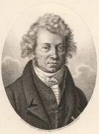

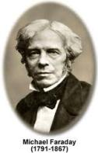

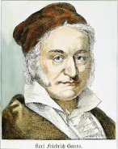
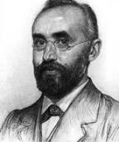

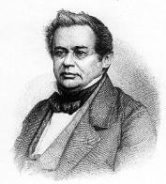
6 Empirical Laws of Electrodynamics
Generalized Ampere’s Law
Faraday’s Law
Gauss’s Electrostatic Law
Gauss’s Magnetostatic Law
Lorentz’s Force Law
Lenz’s Induction Law
Notes:
Here are the six empirical laws of electrodynamics. This is the minimum set of empirical laws for electrodynamics that Newton specified that should be the axioms of electrodynamics. In addition to this mathematical set of empirical laws, there is some additional empirical information regarding the terms which must be also taken into account (next slides).

Slide 26
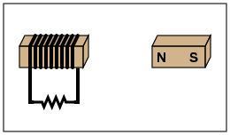
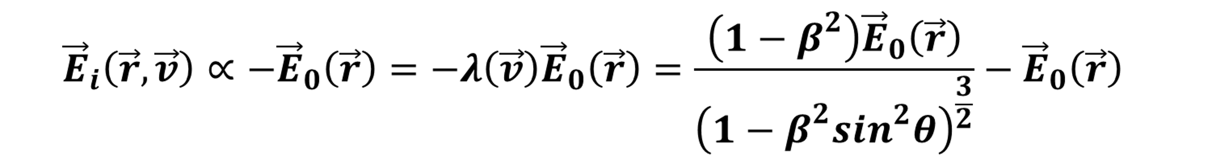
Solution for Lenz’s Law (1 of 2)
An Induced current opposes the change that produced it
(i.e., it’s a Feedback Effect)
An Induced Electric Field Will Be Proportional To and Opposed To (hence the minus sign) the Originating Field That Produced It
→
v
Where:
β
=
−
c
Notes:
This is the solution for Lenz’s Law. Note the Special Relativistic type terms involving β = v/c. The physical origin of relativistic effects is the non-linear electrical feedback on finite size charged particles. The feedback effect changes the size and shape of charged particles. Lenz Law addresses the concept of conservation of magnetic field momentum. Ignoring this conservation in the field itself gave rise to ‘retarded fields’ in Einstein’s work.
In the equations above and induced electric field, E_{i}, resulting from motion due to an originating static electric field, E_{o}, will be proportional to and oppose the originating field (hence the minus sign).

Slide 27
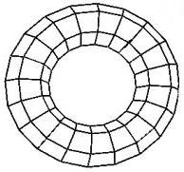
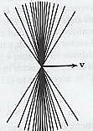
Solution for Lenz’s Law (2 of 2)
Lenz’s Law is the magnetic corollary to Newton’s 3rd Law: For every action there is an equal and opposite reaction.
In effect: whenever a change in a magnetic field occurs, an electric field is generated to oppose the change.
Lenz’s Law reveals the physical origin of relativistic effects to be the non-linear electrical feedback on finite size charged particles.
v
Notes:
The physical origin of relativistic effects is the non-linear electrical feedback on finite size charged particles. The feedback effect changes the size and shape of charged particles.

Slide 28
Additional Empirical Findings
Induced E_{i}(R,V,t) and Static E_{o}(R,t) Fields Are Fundamentally Different (i.e., Cannot Use Superposition; Must Track Them Separately)
Fields of Charges Remain Attached, Have Tensile Strength, and Move WITH the Charge
There Exist Non-Linear Field Effects in Lasers and Other Electrodynamic Devices
Energy Is Conserved in Electrodynamics
Momentum Is Conserved in Electrodynamics
Newton’s 3rd Law Is Valid in Electrodynamics
Mach’s Principle Is Valid
Notes:
Listed here are some additional empirical findings. The induced electric fields and static electric fields are fundamentally different. Static fields have no dependence on velocity while induced fields do. The fields of a charge remain attached when charges move and have tensile strength. There exist non-linear field effects in lasers and other electrodynamic devices. Energy is conserved in all electrodynamic phenomena. Momentum is conserved in electrodynamics. Newton’s 3rd law is valid in all electrodynamic phenomena. Mach’s Principle that local physical laws are determined by the large scale structure of the universe is valid.

Slide 29
Solve a Set of 8 Simultaneous Equations
Derivation by Substitution
8 Unknowns F E₀ E_{i} B₀ B_{i} λ(r,v) r’ t’
Based on 6 Empirical Laws of Electrodynamics
Ampere’s Law B_{i}(r,t) = v/c x E_{o}(r’,t’)
Faraday’s Law ∫E(r’,t’).dl’ = -1/c d/dt ∫B(r,t) . n da
Gauss’s Laws ∫E·n da = 4πq and ·B = 0
Lorentz’s Law F = qE(r,t) - v/c x B_{i}(r,t)
Lenz’s Law E_{i}(r,t) ∝ E_{o}(r,t) (i.e., = -v²/c² E_{o}(r,t)
where E(r,t) = E_{o}(r,t)+ E_{i}(r,t)
Based on 2 Equations from Galilean Relativity
t’ = t and r’ = r - vt - ½ at² - …
Note That This Equation May Be Extended to Include Other Higher Order Motion Terms
Notes:
The universal electrodynamic force is based on the experimental measurements of the size and shape of elementary particles. It is based on the empirical laws of electrodynamics, i.e. Ampere’s law, Faraday’s law, Gauss’s laws, Lenz’s law, and the Lorentz force law. Also, the universal electrodynamic force is based on an absolute reference frame as represented by the Galilean transformation. Note that Ampere’s law and Faraday’s law involve two reference frames (i.e., these Laws include the effects of motion).
+conservation of energy, ang momentum, spin, Mach’s principle
Lenz’s Law is often considered equivalent to conservation of energy therefore is often not considered fundamental. But plays a fundamental role when you avoid the point particle assumption. Ei induced field, Eo is static field.
Lorentz Force Law is actually derivable from our other equations, but we use it here as a fundamental assumption associated with Galilean transformation.
Important thing is unlike Relativity which only involves r and v, our approach involves an infinite series of motional terms. Accelerations do not depend on relative coordinates of r and v, but need a more absolute frame of consideration. Therefore, relativity theories, only, fail to handle higher derivatives. GRT handles acceleration but cannot handle dA/dt (radiation reaction: the recoil of the atom after radiation is not explainable by SRT or GRT).
The universal electrodynamic force is derived by solving the empirical equations above simultaneously. They are solved ‘simultaneously’ because they are all simultaneously true at all times. Lenz’s law causes the equations to be iterative. Thus the solution consists of an infinite series of terms. In order to obtain the solution in useable form one must group the terms such that they can be summed using the binomial theorem.
The overall derivation of the improved electrodynamic force law is very simple. There are 8 unknowns and 8 simultaneous equations. They are simply solved by substituting one into another.

Slide 30
Derived Universal
Electrodynamic Force
(with Velocity Terms)
Galilean Transformation Used
Notice How Both Terms Depend on the Same Variables.
This Means They Will Scale Up/Down Together, Resulting in a ‘Quantized’ Interrelationship.
Scalar Potential
R
'
=
R
−
V
t
t
'
=
t
i.e., Magnitude Only
⎧
⎛
→
2
⎞
⎛
→
⎞
→
→
⎫
⎪
⎜
V
⎟
⎜
V
2
⎟
⎛
V
⎞
⎛
V
⎞
⎪
ˆ
ˆ
ˆ
ˆ
⎪
⎜
1
−
⎟
R
⎜
1
−
⎟
⎜
R
⋅
⎟
R
×
⎜
R
×
⎟
⎪
⎪
⎜
2
⎟
⎜
c
2
⎟
⎝
c
⎠
⎝
c
⎠
⎪
→
qq
'
⎪
⎜
c
⎟
⎜
⎟
⎪
Force
F
=
⎪
⎝
⎠
+
⎝
⎠
⎪
2
⎨
3
⎬
R
⎪
2
⎡
2
⎤
⎪
⎪
2
V
2
⎢
2
V
2
⎥
⎪
Assuming Constant Velocity
⎪
R
−
sin
θ
⎢
R
−
sin
θ
⎥
⎪
⎪
c
2
⎢
c
2
⎥
⎪
⎪
⎢
⎥
⎪
⎩
⎣
⎦
⎭
Radial Force Term
Corkscrew Force Term
Notes:
Here are the Scalar Potential and Electrodynamic Force resulting from motion of velocity. Even in the case of constant velocity a more elaborate force law is obtained than previously known, which is derivable from a velocity dependent potential. Here the V² terms are responsible for induced forces, and the V⁴ terms, as we will see, are responsible for the force of gravity. Notice there are two terms, the first resembling existing force equations derived using different assumptions.
In the force law the term involving R x (R x dV/dt) is responsible for a corkscrew type of motion. It will also contribute to the force of gravity and give rise to a new gravitational term never known before.

Slide 31
Derived Universal
Electrodynamic Force
(with Acceleration Terms)
Galilean Transformation Used
R
'
=
R
−
V
t
−
1
A
t
2
Shown Including Acceleration Term
2
t
'
=
t
Velocity Component
Acceleration Component
Force Equation
⎧
⎛
2
⎞
2
⎛
2
⎞
⎡
⎛
⎤
⎫
⎪
⎜
V
⎟
2
R
A
⎜
V
⎟
⎛
V
⎞
⎛
V
⎞
2
⎞
⎛
1
⎞
⎪
−
+
−
⎜
⋅
⎟
⎜
⎟
+
⎜
⎜
⎟
⎪
⎜
1
⎟
R
⎜
1
⎟
⎢
R
R
×
R
×
R
⎟
R
R
×
A
⎥
⎪
c
c
×
×
⎜
c
⎟
⎪
⎜
2
⎟
2
⎜
2
⎟
⎝
⎠
⎝
⎠
⎝
⎠
⎜
2
⎟
⎪
qq
'
⎪
⎜
c
⎟
c
⎜
c
⎟
⎣
⎝
⎠
⎦
⎪
F
=
⎪
⎝
⎠
+
⎝
⎠
⎪
2
⎨
3
⎬
R
⎪
2
⎡
2
⎤
⎪
⎪
2
V
2
⎢
2
V
2
⎥
⎪
⎪
R
−
sin
θ
⎢
R
−
sin
θ
⎥
⎪
⎪
c
2
⎢
c
2
⎥
⎪
⎪
⎢
⎥
⎪
⎩
⎣
⎦
⎭
Radial Force Term
Corkscrew Force Term
Notes:
In the scalar potential and force law the V² terms are responsible for induced forces, the V⁴ terms are responsible for the force of gravity, and the V⁶ terms are responsible for the force of inertia.
In the force law the term involving R x (R x dV/dt) is responsible for the relativistic emission and absorption of radiation. A force law describing all of these phenomenon has never been derived before.
The term involving R x (R x V) is capable of explaining some very interesting gyroscope experiments by the famous British engineer Eric Laithwaite. These results had always appeared to be very mysterious defying common sense.
One can extend the derivation to da/dt and higher order time derivatives to obtain terms for radiation reaction, etc. Note that there is no agreement in the scientific community on the expression for the fully relativistic radiation reaction term. Since special relativity only takes into account reference frames moving with constant velocity with respect to one another, it is difficult to represent effects dependent on acceleration a, da/dt, etc.

Slide 32
The Impact of Proper
Force Equations
CSS Posits That These Newly-Derived Equations for the Electrodynamic Force Between Charged Particles Define THE ONLY FORCE THERE IS in the Entire Universe, at All Size Scales (i.e., No Gauge Theories)
Notice the Previously Missing/Unknown 2nd Term Which Applies Force on Particles in a Newly-Found Direction
So-Called Relativistic Effects Are a Direct Result of the Proper Mathematical Derivation of the Force (i.e., No Need for a Time-Dilation or Warped-Space Theory to Explain Such Effects)
Notice the Equation Must Be Derived For All Motion Terms (i.e., velocity, acceleration, jerk, etc.) That Apply to the Situation Being Analyzed
Notes:
Lucas’ newly-derived Universal Force equation described the ONLY force that exists. There are no other forces. As we will see, gravity, and the nuclear strong and weak forces, are all THIS force properly applied to the situation.
An important aspect of this force equation is the 2nd term which defines a ‘corkscrew/helical’ direction compared to the radial line of force. Many experiments with previously unexplainable results are not understandable when this 2nd term is taken into account. This term was not discovered until now because physicists have ignored Lenz’s Law, Conservation of Energy (in all forms), finite-sized particles/charge structures and the resulting feedback effects upon charge due to its own motions.
Relativistic (velocities approaching the speed of light) effects are directly a result of the properly-derived force law’s mathematics. Look at the denominators.
When deriving this force law, all terms of Galilean motion must be included that apply to the circumstance being studied. If acceleration (rotational or otherwise) is involved (e.g., as it always is when there’s vibration or oscillation, e.g., standing waves), then the Galilean transformation for motion must include acceleration terms. If a changing acceleration (jerk) is involved, then the force law must be derived with the derivative of acceleration included.

Slide 33
Presentation Outline
What Matters?
Derivation of the Universal Force Law
Derivation of Gravitational Force
Electromagnetic Model of Matter
Derived Features: Mass, Neutron…
New Atomic Model
Subatomic Particle Model
Conclusions
Notes:
Now, let’s see if these new Force equations can be applied to neutral matter (no static attraction or repulsion) and derive some net force between neutral matter that merely vibrates in place. Note, since nothing in the universe is at absolute zero 0ºK, then every particle in the entire universe has some (albeit small for ‘cold’ matter, but stars are far from cold) vibrational energy (heat) causing kinetic motion of all such particles.

Slide 34
Universal Electrodynamic Force Law Explains the Origin of Gravity
CSS Theory Posits that Gravity is simply the Electromagnetic Force Between Vibrating Neutral Matter (Electric Dipoles)
Keep in Mind:
NOTHING in the Universe is at 0 ºK
Even the Black Areas of Space Are At Least 2.7 ºK
All Stars/Galaxies are Much Hotter than that!
Every Particle in the Universe Vibrates
→
_
_
_
_
_
_
_
_
_
_
_
_
_
_
_
_
_
_
_
_
_
_
F
+
+
2
,
1
↓
ω
=
2
π
f
↓
ω
1
1
2
•
•
→
•
•
→
←
→
A
←
→
A
1
2
q
q
q
q
1
+
1
−
2
+
2
−
→
→
→
→
→
F
=
F
+
F
+
F
+
F
2
+
,
1
+
2
+
,
1
−
2
−
,
1
+
2
−
,
1
−
Notes:
In this work it is hypothesized that the origin of gravity is due to the net average statistical force between neutral vibrating electric dipoles consisting of electrons and protons. The proton, being 1836 times heavier than the electron, hardly moves. Thus the diagram above shows only the vibratory motion of the electrons with respect to the protons. The force can be represented as the sum of the forces between the four charges as shown above. Note, since nothing in the universe is at absolute zero 0ºK, then every particle in the entire universe has some (albeit small for ‘cold’ matter, but stars are far from cold) vibrational energy (heat) causing kinetic motion of all such particles.

Slide 35
Lucas’ Derived Electromagnetic Force of Gravity
Apply Reasonable Assumptions about:
Amplitudes of Vibration,
Frequencies of Oscillation, and
Averaging over Time, Position and Orientation…
Add It All Up, and…
The sum of the static terms in the force is zero
The contributions of the (v/c)² terms average to zero
But the contributions of the (v/c)⁴ terms are the first to have a net value
The value is always negative implying an attractive only force
Notes:
Details on the method of calculation and the assumptions made can be found in Dr. Lucas’ book “The Universal Force – Volume 1” and in CSS Foundations of Science articles online at commonsensescience.net
Notice that both static electrical attraction/repulsion net forces, and velocity related net forces, add to zero. But the fourth order terms have a net value, small in magnitude and negative in sign (meaning an attraction force).

Slide 36
Lucas’ Derived Electromagnetic Force of Gravity
N = # of Atoms
Z = # of Charged Particles per Atom
→
→
ω = Frequency of Vibration
2
N
Z
A
2
ω
2
→
2
→
2
→
2
e
N
Z
A
ω
=
ˆ
1
1
1
1
2
2
2
2
F
r
G
5
π
→
→
2
12
2
2
r
−
r
c
c
2
1
2
→
2
→
2
→
2
→
2
9
e
⎛
⎞
⎛
⎞
N
Z
A
ω
N
Z
A
ω
ˆ
⋅
→
ˆ
×
ˆ
×
→
1
1
1
1
2
2
2
2
⎜
r
β
⎟
r
⎜
r
β
⎟
π
→
−
→
2
⎝
12
⎠
12
⎝
12
⎠
2
2
4
r
r
c
c
2
1
→
v
−
Where
β
=
c
NOTICE: Force of Gravity Also Has TWO Terms, Not Just One!
Notes:
When one calculates the net force between vibrating neutral electric dipoles consisting of electrons and protons, one finds that the sum of the static terms in the force is zero. The contributions of the (v/c)² terms average to zero. The contributions of the (v/c)⁴ are the first to have a net value, and the value is always negative implying an attractive only force.
The equation for the force is given above. It can be written in terms of the symbols G and m₁ and m₂ but there is no unique value for them individually. They can only be defined to within a constant. But the product Gm₁m₂ can be exactly defined. Thus we see that the value of G is somewhat arbitrary by just adjusting the value of the mass. This implies that mass is not a fundamental quantity and G is not a universal constant.
The second or non-radial term in the revised law of gravity causes a corkscrew or spiraling type of motion that should be observable in the orbits of the planets about the sun and the orbits of moons about the planets.

Slide 37
Lucas’ Derived Electromagnetic Force of Gravity
Let’s Group Some Terms…
G
m
m
1
2
2
→
2
→
2
→
2
→
2
→
−
2
e
N
Z
A
ω
N
Z
A
ω
ˆ
1
1
1
1
2
2
2
2
F
=
r
G
5
π
→
→
2
12
2
2
r
−
r
c
c
2
1
m
m
1
2
2
→
2
→
2
→
2
→
2
9
e
⎛
⎞
⎛
⎞
N
Z
A
ω
N
Z
A
ω
−
ˆ
⋅
→
ˆ
×
ˆ
×
→
1
1
1
1
2
2
2
2
⎜
r
β
⎟
r
⎜
r
β
⎟
π
→
−
→
2
⎝
12
⎠
12
⎝
12
⎠
2
2
4
r
r
c
c
2
1
45
G
8
Dr. Lucas’ articles on the Gravitational Force have more detail, but Note this is the ONLY theory that Derives the value of G, the ‘Gravitational Constant’
Notes:
When one calculates the net force between vibrating neutral electric dipoles consisting of electrons and protons, one finds that the sum of the static terms in the force is zero. The contributions of the (v/c)² terms average to zero. The contributions of the (v/c)⁴ are the first to have a net value, and the value is always negative implying an attractive only force.
The equation for the force is given above. It can be written in terms of the symbols G and m₁ and m₂ but there is no unique value for them individually. They can only be defined to within a constant. But the product Gm₁m₂ can be exactly defined. Thus we see that the value of G is somewhat arbitrary by just adjusting the value of the mass. This implies that mass is not a fundamental quantity and G is not a universal constant.
The second or non-radial term in the revised law of gravity causes a corkscrew or spiraling type of motion that should be observable in the orbits of the planets about the sun and the orbits of moons about the planets.

Slide 38
Lucas’ Derived Electromagnetic Force of Gravity
Newton’s (1687) Gravitational Force Law
→
m
m
45
m
m
(
→
)
(
→
)
F
≈
−
G
1
2
ˆ
−
1
2
ˆ
⋅
β
ˆ
×
ˆ
×
β
r
G
r
r
r
G
→
−
→
2
12
8
→
−
→
2
12
12
12
r
r
r
r
2
1
2
1
↑
↑
Linear Motion
Corkscrew Spiral Motion
(Not Known for 325 Years)
Like the Electromagnetic Force from which it Originates,
the Force of Gravity Has Two Terms:
the First is Equivalent to Newton’s Gravitational Force Law, while
the Second is Much Smaller in Magnitude than the First (due to the β terms) and in a Spiraling Direction
Notes:
Notice the form of the equations terms. The first term is reducible to exactly Newton’s Gravitational Law, which for force in the radial direction (straight line between the bodies) is correct.
The second or non-radial term in the revised law of gravity is new and represents another component of the force between bodies. This 2nd term causes a corkscrew or spiraling type of motion that should be (and is) observable in the orbits of the planets about the sun and the orbits of moons about the planets.

Slide 39
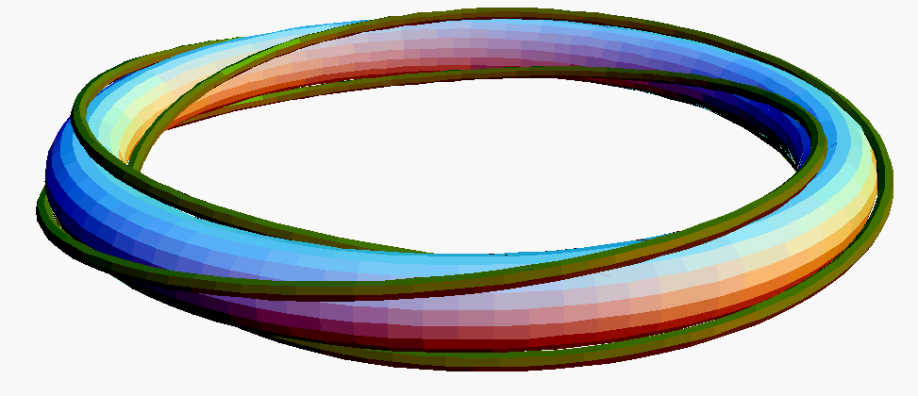
Origin of Planetary Orbit Tilt
Planet Orbit Path on Surface of Toroid as Direct Result of Universal Force Law
One Rotation Cycle Per Orbit
Sun
Equatorial Plane of Sun
Each Green Fiber’s Path Looks Like a Tilted Circle
Toroid
Notes:
The revised version of electrodynamics does explain the origin of the planetary orbit tilt. According to the new universal electrodynamics all the planets move on the surface of a toroid on their path around the sun. The angle of tilt of the orbit is related to the thickness of the toroid. The ellipticity of the orbit is also determined by the thickness of the toroid.
Any theory that explains the solar planetary orbits must predict the quantized orbits, the quantized angular tilts, and the quantized ellipticity of the orbits with the same set of consistent quantum parameters such as N, L, and S.

Slide 40
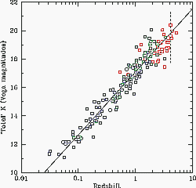
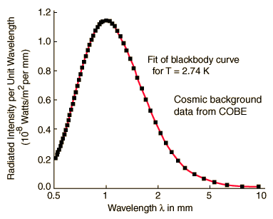
Evidence Consistent with The Electromagnetic Theory of Gravity
1. Increasing Red Shift with Distance
2. Vibrating (i.e., accelerating) dipoles radiate continuously producing 2.7 ⁰K cosmic background radiation (more details on this in Appendix slides)
3. Cosmic background radiation is emitted and re-absorbed, but some escapes
4. Force of gravity is declining over time due to radiating away energy of vibration
5. This decline in the force of gravity can be seen to cause expansions of the earth, the earth’s orbit about the sun, and the universe
Notes:
There are a number of implications of an electrodynamic origin for the force of gravity due to vibrating neutral electric dipoles.
First the vibrating dipoles must radiate energy continuously. A simple calculation shows that this vibration gives rise to the 2.7 ⁰K cosmic background radiation which is the largest radiation source in the universe.
This cosmic background radiation is both emitted and absorbed by the neutral dipoles. However, some of the radiation escapes from all the neutral dipoles causing a slow decline in the amplitude of vibration. This causes the force of gravity to diminish over time. Such a change in the force of gravity causes an expansion of the size of the earth, the orbit of the earth about the sun, and the size of the universe.
Evidence for the expansion of the size of the earth is the splitting of the continents with great stretch marks and the bowing of island arcs.
Evidence for the force of gravity being larger in the past is the generally larger redshifts with distance (equivalent to time in the past) commonly known as Hubble’s Law.

Slide 41
Presentation Outline
What Matters?
Derivation of the Universal Force Law
Derivation of Gravitational Force
Electromagnetic Model of Matter
Derived Features: Mass, Neutron…
New Atomic Model
Subatomic Particle Model
Conclusions
Notes:
Revised Electrodynamics Leads to New Model of Elementary Particles. This section of the presentation will give an introduction to the CSS theory of matter (particles and sub-particles) showing how the model of particles depends on corrected electrodynamics.
The particles have a toroidal shape and consist of three primary charges fibers which may be composed of up to 27 secondary and tertiary charge fibers. The circumference of the toroid of the particle is its Compton wavelength, i.e. all particles have particle and wave properties. The magnetic moment (magnetic field) of the particle is produced by the current around the toroidal ring in the three charge fibers. The spin of the particle is the sum of corkscrew angular motions of the various charge fibers that make up the toroid. The conserved quantities that define the various symmetries of elementary particles that determines the way they decay and interact is determined by the different combinations of angular rotations of the various charge fibers that make up the toroid of the particle.

Slide 42
Revised Electrodynamics Leads to New Model of Elementary Particles
A Little History:
A. L. Parsons (1915) reintroduced Ampere’s notion (1823) that the Electron was a very thin Ring (called Parson’s Magneton)
A. H. Compton, Allen & Others Built on this Model (1916-1919)
Rutherford, Bohr, de Broglie & Schrödinger’s Quantum Model Widely Accepted (1913-1926). Ring Models Abandoned.
Winston Bostick Extended the Ring Concept to a Deformable Helical Torus (~1956-1966)
Barnes (1978) Introduced Self-Field Feedback Effects
Bergman and Wesley (1990) Showed that a Ring Model’s Characteristics are Consistent with a Physical Explanation for Planck’s Constant and Other Measurable Features
Source: https://en.wikipedia.org/wiki/Toroidal_ring_model
Notes:
The concept of a ring shape for elementary particles is not new. Ampere proposed it in the late 1800s. Parsons reintroduced it and presented the concept at many meetings of physicists of the day. Once the Bohr model of the atom was ‘decided’ to be what physics would teach, the ring model fell out of favor and was not worked on until Bostick’s work in the 1950s and 60s. Dave Bergman and Paul Wesley are responsible for the foundation of CSS’ model of elementary particles.

Slide 43
Experimental Data on Elementary Particles
Hard X-Ray and Gamma Ray Scattering on Atomic Electrons Show Ring Shape (Compton)
Fluorescent Absorption of X-Rays on Atomic Electrons Show Ring Shape (Compton)
Electron Scattering on Proton and Neutron Show Finite Size (Hofstadter)
Plasma Injectors Show Ring Composed of Charge Fibers (W. Bostick)
Notes:
Arthur Compton was one of the first investigators to determine the shape of the electron. From three different types of x-ray experiments Compton showed that the electron consisted of a ring of charge with a circumference equal to the Compton wavelength.
Robert Hofstadter received the Nobel prize in physics for measuring the size and shape of the proton and neutron using high energy electron scattering. Circa 1956.
Compton’s last graduate student Winston Bostick performed plasma injector experiments in which he made plasmoids of considerable strength out of charge fibers. This work continues, making plasmoids as large as a baseball from which they have made a jet engine, flown at mach 17

Slide 44
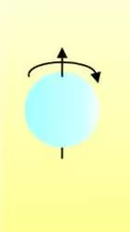
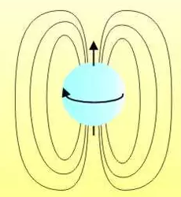
Particle Model - Development
Ask Yourself:
If This is a Ball of All Negative Charge (which should Repel Itself)…
Why Doesn’t Every Electron Fly Apart?
Hmmm…. Perhaps Something Is Holding It All Together?
Start with a Sphere of Negative Charge
Charge in Motion Develops a Magnetic Field
Let’s Give it a Spin
Notes:
Let’s think about how a quantity of charge could become and remain stable. Better than stable: resilient to ‘impact,’ external forces and energy yet be able to recover.
Why doesn’t the electron (composed supposedly of all negative charge) fly apart? Self-repel itself? Let’s see what happens if it rotates.
Charge in motion creates/induces a magnetic field rotating around the moving charge, just like current in a wire.

Slide 45
Particle Model - Development
No. Magnetic Fields Are Generally Not Spherical in Shape.
Notice the Shape (Geometry) of the Magnetic Field. Is it Spherical Like This?
Magnetic Fields Are Toroidal in Shape
Notes:
Magnetic fields are generally not spherical in shape. They’re toroidal (like a doughnut).

Slide 46


Particle Model - Development
This Magnetic Field Will Push Back on the Charge that Created It
(Faraday’s Law)
This Push Back Will Reshape the Charge Distribution
Notes:
Charge in motion produces an induced magnetic field. Per Lenz’s Law (and Newton’s 3rd Law) this Magnetic Field will exert a pushback force on the charge in motion that created (induced) it. Lines of force will be normal to (at 90 degrees to) the lines of magnetic flux.
These lines of force will push on the charge. If the charge is fluid-like (deformable, can be moved, molded) then the shape of the charge (the charge distribution) will begin to change.

Slide 47


Particle Model - Development
The Charge Distribution Must Balance the Forces Induced by the Magnetic Field
Until a Sustainable Equilibrium Shape and State Are Achieved
Notes:
The charge (the ‘stuff’ that makes up whatever electrical charge is) will shift shape until there is an equilibrium state where the Repelling (blow apart) force of the negative charge equals the magnetic push-in force. This creates a balance of forces and the shape should conform to the interior of a toroidal magnetic field.

Slide 48
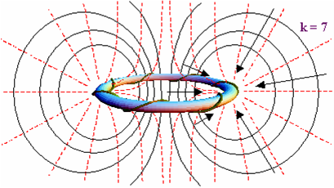
Helicon Model’s Self-Stability
Forces Resulting From Electric Field Energy and Magnetic Field Energy Must Balance for Helicon Particle to Be Stable
Research by David Bergman Achieved a Close Approximation of These Forces in Balance at Specific R and ω Values Corresponding to Known Electron Quantities
Not to Scale
RED Lines: Electric Field Vector Lines
Force of Repulsion is Outward Away From Helicon Surface Attempting to ‘Explode’ Particle (make it Larger)
BLACK Lines: Magnetic Field Vector Lines
Magnetic ‘Pinch’ Force (Arrows) is Inward Normal to Helicon Surface Attempting to ‘Implode’ Particle (make it Smaller)
Notes:
This is CSS’ model for a particle (shown not to scale and greatly simplified, as the minimum stable particle has at least 3 each charge fibers that helically rotate in an overall ring shape (also called a soliton shape). CSS have termed the particle form a ‘Helicon©’ Red lines show the general shape of the electric field, which in the near field approaches the toroid form, but in the far field appears spherically symmetric. Black lines denote the magnetic moment (field lines) which is toroidal in the near field and for a greater distance from the particle. In the far field the magnetic field will vary with 1/R² but up close (near field) the variation is much more complex.

Slide 49
Fundamental Stable Matter:
Helicon Ring Charged Particles
Key Features:
An Electron is BOTH
a Helicon Ring Shaped “Particle” of Charge Fibers (Solitons), With
What an Electron IS Matters…
An Attached Pair of Static Energy Fields That Extend to Infinity
Not to Scale
Failure to Recognize the Fields (Energy) as Integrally Part of the Particle Has Led to Misinterpretations of Observations Such as the Concept of Wave-Particle Duality
Notes:
Key Features: the particle is both a ring of charge (stuff?) AND a pair of energy fields that are integral to and attached to/with the particle. Since the fields are caused by the charge, they are inseparable from the charge. The particle is ALL of these constituents together.
Other scientific models expressly separate the energy (both electric and magnetic) from the particle (usually considered to be a point with no size or extent or shape) leading to misinterpretations of experimental results such as the double slit experiment.

Slide 50
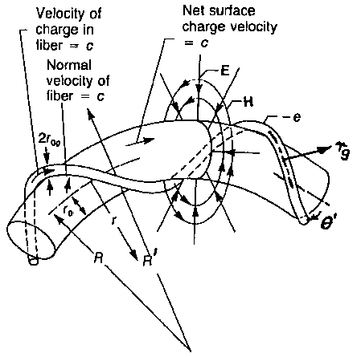
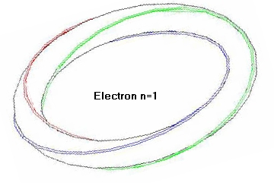
Revised Electrodynamics Leads to New Model of the Electron
Charge Fibers (Solitons of Charge) Helically Spiraling Around a Toroidal Shape: a Helicon
  Three e/3 Intertwined Charge Fibers (Electron Model)
Circumference Equal to Compton Wavelength of Electron
Multiple Ground and Excited States
Physical Spin
Physical Magnetic Moment
Notes:
As part of the new foundation for science a model of the toroidal electron was proposed consisting of three continuous primary charge fibers that are intertwined in such a way that the fibers define the surface of the toroid. The circumference of the toroid for an electron at rest or in motion is the Compton wavelength. The electron possesses a physical intrinsic spin due to the intertwining of the charge fibers. It possesses a physical magnetic moment due to the motion of the current around the toroid. It has ground and excited states reflected in the number of turns of the charge fibers in one revolution of the toroid. These represent standing wave states of the toroid.

Slide 51
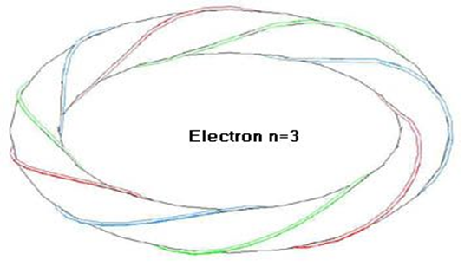
Spinning Charge Fiber Ring Model
Structure of Elementary Particles
Charge Fibers Appear to Be Complex Consisting of:
  At Least 3 Primary Continuous Intertwined Soliton Fibers of Charge
  Primary Fibers May Consist of Smaller Intertwined Secondary Charge Fibers
  Secondary Fibers May Consist of Tertiary Charge Fibers
The More Looping Fibers (Solitons) the Higher the Binding Energy and the Resulting Mass of the Particle
Notes:
The charge fiber ring model of elementary particles was constructed incorporating all of the theoretical and experimental results that had been accumulating over the years but never assimilated back into electrodynamics to replace Maxwell’s equations.
This elementary particle model is a classical string type consisting of 3 to 27 intertwining closed string loops. Stable elementary particles consist of three primary intertwining charge loops. These primary charge loops may consist of up to three secondary intertwining charge loops. The secondary charge loops may consist of up to three intertwining tertiary charge loops. The simplest elementary particle, the electron, consists of three simple intertwining primary charge loops. The most complex elementary particle, which has not been discovered yet, consists of three intertwining primary charge loops which consist of three intertwining secondary charge loops, which consist of three intertwining tertiary charge loops. The more loops the higher the binding energy and the mass of the particle.

Slide 52
Helicon Theory
Charged Particles have Finite Size & Specifiable Physical Shape — Dr. Thomas Barnes
Electromagnetic Energy is Purely Wave-like and is Non-Quantized
  Actual Quantization (or the Appearance Thereof) Occurs In the Interaction of Wave Energy with Matter (e.g., Photoelectric Effect, Line Spectra)
  Standing and Oscillating Waves
Particle Ring Helicon Model
R
Charge
“Fiber”⁻
a
t
r
Toroidal “Form”
Not to Scale
Particle Interactions are Determined by Electric and Magnetic Forces
  Magnetic Force Becomes Rapidly More Influential “Up Close” at Sub-Atomic Distances (Near Field Phenomena)
  As We Will See with the Atomic Model, There is No Need for a ‘Strong Force’ or ‘Weak Force’
Notes:
Per CSS Theory, electromagnetic energy is pure wave motion (analog) and is not, in itself, discrete or quantized. Quantization occurs at the interface with wave energy and physical matter which is CHARGE in the form of a resonant ring shape with specific degrees of freedom ( large Radius, small radius, number of turns per charge fiber, number of charge fibers). Since the number of turns is always an Integer Number (due to the fiber being continuously connected to itself; no discontinuities) the turns can only change discretely in absorbing energy or releasing it. This is where quantization comes from.
Since in the near field the shape of the particle and its fields is not spherical, but rather toroidal, the magnetic field will intensify more rapidly as one nears the particle (no longer 1/R2 variation, as it is in the far field). Magnetic fields also ‘couple’ having shared/mutual inductance effects, which further influence the binding forces among particles which are close together (as in a nucleus, atom). All binding forces in atoms and nuclei, as we will see later in this presentation, can be explained in terms of the electric and magnetic forces alone. No ‘strong’ or ‘weak’ force exists nor is needed.

Slide 53
Bostick’s Explanation of Quantization
Charge Fiber Moves Along in Shape of Circular Solenoid as a Helix Wound Around a Toroidal Form.
Fiber With 1 Turn Represents Electron in a “Non-Excited” State (Minimum Energy). Fibers With Higher Numbers of Turns Correspond to Excited States (Enhanced Energy Levels).
Since the Fiber is Continuous, it CANNOT Rotate a Non-Integer Number of Turns. It MUST Be a Whole Number
This is One Source (One Degree of Freedom) Where the QUANTIZATION of Energy Levels Comes From.
k = 1
k = 3
k = 7
Not to Scale
NOTE: Toroid Form (In Color) Is Shown Only As Visual Aid and Is Not Part of the Spiraling Helicon© Particle
Notes:
The new classical universal electrodynamic force gives rise to specific classical physical models for elementary particles. These particles can have excited states. Here we see five specific states of the electron toroidal ring composed of three simple primary charge fibers. Transitions between these resonant states gives rise to the normal emission spectra of atoms and also to the extreme ultraviolet spectra as measured by NASA rocket probes in outer space.

Slide 54
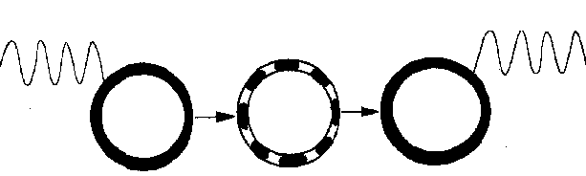
Charge Fiber Ring Model
Resonant States
Charge Fibers Intertwined in a Toroid of Primary Radius R Can Support Multiple Standing Wave Resonant States with Wavelength λ
Resonance/Harmonics Provide Another Physical Mechanism (Degree of Freedom) for Quantized Energy Absorption and Emission
Notes:
The mechanism for radiation is that the charge fiber configuration in the ring can have multiple standing wave states. The charge fibers in the ring can only absorb electromagnetic energy of specific wavelengths that could produce exact harmonics of the fundamental standing wave in the ring.
In the case of the atom, the three-dimensional electron does not have to orbit the atom to be in dynamic equilibrium with the nucleus. In fact, the electron cannot orbit the nucleus, or it would continuously radiate energy due to constant inward acceleration; Bohr’s model (and any other ‘orbiting electrons’ model) is not correct, nor possible. The magnetic field of the ring is strong enough to keep the electron out of the nucleus. The electron can vibrate with respect to its equilibrium position near the nucleus. So-called atomic electron transitions are not orbital transitions as in standard quantum theories of the atom, but rather the resonant/quantized change of electron standing wave states with no quantum jump in orbit.

Slide 55
Presentation Outline
What Matters?
Derivation of the Universal Force Law
Derivation of Gravitational Force
Electromagnetic Model of Matter
Derived Features: Mass, Neutron…
New Atomic Model
Subatomic Particle Model
Conclusions
Notes:
This section will look at properties and characteristics of matter, particularly an electrodynamic derivation of inertial mass showing mass is not ‘stuff/substance,’ rather mass is an electrodynamic pushback force opposing motion. Examples from atomic mass deficit and nuclear fission reactions showing the true origin of mass defect. We’ll look at the real proton, neutron models, and whether there’s an independent universal luminiferous aether (there isn’t’).

Slide 56
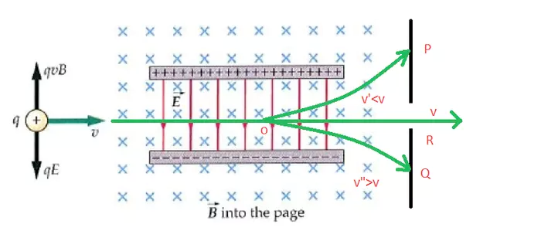
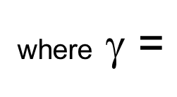
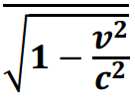
Inertial Mass
If Inertial Mass was an Intrinsic Property, it would not Change with Velocity
Linear Particle Accelerator
However, Particles at High Velocity Appear to Be More ‘Massive’ (Requires More Force to Move Them)
More Force Needed!
m_{o}
+
m
The Calculated Mass Change Becomes
m = γm_{o}
In Other Words, Mass is not ‘Stuff’/Matter (it is a Measure of the Force Required to Accelerate)
Inertial Mass is a Reaction Force Resulting when Charge is Accelerated
Notes:
Increase of mass with velocity. If mass were an intrinsic property of an elementary particle, it would be invariant in all inertial frames of reference. Stated more simply, the mass would not change with velocity. But it does change, and mass dramatically increases as it absorbs kinetic energy.
Increase of energy with velocity. As an accelerated particle acquires more energy (specified by E = mc²), several structural changes occur:
- The particle changes in size and shape.
- The electric and magnetic fields surrounding the particle make a corresponding change in shape and intensity.
- The kinetic energy of the particle’s velocity is absorbed in the electrical fields surrounding the particle.
--Two types of fields absorb the energy: “In addition to the production of a radiation field by acceleration of the charge, an induction field is also developed. This induction field is associated with the velocity of the charge and stays with the charge as long as it is in uniform motion to the ambient field of the fixed frame.”---Thomas G. Barnes (1977).

Slide 57
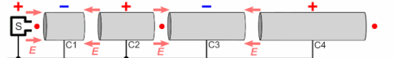

Inertial Mass
The Particle is Accelerated by Pushing On Its Electric Charge (Electric Field)
Kinetic Energy Is Transferred to the Ring Resulting in MOTION
Charge in Motion Produces an Induced Reaction Magnetic Field (Separate From Its Inherent Static Magnetic Field)
This Induced Magnetic Field Creates A Push Back Force on the Charge Distribution Causing It to Become Smaller (Compresses)
This Increases the Charge DENSITY, Which Increases the Electric Field Intensity, Which Requires More ‘Push’ to Make it Move
So As the Size Decreases, Mass Increases.
Mass is a Derived Electrodynamic Property
This Increases the Charge DENSITY, Which Increases the Electric Field Intensity, Which Requires More ‘Push’ to Make it Move
Notes:
Increase of mass with velocity. So what’s really going on? First, a particle is accelerated via, typically, use of an external magnetic field or an electric field. Even if we only considered the known effects on a charge in motion within external fields (such as Ampere’s and Faraday’s Laws), we know an induced magnetic field will form around the charge that moves with the charge. This induced field (see detailed analysis in Dr. Barnes books) will push back (Newton’s 3rd Law reaction force) on the charge in motion opposing the force that’s causing the motion to begin with. This then requires more force, than initially, to achieve the same degree of acceleration; hence, the charge appears to have become more ‘massive,’ when there’s no more matter/stuff there than at the beginning. This so-called relativistic mass is more electrodynamic push back (reaction force) from the charge’s own self fields. Mass is therefore a derived/resultant electromagnetic property.

Slide 58


How Mass Is a Derived Property
Compression Puts Energy INTO Something
Compression Makes Something SMALLER
Same Amount of Something in a Smaller Volume Means an Increase in DENSITY
Smaller size, more potential energy. Higher pressure.
This smaller size condition has higher potential energy. Energy is now stored in the spring.
Notes:
Some background to assist our understanding how the mass increase occurs. Two examples that show how external energy will compress (make smaller, less volume) something that naturally resists being compressed (like a collection of positive charge, called a proton).

Slide 59
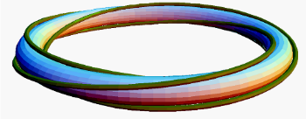
Smaller = More “Massive”
Magnetic Field Intensifies PUSHING BACK HARDER on the Charge Distribution
Until a New Sustainable Equilibrium Smaller Shape Is Achieved
As the Charge Moves, an Induced Magnetic Field Forms
The Charge Distribution and Magnetic Field
Notes:
Sequenced images showing how the induced magnetic field resulting from motion, will cause a reaction force against the charge in motion. This reaction force compresses the charge distribution resulting in a smaller size. Smaller size, same amount of charge, equals higher charge density. Higher charge density requires more force (external fields) to move it, making the smaller charge distribution more ‘massive.’

Slide 60
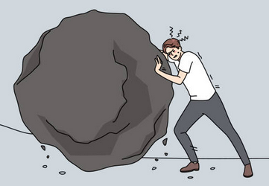
Mass ≠ Matter
Higher Electric and Magnetic Field Strengths (at the Surface of the Particle/Ring) Require MORE FORCE to MOVE Them (than Weaker Fields), Hence They Are More ‘Massive’
Mass = Force Required to Move Something
F = ma m =
F
─
a
Notes:
If something takes more force to accelerate (move) it, then by Newton’s 2nd Law it has more mass. There is clearly not any more charge (the ‘stuff’ that makes up the particle), but the particle has more mass. Mass, therefore, is not ‘stuff.’ Mass is a variable electromagnetically-derived property of charged particles.

Slide 61
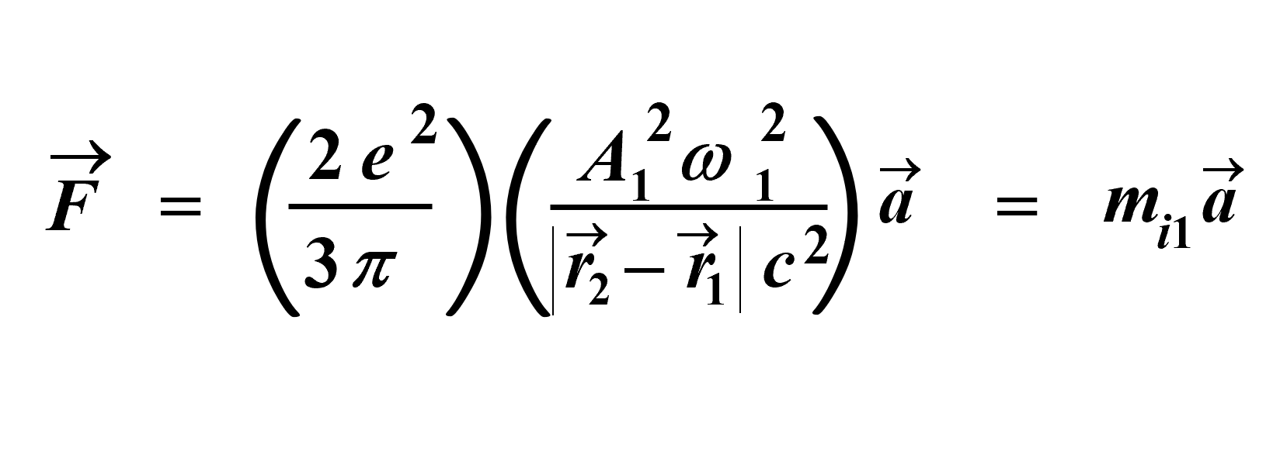
Deriving Inertial Mass
Derive Newton’s 2nd Law F = ma in Electrodynamic Terms:
→
→
_
_
_
_
_
_
_
_
_
r
−
r
→
_
_
_
_
_
_
_
_
_
_
_
_
_
F
+
+
2
1
2
,
1
↓
ω
=
2
π
f
↓
1
→
1
•
←
•
→
•
A
1
q
q
q
1
+
1
−
2
+
→
→
→
F
=
F
+
F
2
+
,
1
+
2
+
,
1
−
m
i1
Notes:
This is how Dr. Lucas proceeds to derive inertial mass. Similar to the approach for deriving the electrodynamic force of gravity, we start with neutral matter (one + and one – charge on the left) and calculate their effects on a single + charge (on the right) using the newly-derived Universal Force equation. Details on this derivation can be found in Dr. Lucas’ book “The Universal Force – Volume 1”

Slide 62
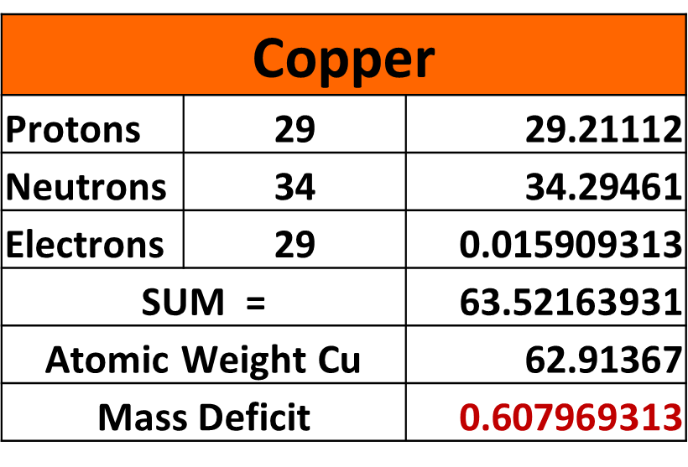
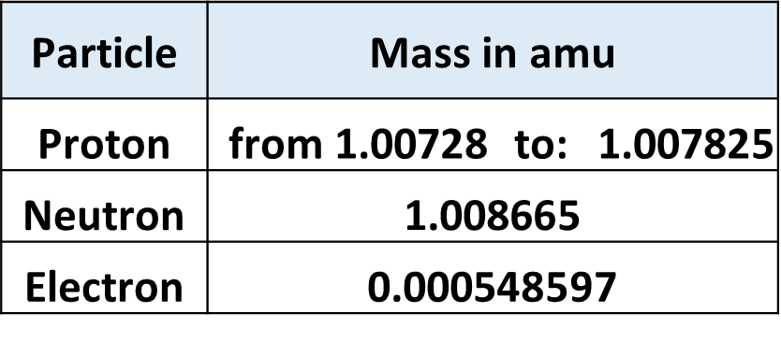
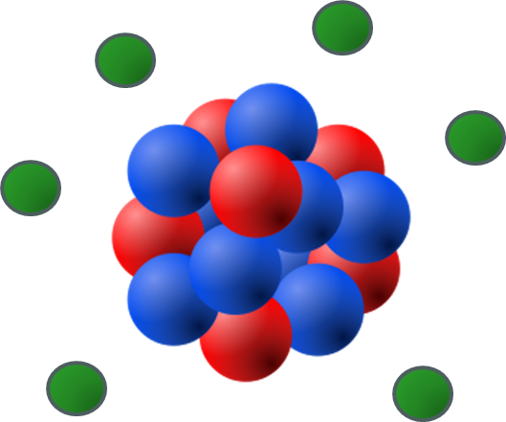
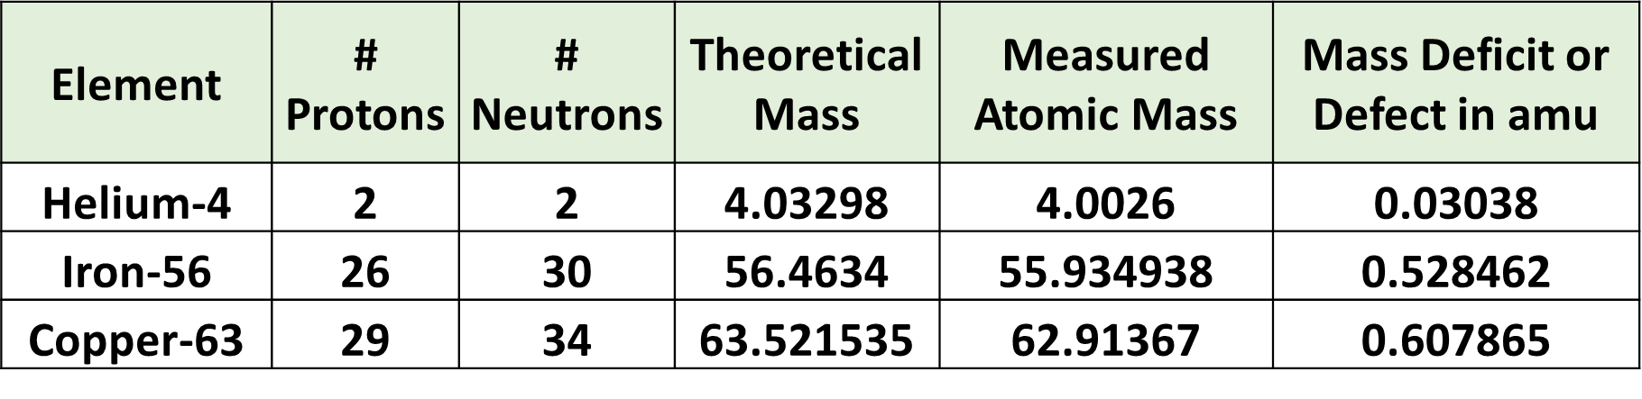
Example 1: Showing Mass ≠ Matter (1 of 3)
Mass Defect = Sum of weights of all protons, neutrons and electrons in ANY Atom/Isotope is not equal to the weight of the combined atom/isotope
The Standard Model “Reason” is some mass is converted into “Binding Energy” in nucleus
o
o
+
+
o
+
NOTE: The Copper Atom Does NOT Look Like This
o
o
o
+
Source: https://sciencenotes.org/mass-defect-definition-and-formula/
https://www.eag.com/app-note/sims-tutorial/
Notes:
When we add up the individual masses of free protons and neutrons (and include the lightweight electrons, if you wish), the total ‘weight’ is not equal to the measured atomic mass (typically the atomic mass is less than the total). This difference is called the Mass Defect. The reason given for this difference (per the Standard Model) is that some mass is converted to energy used to bind the nucleus and overall atom together (i.e., becomes the ‘strong’ and/or ‘weak’ forces). One problem (of many) with this story is that some atomic weights are MORE than the sum of the particles’ weights, yet they still have binding energy. Hmmm…

Slide 63
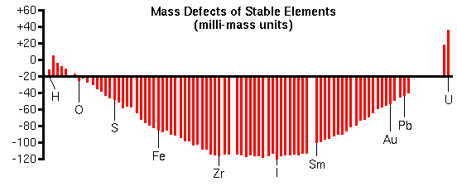
Mass ≠ Matter : Mass Defect (2 of 3)
Notice the Mass Defect for Some Elements (Green Bars) is a Positive Number !
This Cannot Be Explained As ‘Missing Mass’ Converted to Binding Energy
CSS’ Better Explanation is ‘Mass’ Changes with Particle Size Which Depends on the Specific Combination of Internal Forces Unique to Each Isotope
Source: https://sciencenotes.org/mass-defect-definition-and-formula/
https://www.eag.com/app-note/sims-tutorial/
Notes:
As illustrated here the Mass Defect for some elements/isotopes is a positive number, such that the “mass converted to binding energy” explanation is illogical, or at least, inconsistent with observations.

Slide 64
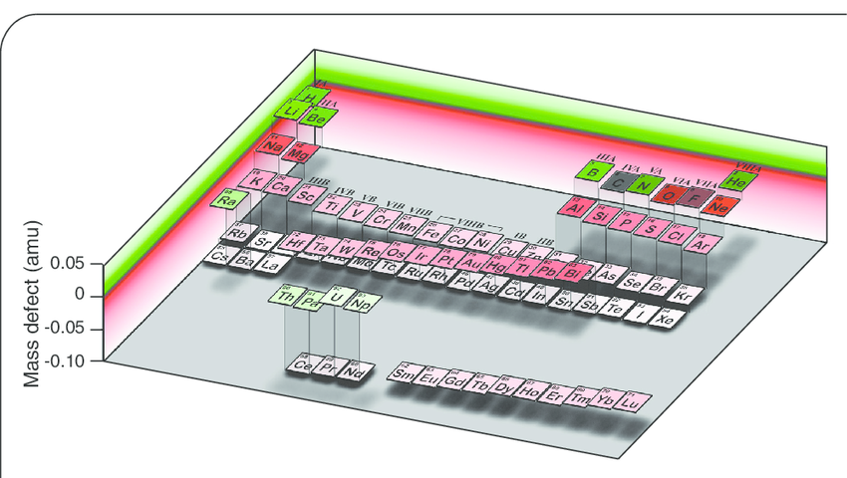
Mass ≠ Matter : Mass Defect (3 of 3)
Green: Positive MD
Red: Negative MD
Visualization of Mass Defects in Periodic Table Layout
Source: https://www.researchgate.net/figure/The-periodic-table-of-the-elements-presented-in-mass-defect-relief-The-mass-defect-of_fig4_7776269
Notes:
An alternative presentation of Mass Defects laid out in periodic table format. The odd use of light green and light/whitish red (vs dark green or red) for the more extreme values makes it more challenging to understand what’s being displayed, but one can still figure it out.

Slide 65
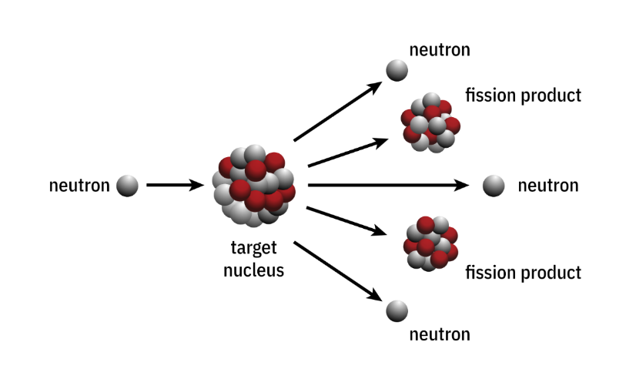
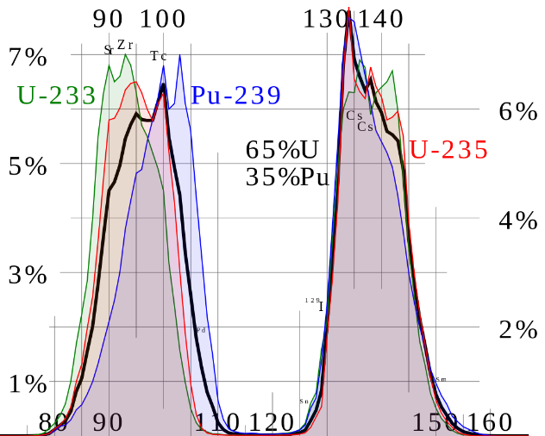
Example 2: Nuclear Fission (1 of 3)
U-235 Red Line
383 possible fission product “daughter” nuclei for U235
Range in atomic weight from 74 to 160
Range from atomic number 29 to 63 (Copper to Europium)
Over 1000 possible unique fission daughter pairs that liberate between 0 to 5 neutrons
Sources: https://www.atomicarchive.com/science/fission/index.html https://www.linquip.com/blog/nuclear-fission-equation/
Notes:
As another example that mass is not an intrinsic property, consider nuclear fission where the resulting products after the reaction still have exactly the same number of protons and neutrons as the initial reactants. Same particle count, but lower mass. Again, the story is that mass has been converted to energy, but where did the mass come from?
The reality is that energy was converted to released energy (energy in compressed nucleons, energy in mutual magnetic coupling among nucleons, is converted into radiated energy and kinetic (heat, motion) energy).

Slide 66
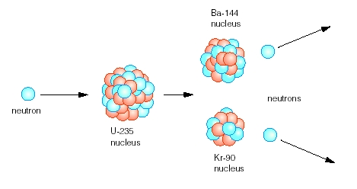
Example 2: Nuclear Fission (2 of 3)
Same number of protons, neutrons after fission (called “nucleon conservation”)
But there is a loss of ‘mass,’ also called a “mass defect”
Example Pair: Cesium & Rubidium
Cs-144
nucleus
The mass defect is the difference in the rest masses of the reactants
²³⁵U + ¹n
neutron
neutron
U-235
nucleus
Rb-90
nucleus
and the fission products
⁹⁰Rb + ¹⁴⁴Cs + ¹n
reactants
products
Notes:
Although there is always “nucleon conservation,” there is always a lower total mass of the fission products than the original mass of the reactants. Where is this ‘mass’ coming from, because no ‘stuff’ (nucleons) is lost; rather it is expressly conserved?

Slide 67
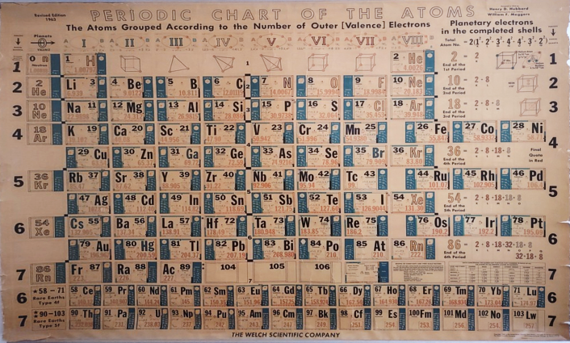




Example 2: Nuclear Fission (3 of 3)
Cs-144
nucleus
Element Symbol | Atomic Number | Atomic Mass | Atomic Weight in amu
U | 92 | 235 | 235.04393
Cs | 55 | 144 | 143.932077
Rb | 37 | 90 | 89.914802
n | 0 | 1 | 1.008665
Loss--> | 0 | 0 | 0.188386
neutron
neutron
U-235
nucleus
Rb-90
nucleus
In CSS’ Particle Model, this Loss of Mass is not a Loss of ‘Stuff’ (particles)
It is due to the Conversion of Energy from One Form Into Another
The Energy Comes From Changes in Size of the Nucleons from differing Forces in each Nucleus, and Changes in Mutual Magnetic Coupling.
Change in mass = ─ 0.188386 amu
Sources: https://en.wikipedia.org/wiki/Fission_products_(by_element)#/media/File:ThermalFissionYield.svg https://www.linquip.com/blog/nuclear-fission-equation/
Notes:
Using the U235 to Cesium and Rubidium reaction, let’s add up the weights of all protons, neutrons and electrons, and compare the before and after totals. As with the mass defect in atomic weights, this so-called mass defect is also attributed to “mass being converted to energy.” But what’s really happening, using CSS model of particles, is that energy (of nucleon size, and mutual magnetic coupling “binding” energies) is being released as gamma radiation and kinetic energy (particle motion and heat).

Slide 68
The Real Proton
Proton and Electron Are Both Based Upon the Helicon Model
Radius of a Free Proton is 1836.15 Times Smaller Than the Electron’s
  Proton Therefore Has a Larger Mass Due to:
  More Intense Electric Field Density Which Produces a Larger Self-Reaction Force (Perceived/Measured As ‘Mass’)
  More Internal Charge Solitons (9 Fibers both + and -)
  Proton Has Lower Magnetic Moment Than the Electron Due to Its Smaller Radius
Bound Helicons (i.e., in a Nucleus) Have Different Radii Than Free Helicons
  Accounts for Nuclear Protons Having ‘Anomalous’ Magnetic Moment. Bound Protons Have Larger Radii Than Free Protons.
Particle Ring Helicon Model
R
Charge
“Fiber”⁻
a
t
r
Toroidal “Form”
Two Quantities Are Conserved at All Times:
Charge: each Helicon has e =1.619 x 10⁻¹⁹ Coulombs of Charge
Magnetic Flux: each Helicon has Φ =4.13089 x 10⁻¹⁵ Webers of Flux
Planck’s Constant is Derived from: h = e . Φ
Notes:
CSS model of the proton is built on the helicon model for the electron but it has a much smaller radius. The resulting higher charge density causes a higher reaction force when accelerated, making the proton more ‘massive’ than the electron. Also, the internal fine structure of the proton consists of more charge fibers whose mutual coupling energy also increases the mass of the proton.
Note that helicons (both protons and neutrons) have different sizes when bound in a nucleus (electrons are smaller and protons are slightly larger, in general, in a nucleus) than as free particles.
Both charge and magnetic flux are conserved at all times, and together form the physical basis for the value of Planck’s constant.

Slide 69
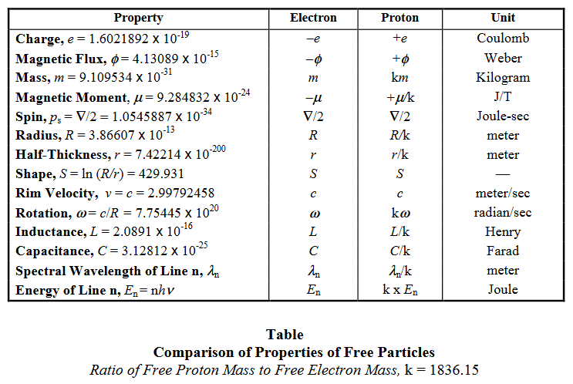
Free Particle Properties
Notes:
Table of Free Particle Properties from Foundations of Science Vol3 No4 “The Real Proton”

Slide 70
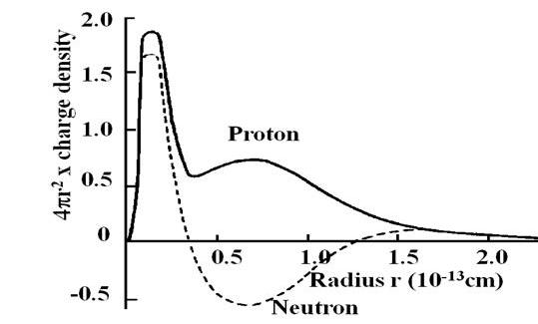
Bergman Neutron Model
Electron
The Neutron Is Not an Elementary Particle but a Paired Electron and Proton.
This Coaxial and Coplanar Configuration, with the Same Direction of Particle Rotation, Stores the Maximum Excess Energy Called Beta Decay Energy. Arrows Show Direction of Moving Charge.
Proton
Notes:
From Foundations of Science Vol4 No2 “Notions of a Neutron.” In CSS’ model, the neutron is not a unique, distinct elementary particle made up of ‘neutral’ charge/stuff. Instead, the neutron is a combination of an electron and a proton concentrically aligned. This configuration may or may not exist in this form within a nucleus, but it does appear to be configured this way when a neutron is expelled from the nucleus (see Hofstadter’s electron scattering data shown on the slide. This configuration is also unstable, decaying into a free proton and free electron in 11 to 15 minutes.

Slide 71
Charge Distribution in a Neutron
Calculated Positional Locations (Radii) of the Proton and Electron in the Bergman Neutron Model Agree with the Scattering Measurements of Hofstadter as Reported by Burcham
Rest Mass is a Result (Combination) of Each Particle’s Individual Rest-Mass Energy PLUS the Mass-Equivalent of the MUTUAL Energy Between the Two Helicons
Mutual Energy is Equivalent to the Beta Decay Energy when the Neutron Separates into a Free Electron and Free Proton
Hofstadter Electron Scattering Data
CONSISTENT WITH RING THEORY
Bound Proton Radius 1.7 x 10⁻¹⁶ m.
Bound Electron Radius 5.7 x 10⁻¹⁶ m.
Notes:
CSS Bergman neutron model calculations agree with electron scattering measurements. Neutron mass represents the individual particles’ mass plus the mass-equivalent of the mutual magnetic binding energy between the two particles. This mutual energy is the beta decay energy released when the electron frees itself from the proton.

Slide 72
No (Independent/Universal) Aether
Electric and Magnetic Fields of Each Electron Extend Throughout the Universe
Fields Remain Attached To and Are Part of Each Particle
Only Charge Fibers (Particles) Emit Radiation
Radiation is a Wave Disturbance of the Static EM Fields
Radiation is “Carried” by Each Particle’s Fields
In This Way, All Transmitted Forces Are Contact Forces
There is No Need for an Independent Medium/Aether
Notes:
An important concept in CSS Theory is that the electric and magnetic fields of each particle carry all radiated energy that leaves the particle. These fields, which extent to infinity, are wholly sufficient to transmit radiated energy to other particles anywhere in the universe. No 3rd–party medium or aether (or ether) is necessary and CSS does not think any such independent luminiferous ether exists.

Slide 73
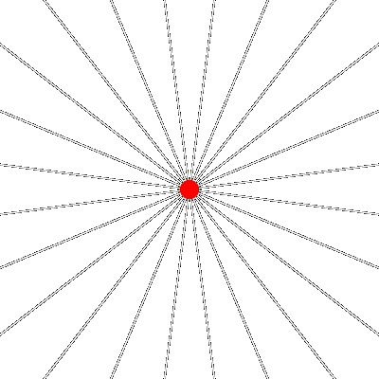
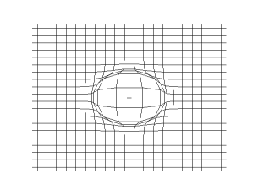
Light (Energy) is Wave Motion of Each Particle’s Own Fields
Energy is Quantized Due to the Mechanism of Release as Charge Fibers Change k value (# of helical rotations)
‘Visualizations’ of Wave Motion in Field ‘Lines’
Source: physics.stackexchange.com
Notes:
Graphic illustrations of waves carried by a particle’s own fields. Quantization is caused by the physical release/radiation mechanism of charge fibers which change k number in quantized steps.

Slide 74

Model of Elementary Particles
Summary
Toroidal shape, Helical path of Charge Fiber(s)
  Three intertwined primary charge fibers form toroid
  Fibers may be composed of secondary/tertiary fibers
  All fibers have intrinsic angular momentum which is conserved in all interactions maintaining 3x3x3 symmetries
Circumference equal to Compton wavelength of particle
Ground and excited states (k value of fiber rotations)
Physical spin (charge revolution about axis)
Physical magnetic moment
E&M Fields are Attached to the Fibers and Have Tensile Strength
Radiated Energy is Emitted Per Particle, and May Be Quantized, Carried on Each Particle’s Own Fields
Notes:
The revised version of electrodynamics leads to a new physical model for all elementary particles. The particles have a toroidal shape and consist of three primary charges fibers which may be composed of up to 27 secondary and tertiary charge fibers. The circumference of the toroid of the particle is its Compton wavelength, i.e. all particles have particle and wave properties. The magnetic moment (magnetic field) of the particle is produced by the current around the toroidal ring in the three charge fibers. The spin of the particle is the sum of corkscrew angular motions of the various charge fibers that make up the toroid. The conserved quantities that define the various symmetries of elementary particles that determines the way they decay and interact is determined by the different combinations of angular rotations of the various charge fibers that make up the toroid of the particle.

Slide 75
Presentation Outline
What Matters?
Derivation of the Universal Force Law
Derivation of Gravitational Force
Electromagnetic Model of Matter
Derived Features: Mass, Neutron…
New Atomic Model
Subatomic Particle Model
Conclusions
Notes:
The new Universal Force Law and CSS model of elementary particles readily leads to a new physical model for atoms and nuclei.

Slide 76



The Atom…
We All KNOW What It Looks Like, Right?
And a Nucleus Looks Like This, Right?
Notes:
Bohr’s model of the atom with protons and neutrons like little balls stuck together in the nucleus, and electrons in shells orbiting about the nucleus like a planetary-solar system, is well-known and have been in continuous use in publications and texts for over one hundred years (introduced in 1913). Per Wikipedia “…because of its simplicity, and its correct results for selected systems…, the Bohr model is still taught to introduce students to quantum mechanics or energy level diagrams before moving on to the more accurate, but more complex, valence shell atom.”

Slide 77

Hydrogen
Not to Scale !
Hydrogen Only Exists as H₂
  No Such Thing as a Hydrogen ‘Atom’ (i.e., One Proton in Stable Combination with One Electron Does Not Exist in Nature)
  Hydrogen IONs Exist As Stand-Alone Protons
The Hydrogen Molecule, Consisting of 4 Elementary Particles, is the Simplest Form of Matter That Is Charge Neutral and Stable
  A Minimum of 4 Particles is Required to Achieve Atomic Stability
  Computer Simulations Demonstrate that the Specified Geometry Results in a Stable Minimum Potential Energy Arrangement
  Proton Centers Are 47% of the Distance to Electron Centers (Notice: No ‘Nucleus’)
  Electron Moment & Radius Have Been Measured to be 658 Times Larger Than Proton Moment & Radius
P⁺
e⁻
e⁻
P⁺
P⁺
e⁻
e⁻
P⁺
Hydrogen Molecule
Upper Diagram Shows Two Protons and Two Electrons in Their Relative Positions
Lower Diagram Shows Same Molecule With Axes and the Centerline of Magnetic Flux Added As Visual Aids.
Notes:
Starting with the simplest element: Hydrogen. Note that the hydrogen ‘atom’ does not exist in nature. Only diatomic hydrogen H2 exists naturally. If a single proton exists, it’s called a hydrogen ion, but it will not combine with a single electron and form a stable pair.
The reason for this is that only a minimum of 4 particles can form a stable combination, which we know as diatomic hydrogen molecule. The key to stability being magnetic coupling along a single curved line of magnetic flux. Deuterium an isotope of hydrogen does not appear as free atoms either but appears, rarely, as D2 (deuterium molecule) or bonded with hydrogen (protium) as hydrogen deuteride. Deuterium is composed of 6 particles (3 protons and 3 electrons). Tritium can appear as a stand-alone atom but is radioactive having a half life of ~12 years. Tritium is composed of 8 particles (4 protons and 4 electrons).

Slide 78
Hydrogen
Not to Scale !
Hydrogen Spectra Result From Characteristics of Bound Electrons in H₂
  Electrons (and Protons) Adjust Radius Depending on Total Captured Magnetic Flux in a Given Atom (Element/Isotope)
  Helium Spectra, for example, Differ Due to Different Particle Count (8), Spacing and Resulting Captured Flux per Particle
  Majority of H₂ Spectra Can Be Calculated From Primary and Secondary Radii (R, r)
Quantization of Energy Results From Integer Values of K and Size of Particle
  K, Number of Turns Around Toroidal Form, Can Only Vary in Integer Steps In Order to Maintain Continuous Fiber Current
  Possible ‘Stretching’ Transition Between K Levels Occurs Rapidly Giving Appearance of ‘Instantaneous’ Jumps Between ‘Quantum States’
Hydrogen Molecule
Upper Diagram Shows Two Protons and Left Electron in Non-excited States (k = 1). Right Electron With Seven Loops Is Shown in Excited State (k = 7) Revealing the Helicon© Geometry.
Lower Diagram Shows Same Molecule With Axes and Toroidal Form Added As Visual Aids.
Notes:
Per CSS particle theory, particles’ radiation results from physical characteristics that enable various degrees of freedom in size, shape, helicity/rotation and the attached/integral electric and magnetic fields that make up each particle. Multiple particles making up an atom are held in place due to a balance between electrical attraction/repulsion and magnetic coupling/alignment. Due to the toroidal helicon’s shape, in the near field these fields no longer vary as 1/R2 (as in the far field) causing strong torques if a particle begins to get out of magnetic alignment. Spectra can be calculated from particle physical parameters and harmonic multiples of these values.

Slide 79
Accurate Predictions of Spectral Radiation
NASA Rocket Probe Data Showing Extreme Ultraviolet Spectrum for Helium and Hydrogen
Notes:
This NASA rocket space probe data for the emission spectrum of hydrogen and helium in the extreme ultraviolet agrees perfectly with the new model of the electron and the hydrogen atom. None of the 64 numbered lines in the spectrum above are predicted by conventional quantum theories of the atom.

Slide 80

Revised Electrodynamics Leads to New Model of the Atom
In CSS’ Atomic Model Electrons Do NOT ‘Orbit’
Particles in an Atom Will Take Positions that Minimize Potential Energy Via:
  Maximum Coupling of Magnetic Flux, and
  Minimum Packing Geometries with
  Electric Forces of Attraction & Repulsion in Mutual Balance.
The Resulting Geometry is Inherently Stable and Resilient.
₁₀Neon-20
Magnetic Flux Lines
Nucleus
Electrons in 2 Shells
Great
Circles
Neon-20 Atom Model by J. Lucas
Not to Scale !
Notes:
The revised model of the electron gives rise to a new model of the atom. In this model the electron does not orbit the nucleus. The electrons pack in shells according to combinatorial geometry due to the attractive electrical force between the electrons and the nucleus. The magnetic forces between the electrons determines how many pack into each shell and the various lines of symmetry in each shell.
In this diagram of the neon atom the symmetry of the great circles is shown for each shell. Note that for all the shells the magnetic flux lines and the great circles are perpendicular. Also note that the number of great circles increases by one with each larger shell. And the number of magnetic flux lines also increases by one with each larger shell.
Atomic models developed by Charles and Joseph Lucas are derived from experiments conducted with magnetic coupling and geometric packing theory [19, 25]. The model proposes that nuclear particles (both electrons and protons in various configurations) and shell electrons will adopt positions of maximum stability by minimizing potential energy. These conditions occur when there is maximum coupling of magnetic flux among closely associated particles (helicons) with simultaneous minimum packing geometries limited by forces of repulsion and attraction in mutual balance. The resulting system is inherently stable and resilient, allowing for significant energy absorption and particle displacement (e.g., due to vibration) while maintaining ‘springy’ resonant-like properties.

Slide 81

Revised Electrodynamics Leads to New Model of the Atom
Shell Filled with 18 Electrons
(e.g., 3rd Shell of ₂₉Copper or ₃₀Zinc)
Magnetic Flux Lines
Electrons
Note: Nucleus and Inner Electron Shells Not Shown
Not to Scale !
Notes:
In this diagram of the third shell of copper, and similar metals on row 4 of the periodic table, one can see how there are 3 magnetic flux lines. Electrons will compact maximally until electrical repulsion balances the magnetic compression forces.

Slide 82

Arrangement of Electrons
In Packing Shells (Magic Numbers)
Note: Only Full Shell Numbers Are Shown
The Helicon Model of Atomic Structure Accurately Predicts Electron Shell Progression Based Upon:
Minimum Potential Energy
Combinatorial Geometry
Maximum Packing
Provides The First Causal Explanation of the ‘Magic’ Numbers of Electrons Per Shell
Notes:
This chart shows the predictions of the electron shell sizes in order for atoms. The periodic table of the elements is reproduced exactly. Note that ring magnet experiments indicate that electron magnetic shells larger than 32 are not bound or stable. The standard quantum theories of the atom can not say this, because they are point particle theories in which the three dimensional magnetic moment of the electron does not play a role.

Slide 83


Revised Electrodynamics Leads to New Model of the Nucleus
No Center
P⁺
Protons
e⁻
e⁻
No Center
P⁺
Electrons in the Nucleus !
H₂ - Hydrogen
This is VERY Different From the Images We Are Still Shown To This Day !
O-16 Oxygen Nucleus Using Bergman Model of the Neutron
O-16 Oxygen Nucleus
Note the Alternating Shells (Spheres) of Positive, Negative, Positive…
Notes:
The revised electrodynamics leads to not only a new model of the electron but also the proton and neutron leading to a new model of the nucleus. The neutron is composed of an electron and a proton. The electron shrinks in the presence of a proton; the protons slightly enlarge in the presence of the electrons (changing their ‘mass’ as bound particles). Combinatorial geometry is able to predict the packing of protons and electrons in the nucleus to form shells. Note the smaller protons and larger electrons in the Oxygen nucleus. See the formation of triplets of shells.

Slide 84
Distribution of Rings In Nuclear Packing Shells
Total # --Combinatorial Geometry Shells--
Rings in 2 2 8 8 18 18 32 32 50 50
2 2
8 8
20 2 18
28 2 8 18
50 18 32
82 32 50
126 8 18 18 32 50
Possible Shells
Disappearing Inner Shells
Second Shell of 18 Forms Above 82
Determined by Minimum Potential Energy, Maximum Packing Density, and Maximum Magnetic Flux Capture
Notice that Inner Shells Can Disappear (Come Apart) As Larger Shells Around Them Are Formed.
This is because the Nucleus Has Nothing In the Center to Help Hold Shells Together.
Notes:
Note that there is nothing in the center of the nucleus to hold the smaller shells intact when larger shells are formed outside them. As a result the smaller inner shells come apart to form larger outer shells. This is most noticeable in order of filling of the various nuclear shells as shown in the table.

Slide 85
Charge Density of Various Nuclides
0.10
This Data is Consistent with the Loss of Inner Shells in the CSS Model
Standard Shell Model Does Not Predict This
0.08
Notice LOWER Avg. Charge Density as Nucleus Gets Larger
0.06
²⁰Ca
ρ(r) in Proton Charges per (10⁻¹³ cm)³
²³V
0.04
²⁷Co
⁴⁹I
⁵¹Sb
⁷⁹Au
0.02
⁸³Bi
0
0 1 2 3 4 5 6 7 8
r in 10⁻¹³ cm
Notes:
This view is further confirmed by measurements of the nuclear charge density of various nuclides. Note that the larger the nucleus the less the average charge density in the center of the nucleus. This indicates that smaller shells near the center of the nucleus are decomposing to form the larger shells near the surface of the nucleus.
The shell model of the nucleus would predict constantly increasing nuclear charge density near the center of the nucleus not a decreasing charge density.

Slide 86

Shell Model Failures To
Predict Nuclide Spin
Why Does the Quantum Nuclear Shell Model Have So Many Spin Prediction Errors?
It’s a Planetary Model where Nucleons Move about the Center of the Nucleus
Has No Mechanism Allowing Inner Shells to Come Apart
CSS Nuclear Model Accurately Predicts ALL Nucleon Spins
Notes:
The new model of the nucleus is able to predict the spin of essentially all observed nuclei. However, the nuclear shell model based on quantum mechanics fails to correctly predict hundreds of nuclide spins, because it does not allow the small interior shells to come apart to form larger shells at the nuclear surface.

Slide 87

Physical Origin of Nuclear
Liquid Drop Model
CSS Maximum Packing Model Eventually Yields Two Adjacent Layers of Protons Which Repel Each Other Forming Sliding Surface
Missing Electron Shell
Notes:
CSS nuclear model, based on electrical and magnetic forces, maximum flux linking, and minimum packing concepts shows that above a certain nuclear size a shell of electrons (part of ‘neutrons’) becomes omitted (cannot be sustained due to combined forces). This creates two successive shells of protons which repel each other creating the slippery boundary between them: the ‘liquid drop’ model.

Slide 88





Revised Electrodynamics Leads to New Model for Molecular Bonds
Acetylene
Cyclopropane
Bonds Are a Combination of Electrical Attraction and Magnetic Alignment
Some Chemists Consider This Model the Best Explanation for the Strength of Covalent Bonds
Notes:
The new model of the atom based on ring electrons gives rise to a new mechanism for the binding of atoms to form molecules. Instead of orbiting valence point electrons performing figure 8 orbits about two nuclei to bind them together, stationary ring electrons bind atoms together magnetically. Each electron acts as a small ring magnet.
The diagrams show various types of molecular bonds found in organic chemistry. Notice the single and triune axes of symmetry displayed in multiple ways in the molecular structures.

Slide 89
Presentation Outline
What Matters?
Derivation of the Universal Force Law
Derivation of Gravitational Force
Electromagnetic Model of Matter
Derived Features: Mass, Neutron…
New Atomic Model
Subatomic Particle Model
Conclusions
Notes:
Summarizing CSS work and findings in a few slides.

Slide 90


CSS Helicon Theory Provides:
Uniformity
  Only One Force: ElectroMagnetic
  Only Two Basic Building Blocks for all Matter: + and - Charge Fibers (Solitons)
Consistency
  Self-Consistent, No Internal Contradictions
  Conforms to All Classical Laws
Verifiability
  Conforms With and Can Explain Experimental Observations
  Can Derive Many Previously ‘Assumed’ Properties and Characteristics
Causality
  Force and Particle Interrelationships Specified by Concrete Mathematics
  Can be Simulated and Validated (and Falsified)
Notes:
CSS particle and atomic models are uniform, consistent and verifiable. Unlike abstractions and ‘clouds of negative charge,’ physical models can be falsified (proved wrong) more easily since they give rise to concrete and specific calculations and mechanisms. All of the particle models are based on one common model: the helicon. It is CSS’ claim that all matter in the known universe consists solely of helicons, each with its own individual electric and magnetic fields which extend throughout all space. Instead of a multiplicity of particles (almost none of which have a physical geometric shape-type model, but rather are mere lists of properties), CSS’ model forms a single platform for all stable particles and sub-particle pieces.
Importantly, CSS physical model can be simulated in computer models using physical geometries and the universal force law for force calculations. No other models known to date are fully simulate-able in this manner; all others devolve to look-up tables or probabilistic formulas to calculate their properties.

Slide 91
CSS Helicon Theory (2 of 2)
Based on Improved Classical Electrodynamics
  Force is Due Only to Electric and Magnetic Fields Acting Upon Charge
  Universal Force Law Includes Radiation Reaction Terms (New Accomplishment!)
  Inclusion of Self-Charge and Self-Force Effects
Successfully Predicts and/or Derives:
  Fundamental Properties of Particles
  Quantum Numbers
  Hydrogen Spectra (including Extreme Ultraviolet)
  Planck’s Constant
  Nuclear Decay Energies, and more
Nucleus of an O-16 Atom
—Nuclear Model
by Joseph Lucas
Notes:
CSS’ helicon particle theory is built upon, and solely upon, electrodynamics assuming only positive and negative charges exist (i.e., no neutral charge ‘stuff’ or substance exists). These charges produce, as is their nature, electric field energy around them (it’s basically the definition of what charge IS, that is ‘stuff’ which has an electric field around and attached to it). Charge in motion produces a second type of field we call magnetic, which behaves differently from the electric field. The Universal Force Law, derived by Dr. Lucas, defines the forces produced by these fields upon the charge that produced them, and other charges within the fields. Using the combination of physical geometries (with specific dimensions, for example) and the Universal Force equations, one can calculate quantum numbers, magic numbers, Planck’s constant, masses, nuclear decay energies, and the like.

Slide 92
Universal Force Equation Combined with Helicon Theory Explains:
Nuclide Spins & Magnetic Moment – Correctly Predicts Spin for All Observed Nuclei / Nuclides
Magic Numbers – Accurately Predicts All Based Upon Simple Geometric Packing
Nuclear Binding & Half-Lives – Provides the Most Accurate Predictions of Radioactive Decay Energies known to date (Boudreaux)
Relativistic Effects – Updated Electrodynamics Equations Provide Correct Results for Velocity, Acceleration, and Radiation Reaction (da/dt) WITHOUT the Need for ‘Special Relativity’
Atomic and Inertial Mass – Mass is a Derived (vs. Inherent) Property Resulting from Electromagnetic Feedback Effects
Notes:
Combining CSS’ model of elementary particles with the derived Universal Force Law permits mathematical calculations of spins, magnetic moment, magic numbers, nuclear properties, relativistic mass increase and atomic, inertial and gravitational mass.

Slide 93
Conclusions
Dr. Lucas’ Newly Derived Universal Force Law Has Wide Reaching Application
This, and Other Research Work based on the CSS Physical Models, is Consistent with a Very Broad Range of Physical Data and Measurements
CSS Thanks You for Your Attention, and Welcomes Your Careful Evaluation, Verification and Ongoing Interest
Notes:
CSS’ scientists and presenters consider this body of theory and models to be accurate and comprehensive to describe all physical phenomena ultimately. Thus far there is no measured physical quantities that are inconsistent with the CSS models, and CSS theories, with one particle model (the helicon) and one Universal Force Law, can explain and derive a far wider range of physical observable data from the subatomic to the galaxies than can any single body of theory in the mainstream of physics today. We thank you for reviewing this material and welcome you ongoing interest and study.

Slide 94

Questions?
Notes:
What Questions do you have?

Slide 95
APPENDIX
Sub-Atomic Particle Model Slides
Physics in the News: The Electron is Round !
Comments & Differing Opinions
Alternative Physics Resources, Theories and Theorists
Supporting Slides re: Gravity
Notes:
Due to time limitations these 4 sections were omitted from the main presentation.

Slide 96
APPENDIX
Sub-Atomic Particle Model Slides
Physics in the News: The Electron is Round !
Comments & Differing Opinions
Alternative Physics Resources, Theories and Theorists
Supporting Slides re: Gravity
Notes:
The subatomic particle model is an extension of the helicon model and provides a physical basis for explaining particle accelerator findings and the underlying observations that gave rise to what some call “the particle zoo.”

Slide 97

Experimental Data on Charge Fibers
Lucas Plasma Sphere Experiments Showing Entwined Charge Fibers To At Least Three Levels
Notes:
This gift shop device called a plasma sphere or plasma lightning ball shows that charge fibers in a plasma automatically entwine together. The number of levels of entwining is not known, but it is at least three levels as shown in the picture. The blue fibers leaving the center of the sphere split to form multiple blue fibers before reaching the inner side of the outer wall of the sphere. Upon reaching the outer wall, the blue fibers split into multiple orange or red fibers. Holding one’s finger on the outer surface of the outer wall enhances the last splitting of the charge fibers.

Slide 98

Primary (White) Secondary (Blue) Tertiary (Violet)
Charge Fibers
Notes:
Note the split in the white fibers to form blue fibers which split into violet fibers. 3 levels of charge fibers can be seen.

Slide 99
Charge Fiber Ring Model
Structure of Elementary Particles
There are Multiple Charge Fibers per Particle Type
Each Charge Fiber Has Helicity
Combinations Of Secondary And Tertiary Charge Fibers Have Unique Angular Momentum
←
↓
−
e
/
3
ch
arg
e
fiber
loop
left
−
handed
helicity
←
⇓
two
−
e
/
3
int
ertwined
ch
arg
e
fibers
left
−
handed
helicity
←
⇔
−
e
/
3
and
+
e
/
3
int
ertwined
ch
arg
e
fibers
with
left
−
handed
helicity
with
ch
arg
es
moving
in
opposite
directions
Notes:
The Standard Model of elementary particles has a large number of conserved quantities, i.e., charge, spin, isotopic spin, color, flavor, lepton number, parity, strangeness, etc. The charge fiber ring model conserves charge loops and spin of those loops. According to combinatorial geometry there are a number of unique combinations of the fiber spins. These unique combinations serve a similar function as the conserved quantities of the Standard Model.
In order to conserve charge fiber loops and fiber spin in all decays, reactions and interactions, one must develop a notation to uniquely identify them and to keep track of them. Some of this notation is shown on the slide.

Slide 100
Charge Fiber Ring Model
Conservation Laws
Each Charge Fiber’s Angular Momentum Pattern Is Conserved In All Particle Interactions And Decays
  These Patterns Are the Basis For and Correspond To Standard Model Quantum Numbers Plus New Quantum Numbers.
  Neutrinos (Spin 1/2) and Neutral Pions (Spin 0) Play A Significant Role In Conserving Angular Momentum.
Each Charge Fiber Loop Is Conserved In All Particle Interactions And Decays (The Standard Model Conserves Net Charge But Not Total Charge)
Notes:
In every elementary particle model there are some particles that play a unique role. The Standard Model uses the exchange particles (photon, gluons, Z bosons, and W boson) as the mediator of the fundamental forces. It also has some special particles created to conserver energy and momentum in certain reactions such as the various neutrinos.
In the ring model the electrodynamic force is the universal force. There are no exchange forces. Photons are merely perturbations in the extended electric and magnetic fields of particles. Also there are some special particles (electron, muon, and tau neutrinos and one of the neutral pion states) that play a critical role in allowing the conservation of charge loops and various spin states in all elementary particle decays, and reactions. Because these particles are difficult to detect, their role was previously unknown and could only be surmised.
The Standard Model has broken symmetries and conservation laws. The ring model does not!!
Quantum numbers relate to the conservation of something. If you don’t know what those things being conserved are, you give them a name: charm, strange, color, etc. In our model they correspond to unique types of fibers with specific spin.

Slide 101
Charge Fiber Ring Model
Particle Binding Energy
The Mass or Total Binding Energy of an Elementary Particle Increases with the Number of Secondary and Tertiary Charge Fibers Due to 1/R² Factor in Binding Force
Notes:
The mass or total binding energy of an elementary particle in the ring model increases with the number of secondary and tertiary charge fibers that are intertwined. Intertwined secondary charge fibers are much closer together than primary charge fibers. The 1/R² factor in the electrodynamic force causes a stronger binding energy. Similarly the intertwined tertiary charged fibers are much closer together than the secondary charge fibers giving rise to an even stronger binding energy.
In the Standard Model the energy and mass of an elementary particle is a function of the conserved quantities. In the ring model it is a function of the conserved spin states of the fibers.

Slide 102
Charge Fiber Ring Model
Scale of Laws
Laws of Electrodynamics Are the Same on All Size Scales
Laws of Mechanics Are the Same on All Size Scales
Notes:
The ring model is based on a classical universal force law. There are no other forces except the electrodynamic forces. The laws of mechanics such as the Law of inertia (F = ma) are derived directly from the universal electrodynamic force law. Thus, the laws of electrodynamics and the laws of mechanical dynamics hold on all size scales.
In the Standard Model there are other forces laws than just electrodynamics. Some of the laws of mechanics and electrodynamics are assumed to not hold on the very microscopic scale. For instance, the acceleration of quarks in hadrons does not produce continual radiation.

Slide 103
Spinning Charge Fiber Ring Model
Structure of Elementary Particles
Composed of Multiple Primary Continuous Intertwined Soliton Fibers of Charge +/- E/3
  e.g., Observed Chirality of Hadron Decay Requires Hadrons To Consist of An Odd Number Of Primary Charge Fibers
Primary Charge Fibers May Be Complex Consisting of Smaller Intertwined Secondary Fibers of Charge
Secondary Charge Fibers May Be Complex Consisting of Smaller Intertwined Tertiary Charge Fibers
The More Looping Fibers (Solitons) the Higher the Binding Energy and the Resulting Mass of the Particle
Notes:
The charge fiber ring model of elementary particles was constructed incorporating all of the theoretical and experimental results that had been accumulating over the years but never assimilated back into electrodynamics to replace Maxwell’s equations.
This elementary particle model is a classical string type consisting of 3 to 27 intertwining closed string loops. Stable elementary particles consist of three primary intertwining charge loops. These primary charge loops may consist of up to three secondary intertwining charge loops. The secondary charge loops may consist of up to three intertwining tertiary charge loops. The simplest elementary particle, the electron, consists of three simple intertwining primary charge loops. The most complex elementary particle, which has not been discovered yet, consists of three intertwining primary charge loops which consist of three intertwining secondary charge loops, which consist of three intertwining tertiary charge loops. The more loops the higher the binding energy and the mass of the particle.

Slide 104

Lucas’ Model of Fine Structure (1 of 2)
Fine Structure Model is a Logical Extension of the ‘Basic’ Single Charge Fiber Helicon Model
Each Electron Consists of Three (3) Separate ‘Primary’ Charge Fibers
Primary Charge Fibers may Consist of Even Finer Constituent Fibers in a Recurring Fractal Composition of Odd Numbers of Fibers
k = 1
k = 3
Notes:
Each helicon (elementary particle) appears to consist of 3 primary charge fibers (solitons), each of which may consist of finer constituent fibers in a recurring fractal arrangement. Note that fractals naturally arise as a result of combinatorial geometry and the curling term in the electrodynamic force law.

Slide 105


Lucas’ Model of Fine Structure (2 of 2)
Fine Structure Model Successfully Derives the Extreme Ultraviolet Spectrum of Hydrogen
Provides a Causal Explanation for Specific Subatomic Particles (e.g., pions, kaons, mesons, quarks, etc.)
All Possible Combinations of + and – Charge Fibers Exhausts the Current Set of Known Observed Elementary Particles [this is the First Known Explanation for the Full Set of These Particles]
Notes:
Using the combined concepts of minimum potential energy, maximum geometric packing (caused largely by electrical attraction forces, but also driven by magnetic alignment and coupling), and maximizing magnetic flux, multiple stable charge fiber arrangements can be achieved based on combinatorial geometry. Each different arrangement can be analyzed for resonance frequencies (determining radiation spectra), per-fiber charge distribution and energy (observable in particle accelerator experiments), leading to a causal explanation for every subatomic particle identified to date (i.e., the list of pions, kaons, mesons, quarks, etc.).
CSS particle model and fine structure theory is the first known physical basis for explaining the full set of these particles.

Slide 106

The Standard Model of Particles
Includes:
6 Quarks
6 Leptons
4 Force Carriers
In Addition to the Standard Model Particles there are:
Quasiparticles
Collective Excitations
Tachyons
Notes:
This chart summarizes the Standard Model of elementary particles. The model consists of 6 types of quarks and 6 types of leptons to be used as building blocks. There are four types of exchange particles or force carriers.
By contrast the charge fiber ring model consists of only two basic building blocks, i.e. a + and a – charge fiber in the shape of a closed ring. There are no exchange particles or force carriers. Thus the charge fiber ring model is much simpler than the Standard Model.

Slide 107
Quasiparticles
33 Quasiparticles
(current count)
Example:
Anyon: type of quasiparticle that occurs only in two-dimensional systems, with properties much less restricted than fermions and bosons.
Abelion (complementary) and non-Abelion Anyons are studied and being exploited for Quantum Computing.
Quasiparticle
Anyon
Bion
Bipolaron
Calorion
Bogoliubon
Configuron
Dislon
Dropleton
Electron quasiparticle
Electron hole (hole)
Exciton
Ferron
Fracton
Fracton (subdimensional particle)
Holon (chargon)
Quasiparticle
Leviton
Magnon
Majorana fermion
Nematicon
Orbiton
Oscillon
Phason
Phoniton
Phonon
Plasmaron
Plasmon
Polaron
Polariton
Roton
Soliton
Spinon
Trion
Wrinklon
Source: https://en.wikipedia.org/wiki/List_of_quasiparticles
https://phys.org/news/2023-05-chiral-liquids-non-abelian-anyons-quantum.html
Notes:
From Wikipedia: quasiparticles and collective excitations are closely related phenomena arising when … a solid behaves as if it contained different weakly interacting particles in vacuum. In other words, electrons or holes are behaving like ‘free’ particles rather than bound particles, so they must be some kind of unique, new particle we haven’t seen before.
This kind of thinking results from refusing to treat particles as elastic/deformable, resizeable, changeable in mass, etc. ALL of these changes, in the Standard Model and QT, are by definition new exotic particles.

Slide 108

Notes:
The first table shown in two slides gives all the combinatorial geometry combinations of single and parallel secondary and tertiary fibers to form a primary fiber. These combinations form a set of building blocks from which all the elementary particles will be formed in later tables (listed in Dr. Lucas’ articles in Foundations of Science issues).
It is interesting to compare these building blocks with the Standard Model. These building blocks from combinatorial geometry include all the quarks, the electron and positron, the electron, muon, and tau neutrinos, the positive and negative pion, and two forms of the neutral pion. In the Standard Model the two forms of the neutral pion are considered together as making up the neutral pion.

Slide 109


NOTE: There are many more pages of the sub-atomic and sub-particle listing. See Dr. Lucas’ papers in Foundations of Science for the full listing.
Notes:
2nd page of the Table of particles begun on the previous slide. See Dr. Lucas’ published articles for more details on particles explainable from CSS’ fine structure model.

Slide 110
APPENDIX
Sub-Atomic Particle Model Slides
Physics in the News: The Electron is Round !
Comments & Differing Opinions
Alternative Physics Resources, Theories and Theorists
Supporting Slides re: Gravity
Notes:
This section takes a recent physics news item (appearing referenced in numerous different publications) and analyzes it from a CSS theory perspective.

Slide 111
The Electron is Round! (Said the Headline)
“The Electron Is So Round That It’s Ruling Out Potential New Particles”
“Electron is perfectly spherical”
Savitsky, Z., “…If the electron’s charge wasn’t perfectly round, it could reveal the existence of hidden particles.”
“A new bound on the electron's electric dipole moment”
Ah, the EDM. Not the Electron Itself (But Assumed to Be So).
Sources: https://www.quantamagazine.org/the-electron-is-so-round-that-its-ruling-out-new-particles-20230410/
https://creation.com/spherical-electron-vs-big-bang
dual_nature_of_the_electron_rev_1_CSS Foundations of Science article_v17n3
Notes:
Headlines from articles listed in the Sources at the bottom of the slide. This is sadly typical of science publishing, especially so-called science news. Frequent overstatements and over-generalizations are made in print. In this case, what was supposedly ‘measured’ (with extremely high accuracy! …) was the electron’s electric dipole moment. Basically, the shape of the electric field surrounding an electron. Given the method of ‘measuring’ by bombarding the particle (bound to a much larger molecule) with a beam of some unspecified neutrally charged particle stream (noted as molecules, so they’re not ‘small’), this would be measuring the far field of the electron, which even for a ring electron will be spherical. So, based on the standard model belief system, the EDM is equivalent to the underlying shape of the electron, even though their electron is a ‘point particle’ or ‘cloud’ of electric charge moving around so much it’s hardly in one location… Many inconsistencies in story line.

Slide 112
The Electron is Round! (Said the Headline)
Here are some of the Assumptions noted in the News Articles:
“Quantum mechanics dictates that inside the electron’s cloud of negative charge other particles are constantly flickering in and out of existence.”
“The presence of certain “virtual” particles beyond the Standard Model — the kind that could help explain the primordial supremacy of matter [instead of anti-matter] — would make the electron’s cloud look slightly more egg-shaped.”
“One tip [of the electron] would have a bit more positive charge, the other a bit more negative… This charge separation is referred to as the Electric Dipole Moment (EDM).”
Sources: dual_nature_of_the_electron_rev_1_CSS Foundations of Science article_v17n3
Cornell Univ. https://arxiv.org/abs/2212.11841
https://www.nature.com/articles/nature10104
Notes:
It’s important to see the line of reasoning behind the experiments, which include many assumptions (though they’re never called what the are - ‘assumptions’ - because the underlying belief system (called the Standard Model, or Quantum Theory, or whatever is ‘generally accepted’). A little bit of critical thinking can see what these assumptions are. In the statements above, it’s assumed that the electron will have some amount of “to be expected” positive charge within it, according to their belief system.

Slide 113
The Electron is Round! (Said the Headline)
More the Assumptions noted in the News Articles:
“Scientists look for a change in the particle’s spin, an intrinsic (magnetic) property that defines its orientation.”
“The electron’s spin can be readily rotated by magnetic fields, with its magnetic moment serving as a sort of handle.”
“The goal of these experiments is to try to detect a rotation of the electron’s spin caused by using electric fields instead of magnetic fields, with the electric dipole moment (EDM), d_{e} as an electric handle.”
“If there’s a sizable EDM, the electric field will use it to tug on the electron’s spin.”
Sources: dual_nature_of_the_electron_rev_1_CSS Foundations of Science article_v17n3
Cornell Univ. https://arxiv.org/abs/2212.11841
https://www.nature.com/articles/nature10104
Notes:
The experiment is attempting to rotate or reorient the bound electron (which is supposedly vibrating or orbiting or whatever motion it’s normally claimed to have at the experimental temperature, which does not appear to be absolute zero, or even close thereto) by using an external electric field to cause the looked-for rotation. To detect the rtation/reorientation they’re ‘measuring’ the bound electron’s spin (magnetic field orientation) using a stream of electrically-neutral molecules (which presumably also have magnetic fields of their own) to see if the stream is diverted even to the slightest degree.

Slide 114
The Electron is Round! (Said the Headline)
So How Is This Done? (According to the Articles):
  An electron is ‘anchored’ to a heavy molecule [it’s Not a ‘free’ electron]
  It’s then subjected to a huge intra-molecular electric field
  Then we shoot a beam of neutral molecules across the lab, probing tens of millions of them every second to see if they are deviated in their path magnetically by the electron being reoriented by the imposed electric field movements
Cornell’s technique was first showcased in 2017 with hafnium fluoride molecules and was the most precise measurement yet of the eEDM using electrons confined inside molecular ions.
Sources: dual_nature_of_the_electron_rev_1_CSS Foundations of Science article_v17n3
Cornell Univ. https://arxiv.org/abs/2212.11841
https://www.nature.com/articles/nature10104
Notes:
Notice there is no justification regarding the degree to which the experiment could be affected by the ‘anchoring’ aspect, because the model (belief system) being used does not have sufficient physical details/reality to make statements about just how bound the outside electron will be. Nor whether the electron itself is affected by being bound versus free (separated from an underlying electric and magnetic complex called the ‘heavy molecule’). Also, no analysis is provided as to why the ‘huge intra-molecular’ electric field wouldn’t affect the heavy molecule such that its changes/reactions would/could affect the experiment’s results; instead, it’s just assumed (without really saying so) that because this molecule is ‘heavy’ (and the electron is ‘lightweight’) that it won’t move or affect what is measured.
The claims of extreme measurement precision are based on a collection of assumptions which are presumed to be true.

Slide 115

The Electron is Round! (Said the Headline)
Results Have Been: Nothing Detected.
Explanation? The Electron is Perfectly Round!
Why This Result According to CSS Particle Theory?
  The Electron Consists of ONLY Negative Charge Fibers (No Positive Charge Inside Anywhere)
  When Bound to a Molecule, the Electron’s Magnetic Field is Aligned Specifically With the Magnetic Fields of the Other Particles in the Molecule. So, It’s Not Going to Move Around Much.
  The Net Far-Field Electric Field SHAPE of a Ring Helicon Electron is ROUND.
Sources: dual_nature_of_the_electron_rev_1_CSS Foundations of Science article_v17n3
Cornell Univ. https://arxiv.org/abs/2212.11841
https://www.nature.com/articles/nature10104
Notes:
Null result is heralded as “extreme accuracy” given how “sensitive” their apparatus and measurement method is claimed to be (assuming all the assumptions are true, of course).
Per CSS particle theory, if the experiment is really measuring what is claimed it’s measuring, then they’ve only measured the electric field of the electron (or at least the half that is exposed above the heavy molecule?) and only further assumptions can be made as to the actual underlying particle’s shape (wait, I thought it was a point particle?). Since only the EDM is what’s measured, and they’re clearly in the far field of the target electron, CSS theory would predict it to be perfectly round as well. The main thing the experiment tells us is that the underlying assumption about the electron having positively charged constituents which pop into and out of existence has been “not detected” thus far.

Slide 116

First X-Ray Image of a Single Atom
An image of a ring shaped supramolecule where only one Fe atom is present in the entire ring.
Image Credit: Saw-Wai Hla
Fe Atom location
Up to Date Imaging Techniques Show Evidence Consistent with CSS Molecular Models
Imaging Technique used Synchrotron X-ray Scanning Tunneling Microscopy (SX-STM) at the Center for Nanoscale Materials at Argonne National Laboratory
Published in Nature 5/31/2023
https://phys.org/news/2023-05-scientists-world-x-ray-atom.html
Notes:
Recent news (May 2023) show molecular patterns consistent with CSS molecular theory.

Slide 117
APPENDIX
Sub-Atomic Particle Model Slides
Physics in the News: The Electron is Round !
Comments & Differing Opinions
Alternative Physics Resources, Theories and Theorists
Supporting Slides re: Gravity
Notes:
There are always differing perspectives on the real world. Here are a few feedback remarks from readers and others who have formed an opinion of CSS’s work and theories.

Slide 118






Comments and Differing Opinions
CSS’ Theories and Claims have received various comments and challenges over time:
CSS’ Theories are Incomplete and Inadequate to Address All Scientific Observations
CSS Have Not Demonstrated that their Theories Are Comprehensive
There Are Suitable Explanations from Existing More-Mainstream Theories (e.g., Causal Quantum Theory)
Planck’s Constant has Not been shown to be ‘Derived from First Principles’ as CSS Claims
The Small Radius Calculated for Stable Particles is Not a Credible Value at 10⁻²⁰⁰
CSS is Merely One of Hundreds of Alternative Theories
The Small Radius Calculated for Stable Particles is Not a Credible Value at 10⁻²⁰⁰
Notes:
Compared to mainstream physics theories and the work accomplished using such theories, CSS is admittedly ~100 years and over $100 billion behind. The particle models are admittedly in their infancy and need further research, particularly via the creation of computer simulation models, and particle accelerator experiments based on CSS assumptions and models. That said, when one studies all the details presented in Dr. Lucas’ book “The Universal Force – Volume 1” and the dozens of “Foundations of Science” articles and related CSS authors’ publications in other works, the comprehensive consistency of CSS theories’ predictions, derivations and conformance with all known measured and observed data, exceeds the conformity of the extant mainstream theories. Spin prediction failures, near ultraviolet radiation prediction, inability to derive any of the fundamental constants and many other such failings of the Standard Model, SRT, GRT and QT are many and glaring, including the many admitted contradictions (oft called ‘paradoxes’ as a cover story). As to ‘suitable’ mainstream theories, particularly ‘Causal’ QM, when compared to CSS’ underlying philosophy of realism, consistency, and avoidance of abstractions versus physical explanations, such ‘suitable’ theories are only suitable to those willing to downplay CSS’ philosophical basis of insisting on causality, physical models and uniform consistency – and such persons are legion (some of whom receive their paychecks because their work is based on the existing physics storylines).
As to the small radius of stable particles, two thoughts: a) recall that the Copenhagen Interpretation (isn’t it odd that a so-called science is based on an ‘interpretation’?) assumes point particles which have 10 to the minus infinity for a size. B) who’s to say what is too small to be credible? How do you know this. Also, string theories are based on “no size” or infinitesimal strings. Lastly, many claims of QT were considered absurd and not credible by Einstein and many other physicists of the day; claiming something is not credible is not a scientific statement, and has a long failed history behind it.
See following pages for Alternative Theory resources and perspectives.

Slide 119
APPENDIX
Sub-Atomic Particle Model Slides
Physics in the News: The Electron is Round !
Comments & Differing Opinions
Alternative Physics Resources, Theories and Theorists
Supporting Slides re: Gravity
Notes:
The following slides contain some resources for those interested in where CSS’ work fits into the overall spectrum of physics thought and theories.

Slide 120
Resources on ‘Alternatives’
physicsroguescience.com Purpose of Website: To examine the problems of physics with greater depth and clarity than they normally receive
Moderated by: Roger Brewis, Lecturer, Head of Maths, Researcher, in England
Open Questions in Physics
math.ucr.edu/home/baez/physics Website maintains a List of Frequently Unanswered Questions in Physics
Moderated by: John C. Baez, Mathematical Physicist at U. C. Riverside California
Condensed Matter and Nonlinear Dynamics
Quantum Mechanics
Cosmology and Astrophysics
Particle Physics
The Big Question™
Source: http://www.physicsroguescience.com
https://math.ucr.edu/home/baez/physics/General/open_questions.html
Notes:
Here are a few resources online for perspectives on non-mainstream theories and thought. Rogue science’s website links to many others particularly Jean de Climont’s publications and videos. CSS is far from being alone in the scientific world, and dissent has been historically essential to move science forward, and preventing it from stagnation. In other presentations by G. Collins for CSS, there is some analysis that shows what we may expect from the Standard Model and QT believers, which is the invention of ever more so-called particles, and ever more magic action at a distance (e.g., entanglement), coupled with a woeful lack of physical How-It-Works explanations based on causal reasoning.

Slide 121


Jean de Climont
In the French tradition of anonymous dissidence, they publish under a nom de net: Jean de Climont
The Failure of Pure Science
This book is devoted to the
Paradoxes,
Contradictions
and Failures
of the official theoretical paradigm made of both
relativity theories, and
quantum mechanics.
It is based upon the analysis of the critics found in the Internet.
Sources: https://books.google.com/books/about/The_Failure_of_Pure_Science.html?id=zHvsqSWkeMEC
http://www.physicsroguescience.com/Alternative-theorists.html
Notes:
A pseudonym, or pen name equivalent, Jean de Climont is a group who analyze statements and claims about physics found on the internet. “The Failure of Pure Science” is a book by this group that compiles and categorizes the perspectives they find. The second book (found on googlebooks) is a listing by name of those who have proposed alternative theories or merely criticized the extant “mainstream” theories.

Slide 122







The Worldwide List of Alternative Theories and Critics
Jean de Climont
2023 Edition:
9671 Scientists have been found and listed via Internet searches.
Source: https://books.google.com/books?id=KnzBDjnGIgYC&printsec=frontcover&source=gbs_ge_summary_r&cad=0#v=onepage&q&f=false
Notes:
Well, look who’s in the listing of over 9000 ‘dissident’ scientists. Your presenter and all of the CSS scientists are there, of course (who were readily found on the commonsensescience.net website), but also Drs. Henry Morris and Russ Humphreys. See who you can find in the list.

Slide 123
Jean de Climont
This group categorises dissidents/critics as:
  alternative theory
  superluminal
  new energy (10 sub-categories)
  expanding Earth
  experiment
  history of the ether
  philosophical
  religious
  relativist
  Unknown, and
  Critics who do not accept:
  special relativity theory,
  general relativity theory,
  quantum mechanics,
  Maxwell’s equations,
  the speed of light as absolute,
  the relativist interpretation of Michelson-Morley,
  the relativist interpretation of the Sagnac effect,
  the relativist interpretation of the cosmological redshift,
  the big bang,
  time as a fourth dimension, or that the universe is four-dimensional.
  ‘philosophical’.
Source: http://www.physicsroguescience.com/Alternative-theorists.html
Notes:
Per Jean de Climont, CSS’ work is categorized as ‘alternative theory.’ A review of CSS’ published articles will match further subcategories above.

Slide 124
Jean de Climont
Alternative Theory Sub-Categories:
  Ether (nine sub-categories)
    Descartes, Lorentz, Le Sage, Newton, Yarkovsky, superfluid, other fluid, energy and metric
  Particles (eight sub-categories)
    Wave, Well, Source, Vortices, Ring, Spiral, pair linked, and multiple
  Other (ten sub-categories),
    electric universe, fractal universe, antigravity, electromagnetic gravity, Ritz ballistic, information, ‘innovative’, theory of everything, unified field and beyond relativity
http://www.physicsroguescience.com/Alternative-theorists.html
Notes:
CSS’ work would likely find itself in one or more of the Particle -> Ring, or similar, subcategories, although “theory of everything” is applicable as well.

Slide 125
APPENDIX
Sub-Atomic Particle Model Slides
Physics in the News: The Electron is Round !
Comments & Differing Opinions
Alternative Physics Resources, Theories and Theorists
Supporting Slides re: Gravity
Notes:
The following slides contain some resources for those interested in where CSS’ work fits into the overall spectrum of physics thought and theories.

Slide 126

Hydrogen Red Shift
Notes:
Galaxy spectra show characteristic absorption lines produced by hydrogen atoms emitting light. The more distant the galaxy, the more the lines are shifted to the red side of the spectrum on this logarithmic scale. The higher force of gravity in the past resulted in lower frequency (red shifted) emissions in the past.

Slide 127
Red Shift Due to Gravitational Force
Red Shift Was Much Greater in the Past
Due to Smaller R and Greater M
R = Distance from the Center of the Universe
M = Mass of Gravitational Object (Galaxy, Star, etc.)
Notes:
The empirical red shift due to the gravitational force is given above. The measured gravitational red shift of light on the earth agrees with this formula. Due to the electrodynamic origin of gravity and its decrease in strength over time, the gravitational red shift would have been much greater in the past.

Slide 128
Hubble’s Law
Increasing Redshifts vs Distance
Notes:
This graph shows the increase in the magnitude of the red shift with distance. This relationship is known as Hubble’s law.
The decrease in the force of gravity over time has a significant effect on the light that we see from distant stars. From conservation of energy light emitted from a stellar surface on a star of mass M and radius R is expected to have a red shift equal to the difference in gravitational potential. Using G for Newton’s universal gravitation constant this potential at the stellar surface is -GM/R and zero at infinity, so the red shift z may be defined as shown on the previous slide. This equation for the gravitational red shift was confirmed experimentally by Pound & Rebka in 1960.
If the force of gravity is decreasing, then GM/R would have been greater in the past when gravity was stronger. Also the force of gravity is larger for larger astronomical bodies. Thus, in general, the gravitational red shift of light from stars should be larger the farther away the star is from the observer independent of the star’s velocity or type. The star’s velocity can produce an additional Doppler red shift. An examination of the data that Hubble used to formulate his famous law that red shifts are roughly proportional to distance is shown above. Note that the Doppler red shift due to velocity and other effects cause a deviation from a perfect straight line but are small in comparison with the main effect of the gravitational red shift from earlier times.

Slide 129

Calculate the Radiation from Gravitational Oscillations in Hydrogen
Assumes motion magnitude, A, of an electron is limited to the max size of H₂ atom
Solve for λ
Microwave wavelengths range from 1mm – 1m
Notes:
The oscillation of neutral electric dipoles should, according to electrodynamics, give rise to continual radiation. If one assumes that the oscillation of the light electron with respect to the heavy proton is such that the electron is confined to the dimensions of the atom, then one can calculate the wavelength of the expected radiation. It is found to be less than or equal to approximately 4 mm for hydrogen. Since hydrogen is the most abundant element in the universe, this radiation should dominate all cosmic radiation sources.

Slide 130
Notes:
The cosmic background radiation is the largest single source of radiation in the universe and peaks at a wavelength of about 1 mm. Thus we see that wavelength of most of the observed cosmic background radiation is < 4mm in perfect agreement with the universal force law and the electrodynamic theory of gravity. Some of the cosmic background radiation is due to helium.

Slide 131
Revised Electrodynamics Leads to New Model of Solar System
Quantized Orbit Radii – Bode’s Law - N
Quantized Angular Tilts of Orbits – L
Quantized Spin of Planets – S
Newton’s Law of Gravity and Einstein’s General Relativity Theory Can Not Explain N, L, S Quantization of the Solar System
Dr. Lucas’ Force of Gravity Derived from Electrodynamics Can Calculate These Quantized Values
Notes:
Since the revised law of electrodynamics replaces all previous force laws and holds on all scales, it must apply to our solar system. The revised law of electrodynamics predicts that the solar planetary orbits are quantized just like the paths of the charge fibers of the elementary particle in its toroid.
Note that neither Newton’s law of gravity nor Einstein’s general theory of relativity can explain any type of quantization of the solar system.

Slide 132

Planetary Orbitals
Planetary Orbits Are Quantized.
First Codified as Bode’s Law.
Notes:
This schematic drawing shows the orbits of the various planets at one point in time. There is a certain regularity in the orbital radii that was first codified as Bode’s law.

Slide 133

Angular Tilts of Planetary Orbits
Planetary Orbit Tilts Are Also Quantized
Notes:
The planes of the orbits of the various planets are tilted at different angles with respect to the sun’s equatorial plane as defined by the sun’s rotation. These tilt angles appear to be quantized just like the planet orbit radii.
Neither Newton’s law of gravitation nor Einstein’s general relativity theory can explain the origin of the tilt of the planes of the orbits of the planets with respect to the equatorial plane of the sun and much less the quantization of these tilts.

Slide 134

Orbits of Jupiter’s Moons
About the Orbit of Jupiter
Notes:
This slide shows the motion of four of Jupiter’s moons about the orbit of Jupiter about the sun. Note the spiral or corkscrew orbits of the moons about Jupiter. Also note the relative periods of the spirals are integer multiples of one another, i.e. Io = 2, Europa = 4, Ganymede = 8, Callisto=16. The periods of Jupiter’s moons follow Bode’s law.

Slide 135
End of Presentation Slides
Presented June 20, 2023 by
Dr. Glen C. Collins, P.E., C.Eng.
Director and Associate Editor for Common Sense Science
Notes:
Thank you for reviewing this material.

