Slide 1


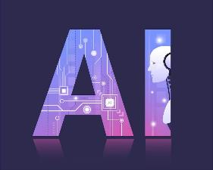
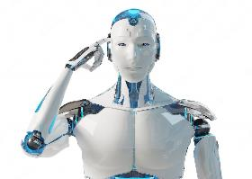
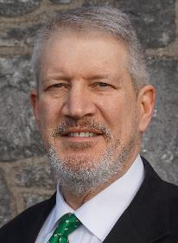
Artificial Intelligence and Even More Real Ignorance
Presented by:
Dr. Glen Collins
Tuesday, July 18, 2023

Slide 2
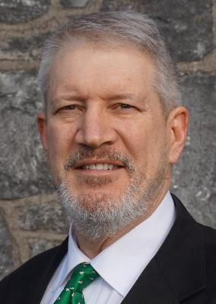

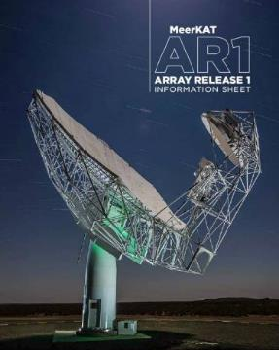
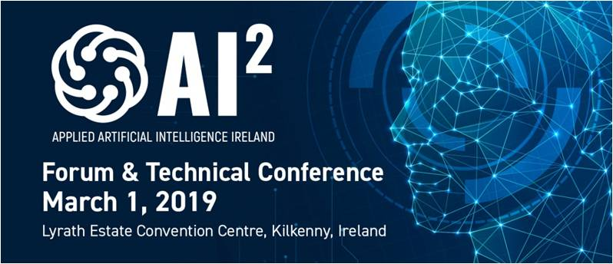

Today’s Presenter
  Dr. Glen C. Collins
  B.E.E., M.S.E.E., Georgia Institute of Technology
  Ph.D. Artificial Intelligence, Vanderbilt University
  Registered Professional Engineer (P.E.) (ret.)
  Chartered Engineer (C.Eng.) (ret.)
        MeerKAT Radio Telescope Program Manger (ret.)
          Square Kilometer Array, South Africa
        Satellite Communications Earth Stations Program Manager
          for General Dynamics (ret.)
          Director & Organizer for Engineers Ireland’s
          Applied Artificial Intelligence Ireland Conference, March 2019
Afghanistan
2002

Slide 3


Overview
Will AI "take over the world" and displace humans on an increasing basis?
This presentation will briefly review the current state of AI implementations and developments, noting what can, and still cannot, be done using AI, with some perspectives on what the future may hold.
Jia Jia ‘robot goddess’ developed by Chen Xiaoping at the University of Science and Technology of China, June 2016
Source: http://www.foxnews.com/tech/2016/04/19/researchers-in-china-introduce-jia-jia-robot-goddess.html

Slide 4
Presentation Outline
AI In The News/Media
What IS AI?
Current Uses of AI
Is This Intelligent?
Where Is This Going?

Slide 5
Presentation Outline
AI In The News/Media
  – Current Trends
What IS AI?
Current Uses of AI
Is This Intelligent?
Where Is This Going?

Slide 6
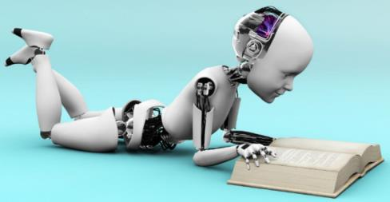

AI In The News
AI in Movies, Television Shows, News
Voice and Image/Pattern Recognition Devices:
  Echo, Assistant, Siri, Cortana, Alibaba, Amazon Transcribe, Nuance Dragon, Deepgram, Genesys Cloud, ChatGPT…
Game Playing:
  IBM Deep Blue 1997 wins Chess
  IBM Watson wins Jeopardy 2011
  Google AlphaGo (Deep Mind) wins Go 2016
  Today, AI is Integrated in Many Popular Games
Large Company Investments:
  Google
  Facebook
  Baidu
Formation of New Organizations about AI
Government Regulation Actions
  Microsoft
  Apple
  Ford
  Merck
  Amazon
  IBM
  Uber
  Tesla
  OpenAI

Slide 7
109 Movies Since 1927 with AI Content
1927 | Metropolis
1968 | 2001: A Space Odyssey
1977 | Star Wars
1979 | Star Trek: The Motion Picture
1982 | Blade Runner
1982 | Tron
1984 | The Terminator (series)
1987 | RoboCop
1999 | The Matrix (series)
2004 | I, Robot
2008 | Eagle Eye
2008 | WALL-E
2012 | Robot & Frank
2013 | Her
2014 | Interstellar
2014 | Transcendence
2015 | Ex Machina
2015 | Chappie
2015 | Tomorrowland
2015 | Avengers: Age of Ultron
Source: Wikipedia https://en.wikipedia.org/wiki/List_of_artificial_intelligence_films
Notes:
From 1927 through 1999: 28 Movies
2000 – 2010: 23
2011 – 2020: 73
2021 – Present: 15…

Slide 8
109 Movies Since 1927 with AI Content
2015 | Terminator Genisys, aka Terminator 5
 | Star Wars: The Force Awakens
2016 | Resident Evil: The Final Chapter
 | Rogue One: A Star Wars Story
2017 | Power Rangers
 | Spider-Man: Homecoming
 | Alien: Covenant
 | Blade Runner 2049
 | Star Wars: The Last Jedi
 | Singularity
2018 | Avengers: Infinity War
 | Extinction
2019 | Alita: Battle Angel
 | Captain Marvel
 | Terminator: Dark Fate
 | iHuman
2020 | Superintelligence
 | Invasion
2021 | Finch
 | Free Guy
 | The Mitchells vs The Machine
 | The Matrix: Resurrections
2022 | Moonfall
 | Brian and Charles
2023 | M3GAN
Source: Wikipedia https://en.wikipedia.org/wiki/List_of_artificial_intelligence_films

Slide 9


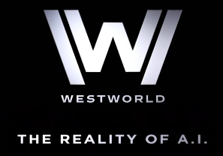

More Movies and TV Programs
Television
  Humans
  Person of Interest
  Black Mirror
  Westworld
  Altered Carbon
Movies
  Impossible Things
  Morgan
  M3GAN

Slide 10


Amazon Alexa, Echo
Plays all your music from Prime Music, Spotify, Pandora, iHeartRadio, TuneIn, and more using just your voice
Allows hands-free convenience with voice-control
Hears you from across the room with far-field voice recognition, even while music is playing
Answers questions, reads audiobooks and the news, reports traffic and weather, gives info on local businesses, provides sports scores and schedules, and more using the Alexa Voice Service
Controls lights, switches, and thermostats with compatible WeMo, Philips Hue, Samsung SmartThings, Wink, Insteon, Nest, and ecobee smart home devices
Always getting “smarter” and adding new features, plus thousands of interfaces like Uber, Domino's, and more
Source: https://www.amazon.com/Amazon-Echo-Bluetooth-Speaker-with-WiFi-Alexa/dp/B00X4WHP5E

Slide 11



Other Home Assistants: Apple Siri, Google Nest Assistant, Pixel, MicroSoft Cortana
Talk to Siri as you would to a friend and it can help you get things done — like sending messages, placing calls, and making dinner reservations.
And it’s tuned in to the world, working with Wikipedia, Yelp, Rotten Tomatoes, Shazam, and other online services to get you even more answers.
Google CEO Sundar Pichai: “We are thoughtfully applying [AI] across all our products, be it search, ads, YouTube, or Play.
“Cortana is your digital agent to help you get things done.”
Home Assistant Blue, and many more.
Sources: http://www.apple.com/ios/siri/
https://assistant.google.com/
https://www.microsoft.com/en-us/mobile/experiences/cortana/

Slide 12

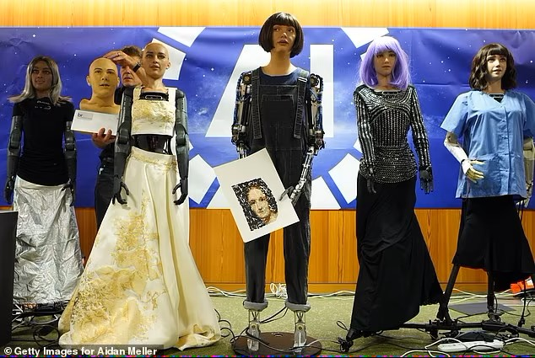

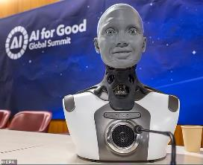
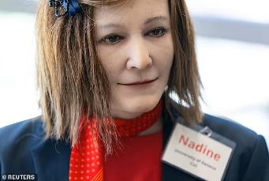
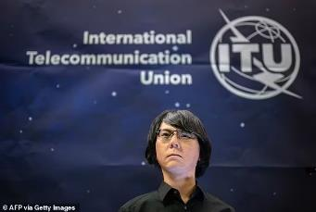
AI for Good Global Summit
6-7 July 2023
AI CEO of Dictador, developed by Hanson Robotics
Hanson Robotics’ AI Pop Star Desdemona
Cornwall-based Engineered Arts’ Ameca called the ''world's most advanced humanoid”
Hanson Robotics also created Grace which is a healthcare robot
Oxford University’s Ai-Da can draw, paint, and create sculptures
Nadine, a ‘social’ robot is modelled on its creator Prof. Nadia M. Thalmann
Geminoid was modelled on its creator Hiroshi Ishiguro - Director of the Japan-based Intelligent Robotics Laboratory
Source: https://www.dailymail.co.uk/sciencetech/article-12286385/The-rise-Terminators-AI-robots-claim-run-Earth-better-clouded-humans.html

Slide 13
Presentation Outline
AI In The News/Media
  – Current Trends
What IS AI?
Current Uses of AI
Is This Intelligent?
Where Is This Going?

Slide 14

Current Trends
New Tricks every month in Translations, Large Language Models (e.g., ChatGPT)
  Machine translation and other forms of language processing have also become far more convincing, with OpenAI, Google, Microsoft, Facebook, and Baidu unveiling new features every month.
Big AI-Related Acquisitions
  Intel ...purchased Nervana Systems (>$400 million) and Movidius, two startups that make …deep-learning computations.
  DeepMind (chief founder, Demis Hassabis) was acquired by Google for $600M in 2014.
  Ginni Rometty, CEO of IBM, who has said that her organization is betting the company on AI
  Panasonic acquired Blue Yonder for $7.1B in 2021
  Microsoft recently invested $10B in OpenAI
Source: http://fortune.com/ai-artificial-intelligence-deep-machine-learning/

Slide 15
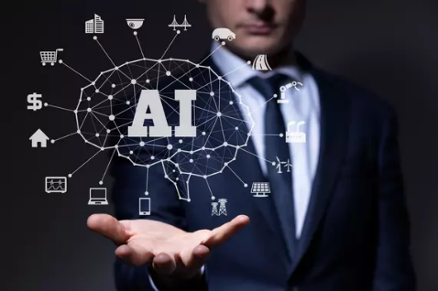


Business – AI Investment
Hype or not, the potential of AI has tech companies enamored
Businesses large and small have begun betting heavily on efforts that leverage AI in some fashion to spur their growth…
There’s an all-out race to add more utility and value to products, and to reap a portion of the resulting demand in AI-powered products and services.
For many tech companies, investors are applying a new valuation method: AI proficiency.
Are we seeing an entirely new generation of software being built and sold? Yes.
  Good Example: Copy.ai – content generator (ghost writer just for you)
Sources: https://techcrunch.com/2023/06/16/ai-transformating-corporate-america/
https://techcrunch.com/2023/03/20/chatgpt-ai-startup-valuations

Slide 16
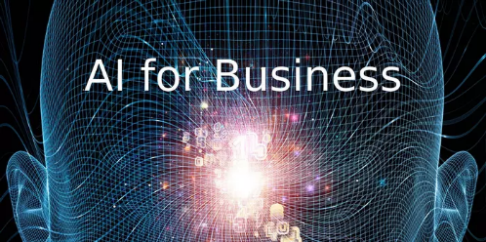

Business – AI Investment
However, AI’s promoters define AI so broadly that almost any kind of automation, statistically-driven computer program or probability-based system qualifies as "artificially intelligent."
Ever since the rise of deep neural networks, AI effectively became synonymous with "efficient pattern-matching on a large scale."
Everything from the Google search engine to the iPhone's face-recognition unlocking tool to the Facebook newsfeed algorithm is already "AI-driven" — and has been for years.
ChatGPT is an attention-seizing program, but the chatbot approach isn't a one-hammer-fits-all-nails solution to the world's problems.
The broader field of generative AI, with its powers of audiovisial mimicry, is similarly impressive but limited.
Source: https://www.axios.com/2023/06/20/ai-everything-definition-label-hype

Slide 17
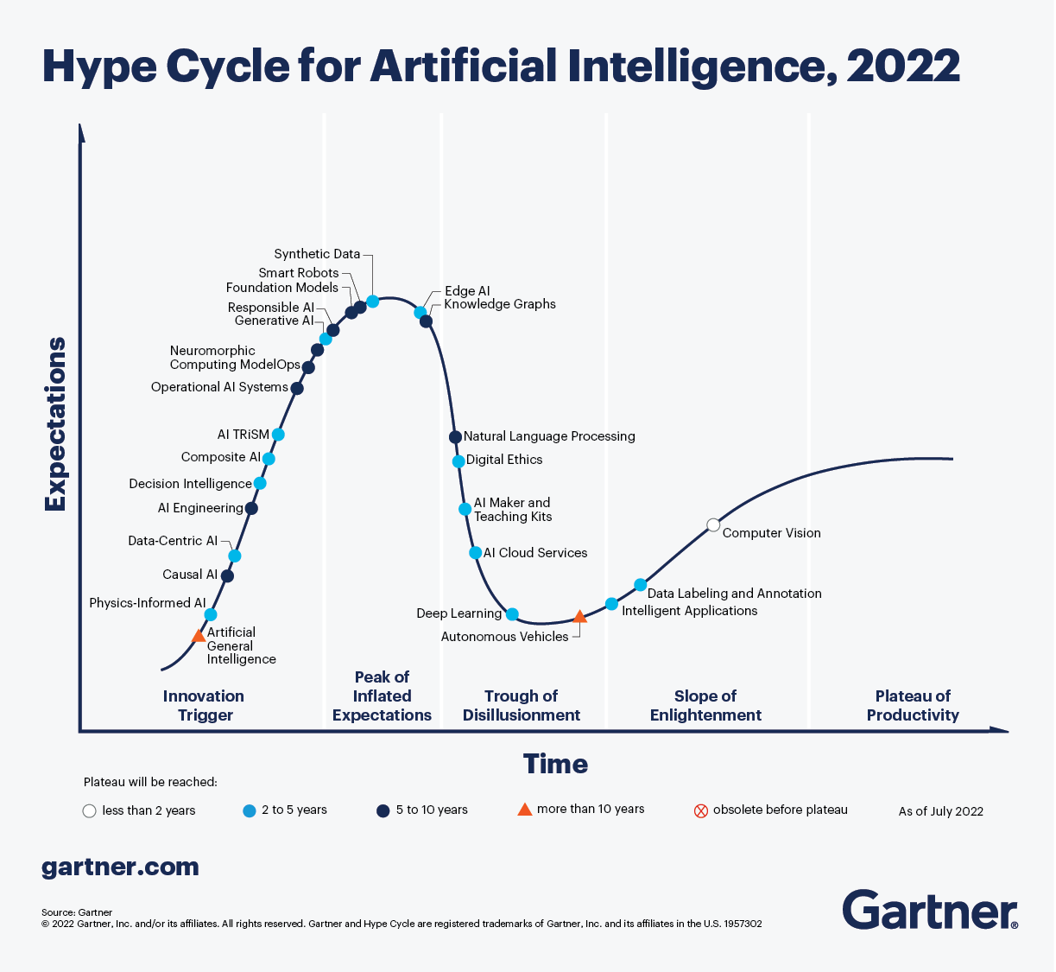
Generative AI is here
Deep Learning AI is here
AGI is here
Source: https://www.gartner.com/en/articles/what-s-new-in-artificial-intelligence-from-the-2022-gartner-hype-cycle

Slide 18






Big Money Going Into AI
Microsoft's Peter Lee stated that the cost of a top AI researcher exceeds the cost of a top NFL quarterback prospect.
Most agree that OpenAI is leading the field. Competitors cannot keep pace with OpenAI unless they get their hands on similar amounts of computing power.
A small group of competitors are building similar chatbots:
  Cohere’s total funding is more than $440 million; recently bought by Ramp
  Silicon Valley company Anthropic, founded in 2021, valued at $4.1B just released their chatbot ‘Claude 2’;
  Character.AI, founded by two leading researchers from Google, is valued at $1B;
  Inflection AI, founded by a former Google executive, raised $1.5 billion in funding.
Elon Musk unveiled xAI on 7/12/2023 “to understand the true nature of the universe,” hiring a team of AI experts who previously worked at DeepMind, OpenAI, Google, Microsoft, Tesla, and U. of Toronto
Sources: https://en.wikipedia.org/wiki/OpenAI
https://www.nytimes.com/2023/07/05/business/artificial-intelligence-power-data-centers.html

Slide 19
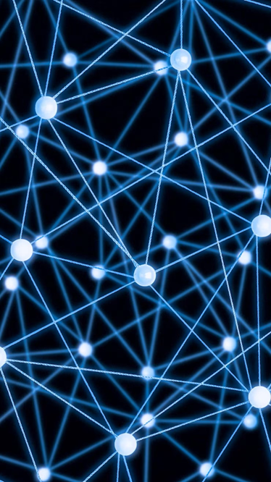


Recent Breakthroughs
But what most people don’t realize is that these breakthroughs are, in essence, all the same breakthrough.
They’ve all been made possible by a family of artificial intelligence (AI) techniques popularly known as deep learning, though most scientists still prefer to call them by their original academic designation: deep neural networks.
Source: http://fortune.com/ai-artificial-intelligence-deep-machine-learning/ Why Deep Learning Is Suddenly Changing Your Life, by Roger Parloff, September 28, 2016

Slide 20
Presentation Outline
AI In The News/Media
What IS AI?
– Traditional AI
– Machine/Deep Learning
Current Uses of AI
Is This Intelligent?
Where Is This Going?

Slide 21
Artificial Intelligence – What Is It, Really?
John McCarthy coined the term in 1955 while at Dartmouth defining AI as “the science and engineering of making intelligent machines.”
“The goal of work in artificial intelligence is to build machines that perform tasks normally requiring human intelligence.” (Nilsson, Nils J. (1971))
‘Traditional’ Artificial Intelligence consists of a collection of computer program structuring techniques that expressly separate application Knowledge from application Algorithms and Data, and then apply that Knowledge to real world problems.
“Knowledge” is applied to the Data/Problem typically via a generic mechanism called an “Inference Engine.”

Slide 22

Functionally, AI is a Collection of Computer Techniques
Inference Engines
Rule-Based Reasoning
Forward-Chaining
Backward-Chaining
Case Based Reasoning
Fuzzy Logic
Natural Language Processing (NLP)
Pattern Matching
Neural Networks ← Current ‘Hot’ Area

Slide 23
Presentation Outline
AI In The News/Media
What IS AI?
– Traditional AI
– Machine/Deep Learning
Current Uses of AI
Is This Intelligent?
Where Is This Going?

Slide 24


Building a Traditional AI System
Developer Console for System Control and Operation
AI Inference Engine
System Outputs:
  Trends
  Trend Changes
  Rankings
  Rank Changes
  Alerts
Data Sources
Knowledge Base
Archived Data Sources
SME/Expert Desk/Console for Knowledge Entry/Editing
6
Front-End Data Processing/
Tagging

Slide 25

Traditional AI ‘Expert System’
AI Inference Engine
AI: Implementing Independent, Intelligent Automation In Data Mining, Diagnosis, and Trend Detection Systems
System Outputs
Input Data
Knowledge Base
Expert Systems Use the ‘Reasoning Mechanism’ (the Inference Engine) and the Stored ‘Knowledge Base’ to Evaluate and Process Run-time Input Data.
The Knowledge Base Captures Expertise from Multiple Sources Creating a Growing and Valuable Store of Domain-Specific Knowledge that can be Applied to New Data and Events

Slide 26
Presentation Outline
AI In The News/Media
What IS AI?
– Traditional AI
– Machine/Deep Learning
Current Uses of AI
Is This Intelligent?
Where Is This Going?

Slide 27
A Glossary of
Artificial Intelligence Terms
ARTIFICIAL INTELLIGENCE
  AI is the broadest term applying to any technique that enables computers to mimic human intelligence, using logic, if-then rules, decision trees, neural networks and machine learning algorithms.
  MACHINE LEARNING
    The subset of AI using neural networks with probability and statistical techniques that enable machines to improve at tasks with experience. The category includes deep learning.
    DEEP LEARNING
      A subset of machine learning that enables a multilayered neural network to “train itself” to perform tasks, like speech and image recognition, by analyzing and building upon to vast amounts of data.

Slide 28
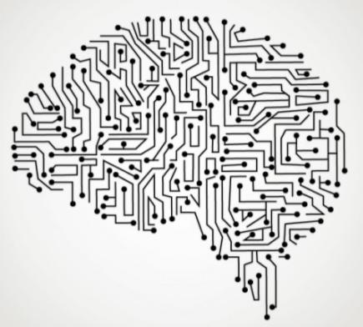
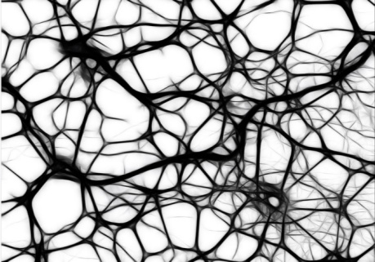
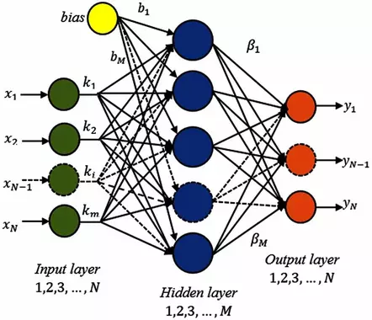
Neural Networks
Neural Networks are inspired by our understanding of the biology of our brains – all those interconnections between the neurons.
But, unlike a biological brain where any neuron can connect to any other neuron within a certain physical distance, these artificial neural networks have:
  discrete layers,
  specific connections, and
  directions of data propagation.
Source: MIT Technology Review: 2013 “Deep Learning With massive amounts of computational power, machines can now recognize objects and translate speech in real time. Artificial intelligence is finally getting smart” by Robert D. Hof https://www.technologyreview.com/s/513696/deep-learning/

Slide 29
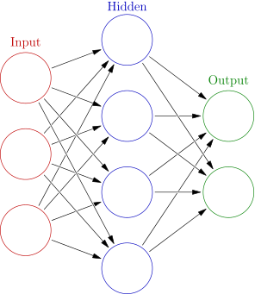
Simplified Neural Network
Each Node (“Neuron) Has Its Own Processing Function (Algorithm)
Each Input Node Detects a Unique Characteristic of the Data (e.g., Image, Voice, File…)
Each Output Node Represents a Specific and Unique Outcome
As Multiple Inputs Are Presented, the Weights & Probabilities Are Adjusted to Achieve the Proper Output. The System is Said to ‘Learn’

Slide 30
Neural Network in Use
With Neural Networks, the Knowledge is Imbedded in the Network’s Nodes (Neurons) as Weights, Probabilities, and Stored Data for Each Node and Each of the Node’s Links
Neural Network
System Outputs
Input Data Sources
Knowledge Base
Neural Networks Require EXTENSIVE Front-End Development Work, But Provide a Means to Capture Large Amounts of Examples (Exemplars) Over Time
Self-Correcting Functions Automate the Weight/Probability Adjustments to Achieve the Proper Output

Slide 31
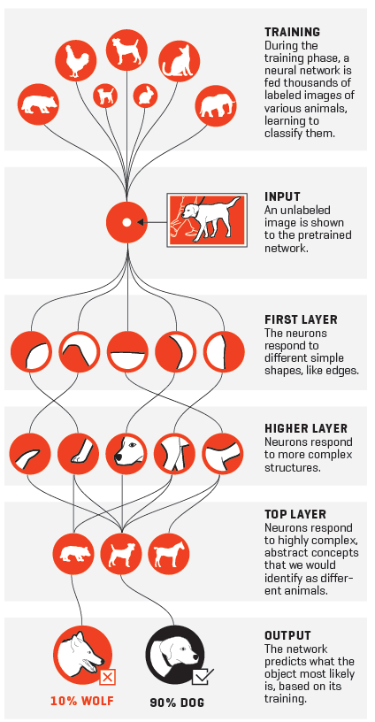




Dr. Fei-Fei Li is credited with Reviving Neural Networks ~2007 by Using a Massive Database of Labelled Images
Source: http://fortune.com/ai-artificial-intelligence-deep-machine-learning/ Why Deep Learning Is Suddenly Changing Your Life, by Roger Parloff, September 28, 2016

Slide 32
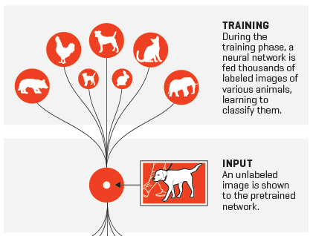

Slide 33
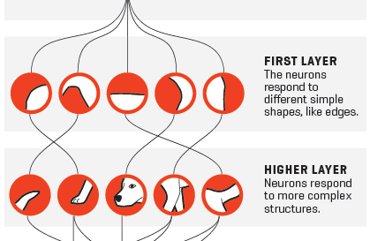

Slide 34
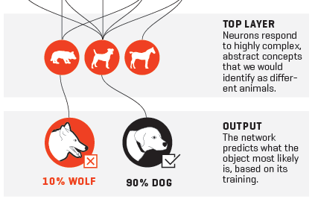

Slide 35
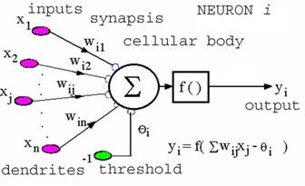
Machine Learning
Uses algebraic continuous algorithms to parse, categorize and store data about inputs, and then make a determination or prediction
Hidden Nodes Contain Algorithms of All Sorts: decision tree learning, inductive logic, clustering, reinforcement learning, Bayesian networks … All with Adjustable Parameters called ‘Weights.’
So rather than hand-coding software routines with a specific set of instructions to accomplish a particular task, the machine is “trained” using large amounts of data and algorithms that give it the ability to “learn” how to perform the task.
Source: MIT Technology Review: 2013 “Deep Learning With massive amounts of computational power, machines can now recognize objects and translate speech in real time. Artificial intelligence is finally getting smart” by Robert D. Hof https://www.technologyreview.com/s/513696/deep-learning/

Slide 36

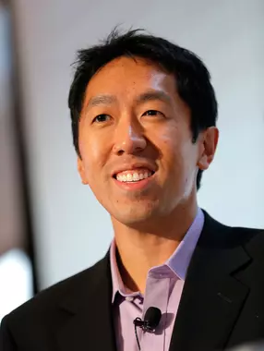
Deep Learning
Each Neural Network needs training. Lots of Training.
Programmers created a “learning” algorithm, exposed it to terabytes of data — hundreds of thousands of
images or years’ worth of speech samples — until the weightings of the neuron inputs/parameters are tuned so precisely that it gets the answer right practically every time.
It’s at that point that the neural network has “taught itself” what looks like a stop sign; or your mother’s face (in the case of Facebook); or a cat, which is what Andrew Ng did in 2012 at Google.
Source: NVIDIA article “What’s the Difference Between Artificial Intelligence, Machine Learning, and Deep Learning?” by Michael Copeland. https://blogs.nvidia.com/blog/2016/07/29/whats-difference-artificial-intelligence-machine-learning-deep-learning-ai/

Slide 37
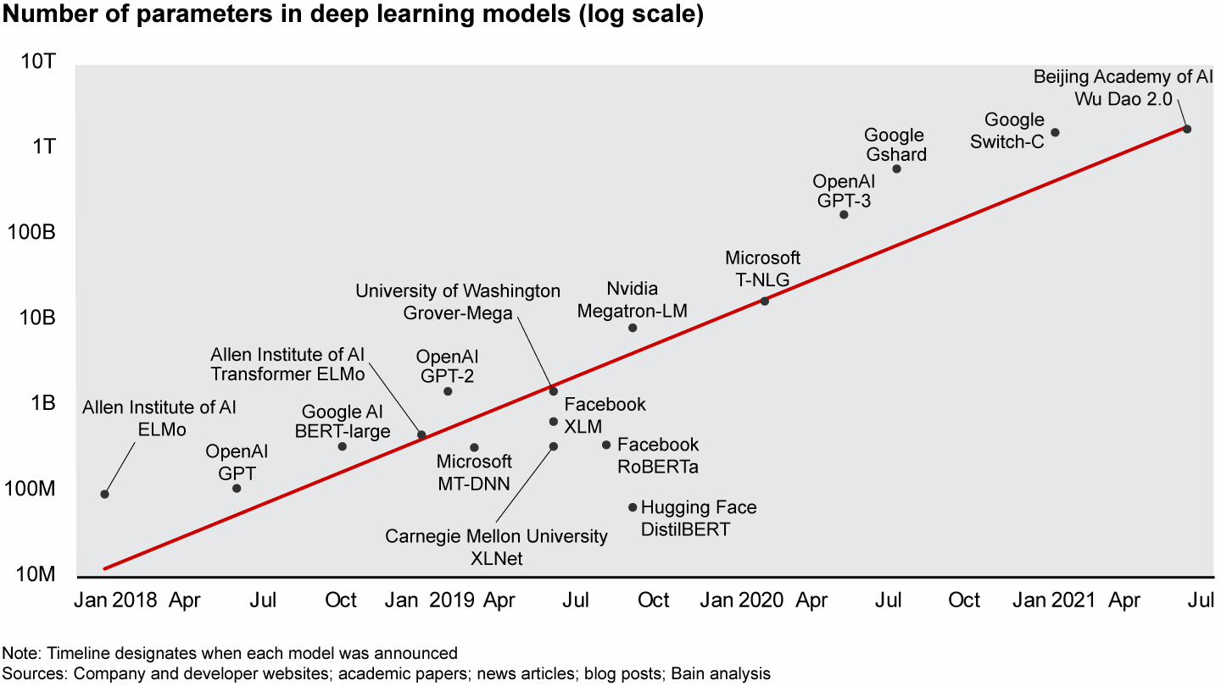
Complexity Behind Deep-Learning Models
Complexity of the NN more than doubles every three to four months.
Much of the AI talent that drives this complexity is concentrated within CSPs (Cloud Service Providers).
The number of AI employees at the top five US hubs (Amazon, Microsoft, Alphabet, Facebook, and IBM) exceeds the size of the AI workforces at the next 45 US companies combined.
ChatGPT: ~200B+ Parameters
Source: https://www.bain.com/insights/who-will-lead-the-next-era-of-artificial-intelligence-tech-report-2021/

Slide 38
Presentation Outline
AI In The News/Media
What IS AI?
Current Uses of AI
– ChatGPT
– The Human Cost of AI
Is This Intelligent?
Where Is This Going?

Slide 39

Current Uses of AI
Planning Assistance: Gardens, Workouts, Route Optimization
Financial/Insurance: Underwriting, Claims Processing, Fraud Detection, Market Trend Analysis
Writing: Speeches, Emails, Reports, Computer Code
Video/Image Editing/Creation in Movies, TV Programs, CGI
Image Analysis: Farming Soil Optimization
Research & Search: Recommendation Engines, Sort Pictures, Find Articles with Specific Content
Design Assistance: Mechanical Parts, Proteins, Drugs/Chemicals
Medical Diagnosis & Image Analysis, Monitoring
Language Translation
Autonomous Vehicles

Slide 40
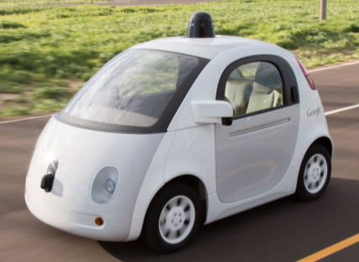
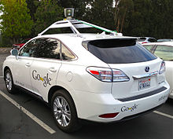
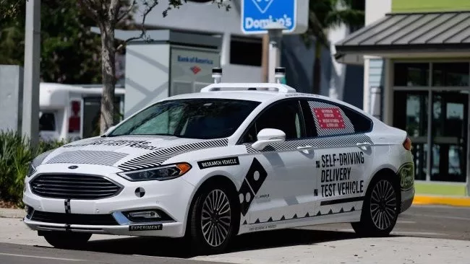
Autonomous Vehicles
Uber’s Pittsburgh Experiment, featuring semi-autonomous vehicles, is up and running. If only its fleet could distinguish the proper path down a one-way street.
And Google is reporting smashing results for its autonomous vehicle program. [Google’s Lexus was hit in an intersection]
Although autonomous vehicles are an exciting concept, this is really hard – as in “difficult” – science. We’re talking about solving and integrating concepts such as real-time computer vision, deep learning, machine learning, and latency.
… according to Carnegie Mellon computer scientist Phillip Koopman, an automotive industry specialist, “You just can’t assume this stuff is going to work.”
Source: Wall Street Daily “Artificial Intelligence: The Race Is On to Smarten Our Cars” Mon, Oct 10, 2016 David Dittman, Editorial Director http://www.wallstreetdaily.com/2016/10/10/artificial-intelligence-race-smarten-cars/
(1 of 4)

Slide 41
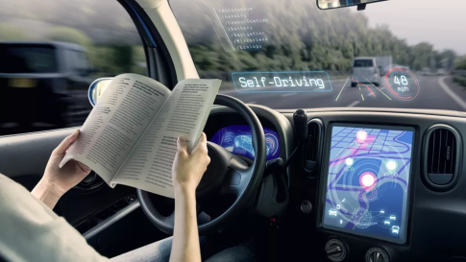
Autonomous Vehicles – Claims in 2016
Vehicles would simply drop you off at your destination and vanish … somewhere.
Cars would chat with each other and the roads themselves to modulate traffic flow
Car accidents would no longer be a thing
Then-US Secretary of Transportation Anthony Foxx declared that we’d have fully autonomous cars everywhere by 2021.
As of 2023, Tesla CEO Elon Musk now largely stands alone for sticking with aggressive predictions. He’s said every year since 2017 that the software capable of full self-driving will probably arrive in the “next year.” The software hasn’t arrived though.
Sources: https://www.vox.com/recode/2020/9/25/21456421/why-self-driving-cars-autonomous-still-years-away
https://www.cnn.com/2022/11/01/business/self-driving-industry-ctrp/index.html
(2 of 4)

Slide 42
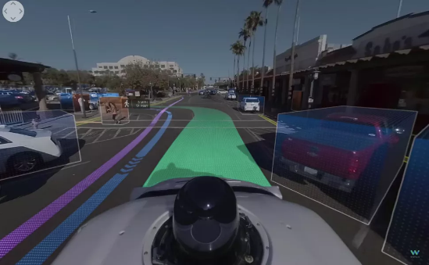
Autonomous Vehicles - Why we’re still years away from having self-driving cars
From May 2021 through April 2022, automakers reported nearly 400 crashes of vehicles with partially automated driver-assist systems, including 273 involving Teslas
A Self-driving Uber vehicle hit and killed a woman walking her bicycle across the street in AZ in 2018.
Waymo's visualization of what a driverless car 'sees' on the road (Image credit: Waymo)
Difficulties (2 Examples of Many):
  Though it was programmed to avoid cyclists and pedestrians, it didn’t know what to make of someone walking a bike across the street.
  Getting a machine to comprehend the difference between a flock of birds dashing across the road versus wind-blown leaves
Sources: https://www.npr.org/2022/06/15/1105252793/nearly-400-car-crashes-in-11-months-involved-automated-tech-companies-tell-regul
https://www.techradar.com/news/self-driving-cars
(3 of 4)

Slide 43
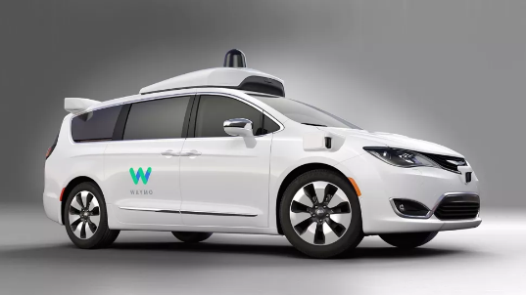
Autonomous Vehicles - Why we’re still years away from having self-driving cars
Recently many of the main players in the autonomous vehicle game have been scaling back or outright abandoning their lofty ambitions.
In October 2022, Ford and Volkswagen pulled the plug on their self-driving effort Argo AI
Automakers, aside from Tesla, largely rely on Mobileye, an Israeli tech company, for driver-assist technology. Intel spun out Mobileye in late 2022.
According to Lux Research, self-driving cars will represent “an $87 billion opportunity in 2030…although none will reach full autonomy” by that date.
Waymo self-driving minivan (Image credit: Waymo)
Sources: https://www.vox.com/recode/2020/9/25/21456421/why-self-driving-cars-autonomous-still-years-away
https://www.cnn.com/2022/11/01/business/self-driving-industry-ctrp/index.html
(4 of 4)

Slide 44
Presentation Outline
AI In The News/Media
What IS AI?
Current Uses of AI
– ChatGPT
– The Human Cost of AI
Is This Intelligent?
Where Is This Going?

Slide 45









What is ChatGPT ?
ChatGPT is a natural language processing tool produced by OpenAI that allows you to have human-like conversations: a conversational chatbot (a talking robot/computer) of the Generative Pre-Trained Transformer (GPT) family.
  It’s the latest tool in automatic text-generating AIs
  It’s trained to follow instructions in a prompt and provide a detailed response
  It can answer questions, produce follow-up responses, admit its mistakes, challenge incorrect premises, and reject inappropriate requests.
  The language model can assist you with composing emails, essays, and code.
ChatGPT has competition: Google Bard, Snapchat’s chatbot called ‘My AI’, Microsoft’s Bing Chat, Character.AI, YouChat, Socratic, JasperChat, WriteSonic
Source: https://medium.com/@margauxvanderplaetsen/the-journey-and-architecture-of-chatgpt-a-look-behind-the-scenes-ef35bed11072

Slide 46


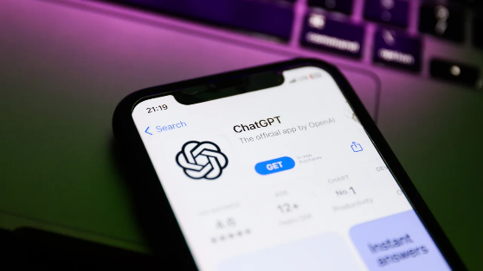
ChatGPT in the News
CNN —
“Ever since ChatGPT was released last November (2022), artificial intelligence has been thrust into the spotlight, sparking enormous excitement and debate over the possibilities.
ChatGPT, along with other AI tools …, racked up millions of users [100 million in 4 months], who utilized it to:
  write emails,
  plan their vacations,
  impersonate musicians,
  produce campaign ads, and
  design buildings.”
Source: https://www.cnn.com/2023/06/28/tech/openai-chatgpt-microsoft-data-sued/index.html

Slide 47
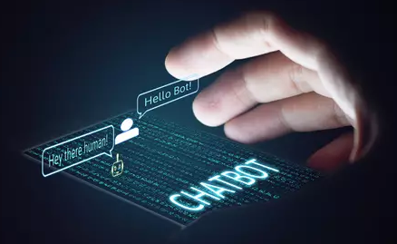
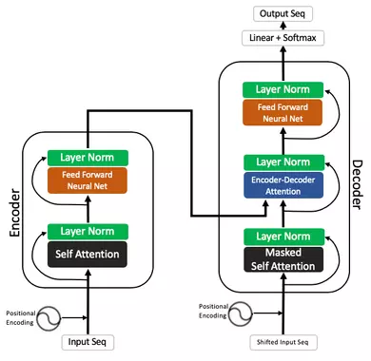
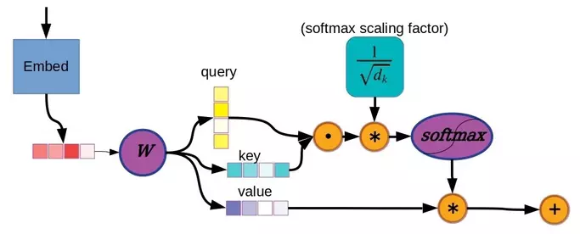
GPT
G = Generative — meaning that the model can generate new content that is similar to the data it has been trained on
P = Pre-trained — meaning that the model has been trained on vast amounts of data
T = Transformer — a type of deep neural network architecture for sequential data processing (e.g., natural language, videos) that uses an ‘attention
mechanism’ to properly weight features’ (e.g., a word) importance in a sequence

Slide 48
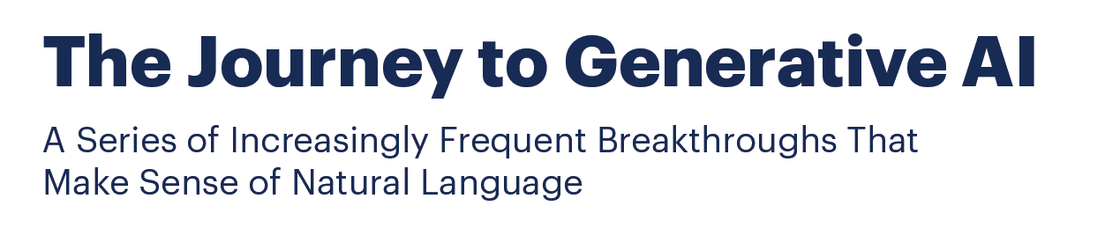
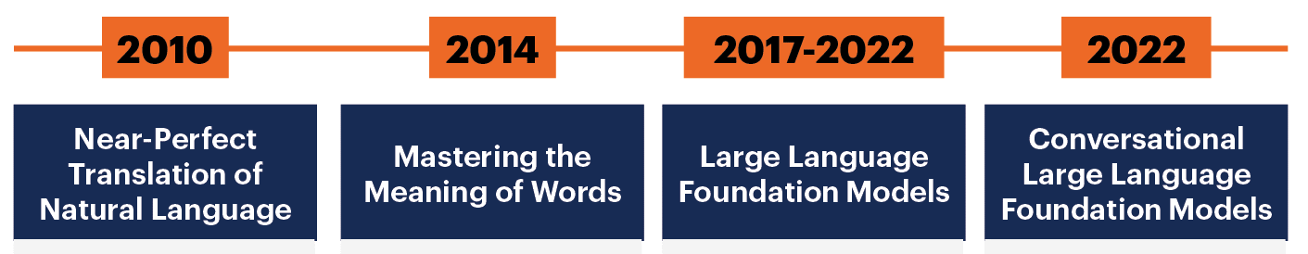
What is Generative AI ?
Generative AI is a Foundation Computer Model (a Software System) trained, using existing artifacts, to generate new, realistic artifacts (at scale) Note: ‘Artifacts’ include language, images, videos, sound/music
New artifacts reflect the characteristics of the training data, but don’t repeat it.
It can produce novel images, video, music, speech, text, software code, and product designs
Complex math and enormous computing power are required to create these trained models, but they are, in essence, prediction algorithms
Source: https://www.gartner.com/en/topics/generative-ai

Slide 49
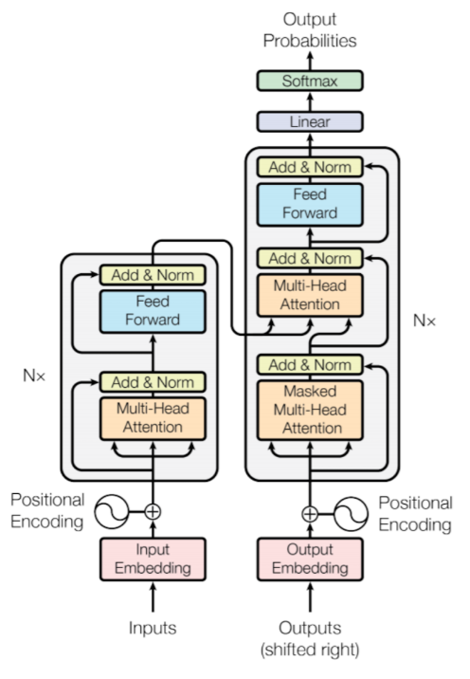
What is an AI Transformer ?
A Transformer is a Neural Network Architecture that relies on an “Attention Mechanism” to properly weight the importance of elements of a Sequence (e.g., particular words in a sentence)
Computers don’t understand words. Instead, they work on numbers, vectors or matrices. So, we need to convert words to a vector.
The Transformer architecture replaced previous Recurrent (RNN) and Long-Short Term Memory (LSTM) Neural Network Models beginning after 2017
Source: https://builtin.com/artificial-intelligence/transformer-neural-network

Slide 50
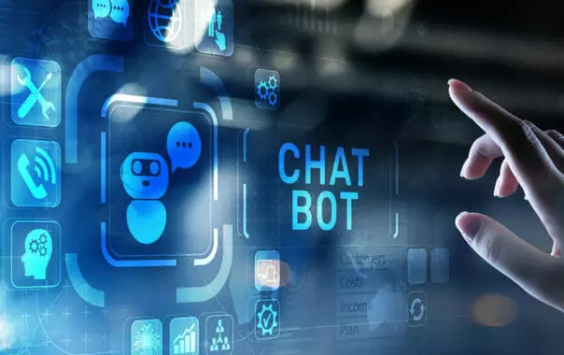
Known Problems with ChatGPT (or ANY ChatBot)
OpenAI admits that ChatGPT sometimes writes plausible-sounding but incorrect or nonsensical answers.
  These are actually called ‘hallucinations’
  It is often excessively verbose and overuses certain phrases.
Its proficiency largely depends on the quality and clarity of the prompt it’s given.
“Ideally, the model would ask clarifying questions when the user provided an ambiguous query. Instead, our current models usually guess what the user intended.”
ChatGPT is not a:
  secure channel for sensitive information,
  reliable source for legal or medical advice,
  substitute for human decision-making or professional mental health support,
  a precise tool for complex mathematics, or
  definitive source of truth (there’s currently no source of truth).
This Statement is per OpenAI and many in the Tech world.
Sources: https://www.howtogeek.com/886928/6-things-you-shouldnt-use-chatgpt-for/ https://openai.com/blog/chatgpt
https://www.malwarebytes.com/blog/podcast/2023/06/trusting-ai-not-to-lie-lock-and-code-s04e12

Slide 51

Trusting AI not to lie: The cost of truth
Far from being understood simply as chatbots that can produce remarkable mimicries of human speech and dialogue, these tools are becoming sources of truth for countless individuals
“What are the potential consequences of companies and individuals embracing natural language processing tools—like ChatGPT and Google's Bard—as arbiters of truth?
Many companies see artificial intelligence (AI) and large language models (LLM) as the future, no matter what industry they operate in.
For example: Basic AI Language Translation Tools rapidly displaced human workers.
  Although the AI tools were far, far cheaper, the quality of the translations — of the truth — was worse.” — Mark Stockley of MalwareBytes
Source: https://www.malwarebytes.com/blog/podcast/2023/06/trusting-ai-not-to-lie-lock-and-code-s04e12

Slide 52
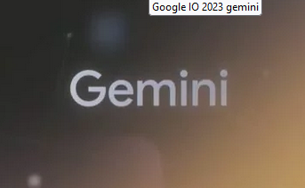
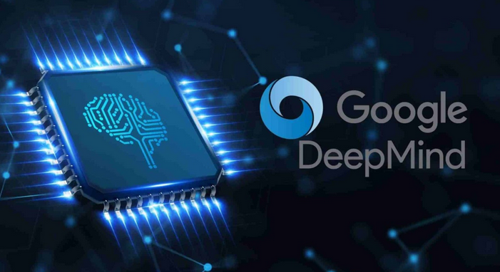
ChatGPT vs. Google Gemini
Google DeepMind's CEO, Demis Hassabis, claims that Gemini, their upcoming AI project, “will surpass OpenAI's ChatGPT in capabilities.”
“Gemini will leverage a fusion of AlphaGo's techniques, the language prowess of models like GPT-4, and Reinforcement Learning
This will enable Gemini to …learn from previous attempts and adapt its strategies based on feedback..”
Sources: https://www.cmswire.com/digital-experience/google-deepmind-ceo-says-companys-ai-will-surpass-chatgpt/
https://www.linkedin.com/pulse/google-deepminds-ceo-says-its-next-algorithm-eclipse-chatgpt-jones

Slide 53
Presentation Outline
AI In The News/Media
What IS AI?
Current Uses of AI
– ChatGPT
– The Human Cost of AI
Is This Intelligent?
Where Is This Going?

Slide 54

Human Intelligence in AI
Human intelligence is the basis of artificial intelligence.
AI and machine learning depend on people as much as on math.
Google’s search engine and ad system use thousands of human “raters” to assess the quality of its AI-driven search results and help identify scam ads.
Facebook’s facial recognition software asks people to label their photos to improve accuracy.
Deep learning…can require extensive human training on hand-picked data sets.
Source: MIT Technology Review: “Man and Machine. Despite many advances, AI still works best when paired with humans” by Robert D. Hof, March 28, 2016 www.technologyreview.com/s/600989/man-and-machine/

Slide 55
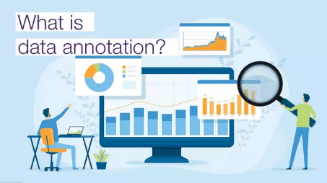
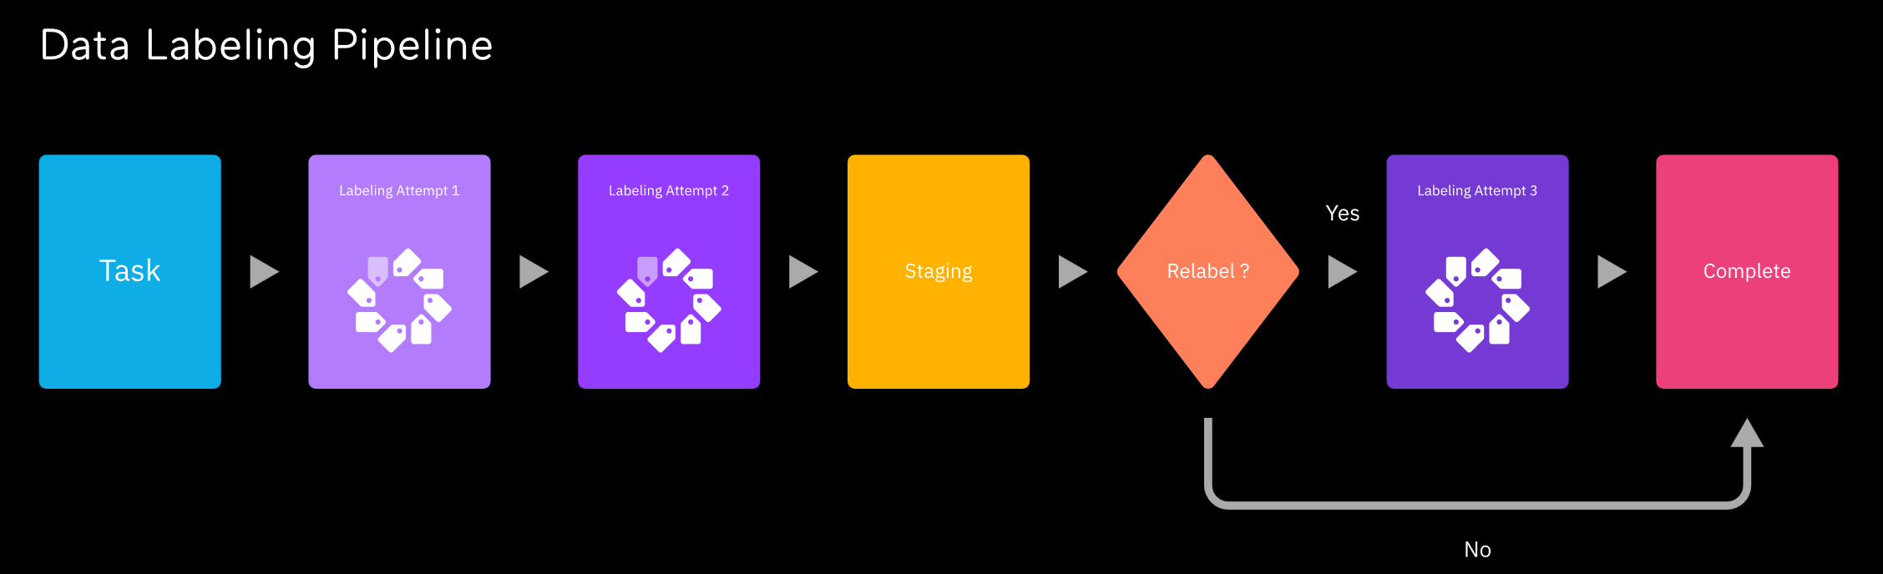

Data Annotation – The Human Cost of AI
Behind even the most impressive AI system are people — huge numbers of people labeling data to train it and clarifying data when it gets confused.
This is called ‘Data Annotation’ or ‘Data Curation’
Little is known about the information shaping these systems’ behavior, and even less is known about the people doing the shaping.
Only the companies that can afford to buy this data can compete, and those that get it are highly motivated to keep it secret.
The current AI boom — the convincingly human-sounding chatbots, the artwork that can be generated from simple prompts, and the
multibillion-dollar valuations of the companies behind these technologies — began with an unprecedented feat of tedious and repetitive human labor.
Annotation, called “human-feedback data,” remains a foundational part of making AI, but there is often a sense among engineers that it’s a passing, inconvenient prerequisite to the more glamorous work of building models.
Source: https://www.theverge.com/features/23764584/ai-artificial-intelligence-data-notation-labor-scale-surge-remotasks-openai-chatbots

Slide 56







Data Annotation – The Human Cost of AI
Data Annotation: it’s infrastructure for AI,
and Annotation is Big Business.
Kenya- and Nepal-based CloudFactory, where annotators earn $1.20 an hour. Slightly better work-from-home pay with Remotasks.
Workers training ChatGPT to recognize toxic content were getting paid less than $2 an hour by the vendor Sama AI.
There are also “crowdworking” sites like Mechanical Turk and Clickworker where anyone can sign up to perform tasks.
In the middle are services like Scale AI.
  Scale, founded in 2016 by then-19-year-old Alexandr Wang, was valued in 2021 at $7.3 billion, making him what Forbes called “the youngest self-made billionaire.”
Source: https://www.theverge.com/features/23764584/ai-artificial-intelligence-data-notation-labor-scale-surge-remotasks-openai-chatbots

Slide 57
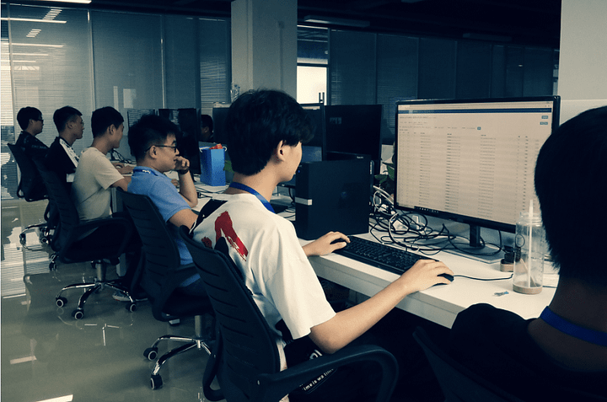
Pulling Back the Curtain
“You might miss this if you believe AI is a brilliant, thinking machine.
When you pull back the curtain even a little, it looks more familiar:
Testin’s Beijing data labeling office
  the latest iteration of a particularly Silicon Valley division of labor, where
  behind the futuristic gleam of new technologies
  hides a sprawling manufacturing apparatus and the millions of Data Annotation (DA) people who make it run.”
“OpenAI, Microsoft, Meta, and Anthropic did not comment about how many people contribute annotations to their models, how much they are paid, or where in the world they are located.” [Millions of people are employed in DA]
Irving of DeepMind, which is a subsidiary of Google, said the annotators working on Sparrow are paid “at least the hourly living wage” based on their location.
Taskup.ai, DataAnnotation.tech, and Gethybrid.io all appear to be owned by the same company: Surge AI, CEO: Edwin Chen.
  Surge’s customers include OpenAI, Google, Microsoft, Meta, and Anthropic.
Source: https://www.theverge.com/features/23764584/ai-artificial-intelligence-data-notation-labor-scale-surge-remotasks-openai-chatbots

Slide 58
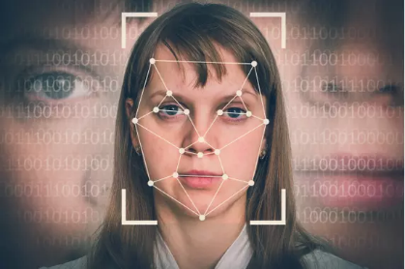
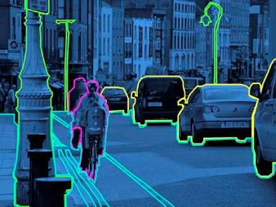
Pulling Back the Curtain
Put another way, ChatGPT seems so human because it was trained on human writing, is mimicking human writing, and gets rating feedback from humans who were rating how well it was mimicking humans.
This circuitous technique is called “Reinforcement Learning from Human Feedback,” or RLHF
“RLHF is so effective that it’s worth pausing to fully register what it doesn’t do.
  When annotators teach a model to be accurate, the model isn’t learning to check answers against logic or external sources, or about what accuracy as a concept even is.
  The model is still a text-prediction machine mimicking patterns in human writing, with training content supplemented with specific known-correct examples, and the model has been weighted to favor them.”
“Maybe this …happens to align with the truth, but it can also result in it mimicking the confident style and expert jargon of the accurate text while writing things that are totally wrong.”
Source: https://www.theverge.com/features/23764584/ai-artificial-intelligence-data-notation-labor-scale-surge-remotasks-openai-chatbots

Slide 59
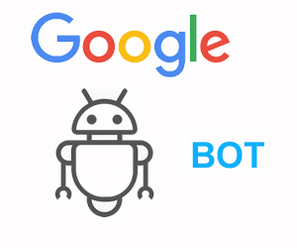

Google Plans To Scrape Everything You Post Online To Train Its AI
Google’s new EULA terms and conditions means your text, photos, and music could [will] end up helping to train its products and “AI models” (e.g., BARD)
Note: FaceBook, Twitter, Instagram, WhatsApp, MicroSoft, TicToc, etc. are doing the same.
Class Action Lawsuits against OpenAI and Google claim their AI products “use stolen private information, including personally identifiable information, from hundreds of millions of internet users, including children of all ages, without their informed consent or knowledge.
“With so many AI tools doing things like falsely claiming that people have written articles or just running into copyright trouble, we have no real way to know if [these generative AI tools] will actually improve anything.”
Now we have AI-generated spam posing a threat to [search] engines (and search engine Users).
Rise of the Newsbots: AI-Enabled Misinformation “News” content farms are Proliferating Online
  – as of 7/10/2023 there are 331 ‘Unreliable AI-Generated News’ Websites (and Counting).
Sources: https://www.malwarebytes.com/blog/news/2023/07/google-plans-to-scrape-everything-you-post-online-to-train-its-ai https://www.cnn.com/2023/07/11/tech/google-ai-lawsuit/index.html
https://econsultancy.com/generative-ai-new-wave-content-farms-ask-the-experts/ https://www.cnn.com/2023/06/28/tech/openai-chatgpt-microsoft-data-sued/index.html
https://www.newsguardtech.com/special-reports/newsbots-ai-generated-news-websites-proliferating/ 5/1/2023 /ai-tracking-center/

Slide 60
Presentation Outline
AI In The News/Media
What IS AI?
Current Uses of AI
Is This Intelligent?
  Concerns About AI
  Human 2.0
Where Is This Going?

Slide 61


Is AI Intelligent?
For all the recent advances in AI, human beings remain more adept than machines at distinguishing, say, a tile mosaic from a similar pattern on a blanket.
“It will be a long way out before machines will be able to do this,” says Pinterest data scientist Mohammad Shahangian.
“This is a temporary embarrassment,” says neuroscience researcher Jeff Hawkins, cofounder of the machine intelligence firm Numenta — though “temporary” could extend to years or even decades.
Source: MIT Technology Review: “Man and Machine. Despite many advances, AI still works best when paired with humans” by Robert D. Hof, March 28, 2016 www.technologyreview.com/s/600989/man-and-machine/

Slide 62
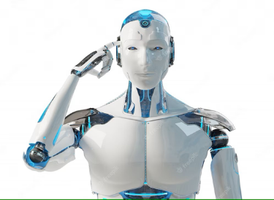

Today’s AI is Not I
“At its core, today’s AI is incapable of comprehension, knowledge, thought or “intelligence.” This name is little more than a marketing gimmick.”
Nothing’s easier to sell than a product with a good name. The technology that we call “artificial intelligence” is extremely complicated, but thanks to its name, you [think you] already have an idea of what it does!
There’s just one problem; AI isn’t “intelligent” at any level, and corporations aren’t interested in correcting the public’s misconceptions.”
– Andrew Heinzman, News Editor for Review Geek
Source: https://www.reviewgeek.com/143948/ai-isnt-really-artificial-intelligence/

Slide 63


Today’s AI is Not I
Stuart Russell: a computer science professor at the University of California, Berkeley who co-authored the textbook, “Artificial Intelligence: A Modern Approach” stated:
“Right now, what a lot of people are excited about are large language models (LLMs). They are a product of AI, but they are not AI.”
“…we think that these large language models are one piece of that jigsaw puzzle, but we haven’t yet figured out what shape that piece is…”
Sources: https://www.microsoft.com/en-us/research/publication/sparks-of-artificial-general-intelligence-early-experiments-with-gpt-4/
https://www.cnn.com/2023/05/31/opinions/artificial-intelligence-stuart-russell/index.html

Slide 64

Artificial General Intelligence (AGI)
While GPT-4 can solve novel and difficult tasks that span mathematics, coding, vision, law, and more, Developers at MicroSoft claim it constitutes an ‘early form of AGI.’
“Some of us think that AGI — in the sense of systems that are genuinely as capable as a college-educated person — are maybe five to 10 years away” — Jared Kaplan, Anthropic’s chief scientist
Russell asks: “But, if you strip out all the effect of the coherent, grammatically correct, elegant, sophisticated prose and look underneath, how much intelligence is left?
We just can’t [answer that question] because we can’t inoculate ourselves against this effect of perceiving intelligence.
Meanwhile, you’ve got tens of billions of dollars going into the old-fashioned approach to AI [i.e., neural nets where we don’t know how they work] — that don’t work right in the long run, that produce misaligned and eventually perhaps catastrophic consequences.”
Sources: https://www.microsoft.com/en-us/research/publication/sparks-of-artificial-general-intelligence-early-experiments-with-gpt-4/
https://www.cnn.com/2023/05/31/opinions/artificial-intelligence-stuart-russell/index.html

Slide 65
Presentation Outline
AI In The News/Media
What IS AI?
Current Uses of AI
Is This Intelligent?
  Concerns About AI
  Human 2.0
Where Is This Going?

Slide 66

“Superintelligence:
Paths, Dangers, Strategies” by Nick Bostrom
“Superintelligence …argues that true artificial intelligence, if realized, might pose a danger that exceeds every previous threat from technology—even nuclear weapons.
If [AI’s] development is not managed carefully humanity risks engineering its own extinction.”
Central is the “intelligence explosion (a.k.a., singularity),” a speculative event in which an A.I. gains the ability to improve itself, and in short order exceeds the intellectual potential of the human brain by many orders of magnitude.
Source: New Yorker Magazine “Doomsday Invention” by Raffi Khatchadourian, Nov 2015 http://www.newyorker.com/magazine/2015/11/23/doomsday-invention-artificial-intelligence-nick-bostrom

Slide 67

“Superintelligence” by Nick Bostrom
Elon Musk, the C.E.O. of Tesla, promoted the book on Twitter, noting, “We need to be super careful with AI. Potentially more dangerous than nukes.”
In contrast, Elon also stated Humans are so well integrated with our phones and computers that we are already cyborgs.
The logical next step is to imbed this technology in our brains so we don’t ‘lose our smart phone.’
“With artificial intelligence we are summoning the demon.”
Yet, now he’s starting an AI company (xAI) …
Sources: http://www.newyorker.com/magazine/2015/11/23/doomsday-invention-artificial-intelligence-nick-bostrom
https://www.cnbc.com/video/2019/08/29/why-elon-musk-says-we-are-already-cyborgs.html

Slide 68





“The Doomsday Invention”
In 2000, an organization called the Singularity Institute for Artificial Intelligence (subsequently Singularity University and the Machine Intelligence Research Institute) began …publishing a stream of literature on the dangers of A.I.
In 2005, the futurist and inventor Ray Kurzweil wrote “The Singularity Is Near,” a best-seller that prophesied a merging of man and machine in the foreseeable future.
Sources: http://www.newyorker.com/magazine/2015/11/23/doomsday-invention-artificial-intelligence-nick-bostrom
https://intelligence.org/ https://www.su.org/

Slide 69


Concerns About The Current Trends
Stephen Hawking: ‘…are we taking AI seriously enough?’
In September 2016, five corporate AI leaders—Amazon, Facebook, Google, IBM, and Microsoft—formed the nonprofit Partnership on AI to advance public understanding of the subject and conduct research on ethics and best practices.
“We need to be sensitive to the possibility that there are hidden assumptions and biases in data, and therefore in the systems built from that data”
Sources: http://fortune.com/ai-artificial-intelligence-deep-machine-learning/ Why Deep Learning Is Suddenly Changing Your Life, by Roger Parloff, September 28, 2016
http://www.independent.co.uk/news/science/stephen-hawking-transcendence-looks-at-the-implications-of-artificial-intelligence-but-are-we-taking-9313474.html http://www.partnershiponai.org/

Slide 70



Call for Greater Regulation of AI
"AI, or automated decision-making technologies, are advancing at breakneck speed, yet ... the regulations are not keeping pace.“
New ‘Safety’ Organizations are forming, and governments are responding… slowly.
In May 2023, hundreds of top AI scientists, researchers, and others — including OpenAI chief executive Sam Altman, Google DeepMind chief executive Demis Hassabis, and Microsoft president Brad Smith called for greater regulation of AI.
Dan Hendrycks with the Center for AI Safety called the situation “reminiscent of atomic scientists issuing warnings about the very technologies they’ve created.”
“There are many ‘important and urgent risks from AI,’ not just the risk of extinction; for example, systemic bias, misinformation, malicious use, cyberattacks, and weaponization…”
Proposed EU legislation sets tight restrictions on “high-risk” AI applications, which are those that threaten “significant harm to people’s health, safety, fundamental rights, or the environment.”
Sources: https://www.cnn.com/2023/05/30/media/artificial-intelligence-warning-reliable-sources/index.html https://www.governance.ai/ https://www.npr.org/2023/05/15/1175776384/congress-wants-regulate-ai-artificial-intelligence-lot-of-catching-up-to-do https://www.safe.ai/

Slide 71
Presentation Outline
AI In The News/Media
What IS AI?
Current Uses of AI
Is This Intelligent?
  Concerns About AI
  Human 2.0
Where Is This Going?

Slide 72


Transhumanism Claims and Uploading One’s Consciousness to the Computer
Yuval Noah Harari, Israeli History Professor and ‘Futurist,’ Keynote Speaker at Davos and World Economic Forum Meetings, and Author of Bestseller Sapiens: A Brief History of Humankind
Sees AI as taking on ‘Being’ and becoming more Intelligent than humans.
Assumptions about what AI will enable makes it an important ‘stepping-stone’ for transhumanism.
“We will soon have the power to re-engineer our bodies and brains, whether it is with genetic engineering or by directly connecting brains to computers, or by creating completely non-organic entities…”
“AI has hacked the operating system of human civilization”
Source: https://www.d.umn.edu/~tcolburn/cs3111/presentation/schedule/2020-spring/presentations/The%20Ethics%20of%20Transhumanism.pdf

Slide 73


Define Some Terms
Transhumanism: is an intellectual movement that aims to transform the human condition by developing and making widely available sophisticated technologies to greatly enhance human intellectual, physical, and psychological capacities, creating ‘Human 2.0’
A considerable portion of transhumanists and singularitarians place great hope into the belief that they may become immortal (via technology).
Extropianism: is an "evolving framework of values and standards for continuously improving the human condition." Extropians believe that advances in science and technology will some day let people live indefinitely.
[Extropy: coined term meaning the opposite of Entropy (increasing disorder)]
Sources: https://en.wikipedia.org/wiki/Mind_uploading
https://en.wikipedia.org/wiki/Transhuman

Slide 74


Transhumanism in Media – Upload One’s Consciousness/Mind to the Computer
Movie: Chappie – uploading one’s mind/life to a machine/robot
Movie: Alita: Battle Angel – connecting the brain to a replacement human body (cyborg)
Michio Kaku, in Science, Episode 4, "How to Teleport," mentions that mind uploading via techniques such as quantum entanglement and whole brain emulation using an advanced MRI machine may enable people to be transported vast distances at near light-speed.
Fair use of copyrighted material in the context of Alita: Battle Angel

Slide 75




Example: Musk’s Neuralink
When the company was first launched in 2016, Musk said he wanted to help humans compete in a world where artificial intelligence had surpassed them – to give us more ‘bandwidth,’ such as controlling machines with just the power of thought.
In 2019 the researchers have turned their attention to creating a generalized brain interface (wireless implant) to help those with brain-related disorders.
Musk’s stated purpose, however, is much bigger: To more tightly couple the “collective human world” to “digital super intelligence”
Similar work ongoing by Synchron who Announced the First Human U.S. Brain-Computer Interface Implant Aug 2022
Sources: https://neuralink.com/ https://synchron.com/about-us

Slide 76


“Technologies reflect and encourage the worst aspects of human nature” – Jaron Lanier
Lanier, a Microsoft researcher and tech commentator, “…even framing the differing views [Reference to Transhumanists, Extropians] as a debate was a mistake.”
“This is not an honest conversation,” …“People think it is about technology, but it is really about religion, people turning to metaphysics to cope with the human condition.”
“They have a way of dramatizing their beliefs with an end-of-days scenario—and one does not want to criticize other people’s religions.”
Others see the 4th Industrial Revolution and the drive toward Human 2.0 as a Mutation driven by Scientism: effectively a War on Humanity rather than ‘Progress.’
Sources: http://www.newyorker.com/magazine/2015/11/23/doomsday-invention-artificial-intelligence-nick-bostrom
https://joebot.substack.com/p/dark-on-transhumanism-and-the-war

Slide 77


Extropians and Immortality
Extropianism seeks to “direct human evolution,” hoping to eliminate disease, suffering, even death;
…the means might be genetic modification…, or perhaps dispensing with the body entirely and uploading minds into supercomputers (as Koch and Tononi noted, “Immortality is mathematical, not mystical.”)
Many eminent computer scientists and neuroscientists have long predicted that advanced computers will be capable of thought and even attain consciousness
Extropians advocate the development of artificial superintelligence (AGI) to achieve these goals
Ray Kurzweil, director of engineering at Google, has long predicted that people will be able to "upload" their entire brains to computers and become "digitally immortal" by 2045.
Sources: https://en.wikipedia.org/wiki/Mind_uploading
https://medium.com/@sgunnisonmiller/ray-kurzweils-prediction-scorecard-7d40ee2ff42a

Slide 78
Presentation Outline
AI In The News/Media
What IS AI?
Current Uses of AI
Is This Intelligent?
Where Is This Going?

Slide 79

What’s Going On?
Significant Computational Gains have been made in Human Assistance Applications, However….
Many Writers Appear to be Glossing Over (or Failing to Reveal) the Human Effort (Intelligence) Put Into These
New AI Capabilities (don’t’ look behind the curtain) Leaving the Reader to Think that the Machines’ ‘Learning’ Was Somehow Automated
(1 of 3)

Slide 80

What’s Going On?
Massive Increases in Machine Automation for Text, Voice and Image Recognition, Yet…
There Remains Some Apparent Oversimplification (or Trivializing) as to What Constitutes ‘Intelligence,’
‘Learning’ or ‘Consciousness’ (Consistent with Early AI Researchers’ Claims)
(2 of 3)

Slide 81

What’s Going On?
Extensive Improvements in Pattern Recognition (Voice, Images, Music, Highways) Yet…
There Remains Significant Overstatement (bordering on wild claims) as to What has Technically Been Achieved Regarding Machine Autonomy, Learning, and Intelligent Behavior
(3 of 3)

Slide 82

Where Is This Going?
Despite the hype, artificial intelligence remains inferior to the human brain
With new alarming predictions being made every week, it is important to consider the current limitations of AI.
The human brain provides the best reference point:
  Research suggests the human brain consists of about 86 billion neurons.
  Each neuron forms connections to other neurons, which could add up to 1 quadrillion (1,000 trillion) connections.
The scientific community broadly divides its major functions into a dozen primary categories (e.g., decisions, emotions, perception, language, memories, etc.), but where sentience (or consciousness) lies within these categories remains an open question (i.e., they don’t know).
“If we cannot fully understand how the human brain works or even define sentience, why are we cutting and pasting plots from sci-fi flicks onto our reality?”
Sources: nm.org https://www.rt.com/news/577647-predictions-ai-human-brain/ by Dr. Mathew Maavak, a Malaysian expert on risk foresight and governance
(1 of 4)

Slide 83

Where Is This Going?
Does that mean it’s time to brace for “the Singularity” — the hypothesized moment when superintelligent machines start improving themselves without human involvement, triggering a runaway cycle that leaves lowly humans ever further in the dust, with terrifying consequences?
Or, is AI bringing a New Utopia where machines do all the work and humans have a life of total leisure?
Neither, just yet. Neural nets are good at recognizing patterns—sometimes as good as or better than we are at it.
But they can’t reason.
Source: http://fortune.com/ai-artificial-intelligence-deep-machine-learning/
(2 of 4)

Slide 84


Where Is This Going?
The holy grail of artificial intelligence —creating software that comes close to
mimicking human intelligence — remains far off.
But 2014 saw major strides in machine learning software that can gain abilities from experience
And 2022 brought rapid wide-spread use of large language and image models based on the GPT architecture.
Source: MIT Technology Review “2014 in Computing: Breakthroughs in Artificial Intelligence” by Tom Simonite, December 29, 2014 www.technologyreview.com/s/533686/2014-in-computing-breakthroughs-in-artificial-intelligence/
(3 of 4)

Slide 85


Where Is This Going?
Can software fundamentally rewrite itself without risking crippling breakdowns?
No one knows.
In the history of computer science, no programmer has created code that can substantially improve itself.
Source: http://www.newyorker.com/magazine/2015/11/23/doomsday-invention-artificial-intelligence-nick-bostrom
(4 of 4)

Slide 86

What To Expect? Views…
As Computational Power and Data Storage Densities Increase, So Will AI-Related Applications
Expect Ebb and Flow Cycles in AI
Breakthroughs in Machine ‘Reasoning’ Capabilities Are Yet to Occur, But Will…
AI + Robotics + Big Data Will Replace Some Human Jobs
This WILL Become an Issue, Like Nuclear Power Continues to Be, Likely Sooner Than Many Now Predict

Slide 87



What Questions Do You Have?

Slide 88
Backup slides

Slide 89
History of AI

Slide 90

Starting in 1949, Arthur Samuel developed the first machine learning program for the game of checkers. The machine could play against itself and improved on its own using a scoring technique. It played live on television in 1956 running on an IBM701; IBM’s stock value increased 15 pts overnight. At the time, it caused an uproar comparable… to what’s going on now with ChatGPT.
Arthur Samuel demonstrates how machine learning can be used to play checkers.
From IBM Watson Media
https://www.cnn.com/2023/05/31/opinions/artificial-intelligence-stuart-russell/index.html

Slide 91

History of AI – Focusing on Neural Networks (1 of 5)
1969 → 1986 Neural Networks Out of Vogue
Source: http://fortune.com/ai-artificial-intelligence-deep-machine-learning/ Why Deep Learning Is Suddenly Changing Your Life, by Roger Parloff, September 28, 2016

Slide 92

History of AI – Focusing on Neural Networks (2 of 5)
1986 → 1997 Neural Networks Still Out of Vogue

Slide 93

History of AI – Focusing on Neural Networks (3 of 5)
Dr. Li is Professor of Computer Science at Stanford University
2007 → 2011 Neural Networks Show Utility, More Research Begins
(Example: Facebook tagging of faces)

Slide 94

History of AI – Focusing on Neural Networks (4 of 5)
2012 → Present Neural Networks Resurgence

Slide 95

History of AI – Focusing on Neural Networks (5 of 5)
2014 Deep Learning Advances Due to GPUs, Large Memory, Massive Data Sets

Slide 96
AI’s History …‘Winters’
1943: McCulloch and Pitts Article (influenced Von Neumann (electronic computer), Minsky (expert systems), Rosenblatt (Perceptron))
1956: Modern AI Founded – Checkers & Chess
1969 → 1986 Neural Networks Out of Vogue
1974 → Early 1980s: AI Winter
1983 → 1987: Expert Systems
1986: Brief Neural Network Revival
1987 → 1997: Lisp Demise, AI Winter
1997: Data Mining, Medical Revival
2007: Neural Networks Deep Learning Techniques Begin
2012 → Present: Deep Learning Dominates
2016 → 2022: Development of Language Models
2022 → Present: Large Language Transformers in Vogue
AI Winters – When AI R&D Funding dries up due to perceived Over-Promising and Under-Delivering

Slide 97
Graphics & Spare Slides

Slide 98


